Slide 1
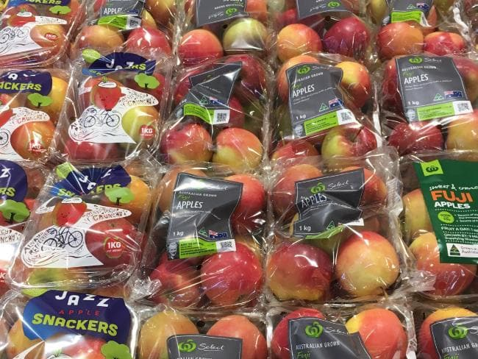
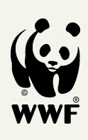
Plastics
Plastic pollution: status and impacts
Lorren de Kock, Circular Plastics Economy
29 October 2019
IPA Conference 2019
Source: news.com.au
Notes:
Plastic – what is the problem with plastic? Is there anyone here today who thinks there is a big problem with the amount of plastic society consumes?

Slide 2
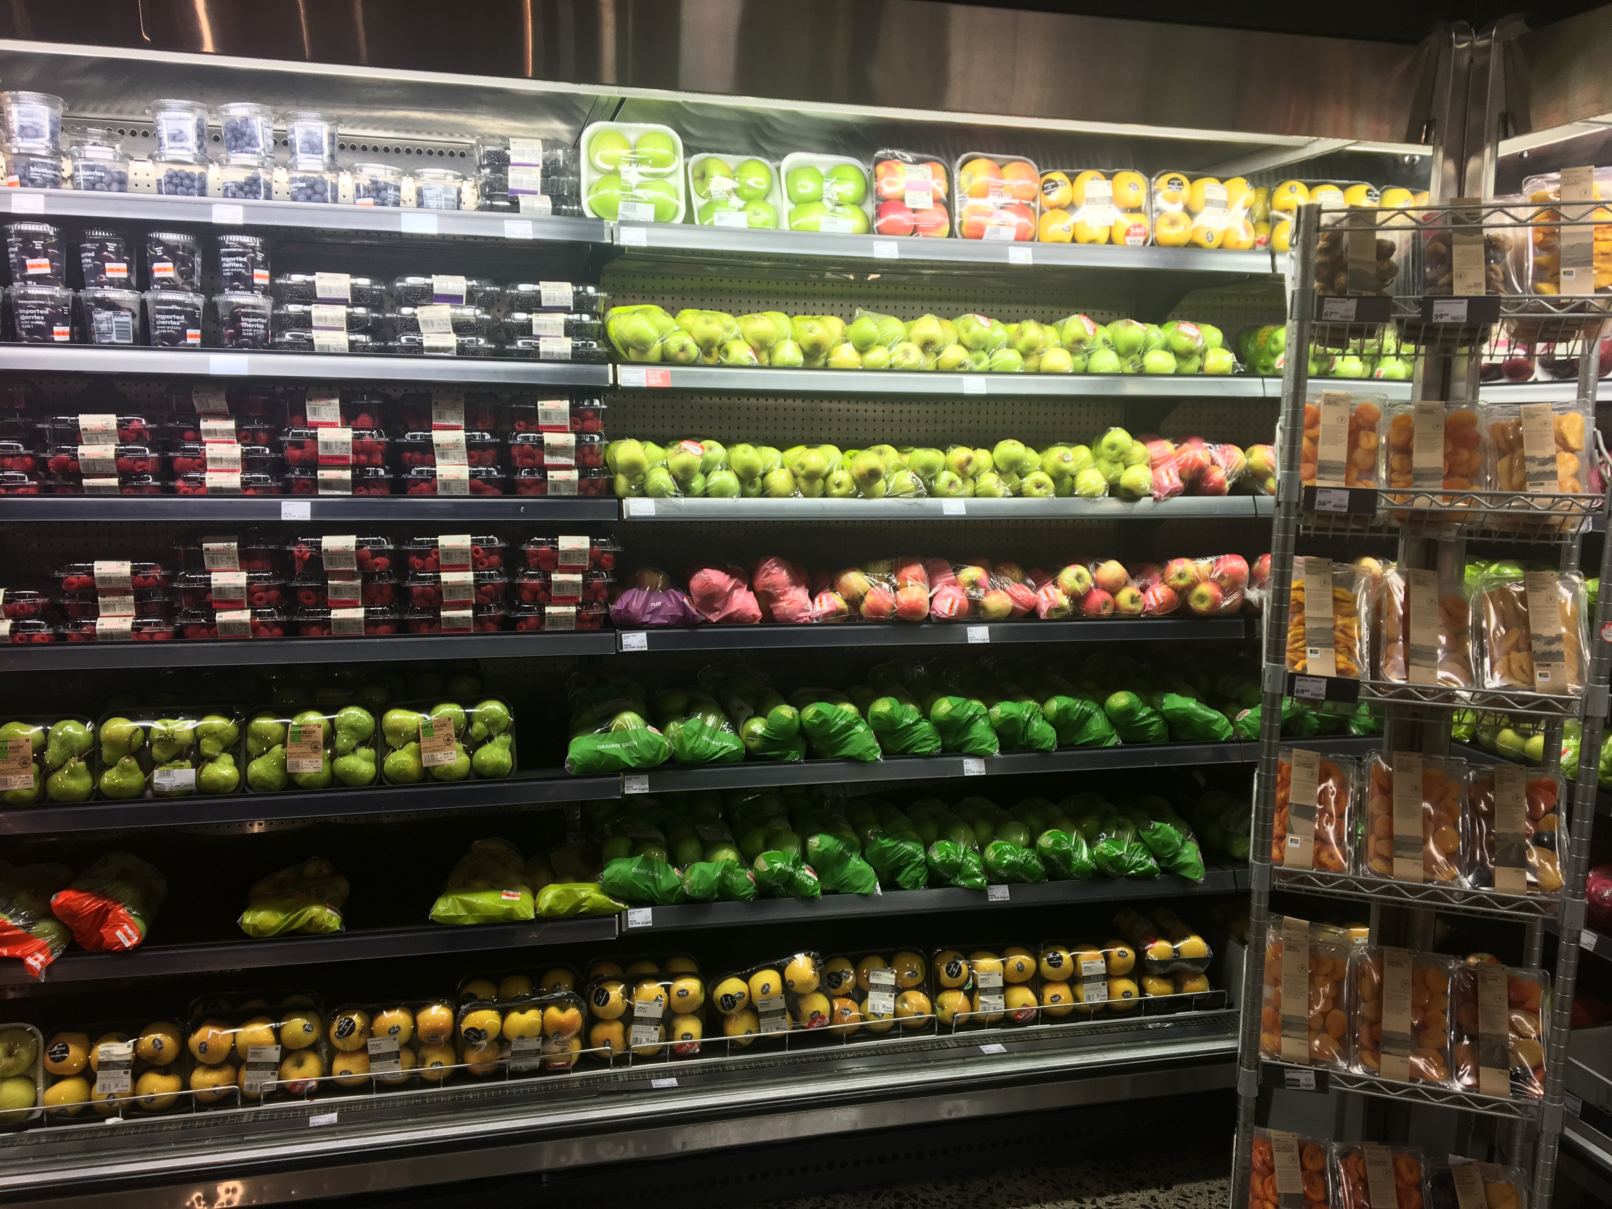
Notes:
Looking at where your fruit lands up before it gets to the consumer you can see that plastic packaging is ubiquitous. Specifically for food packaging, plastic is the material most used (look at photos – local and international).

Slide 3
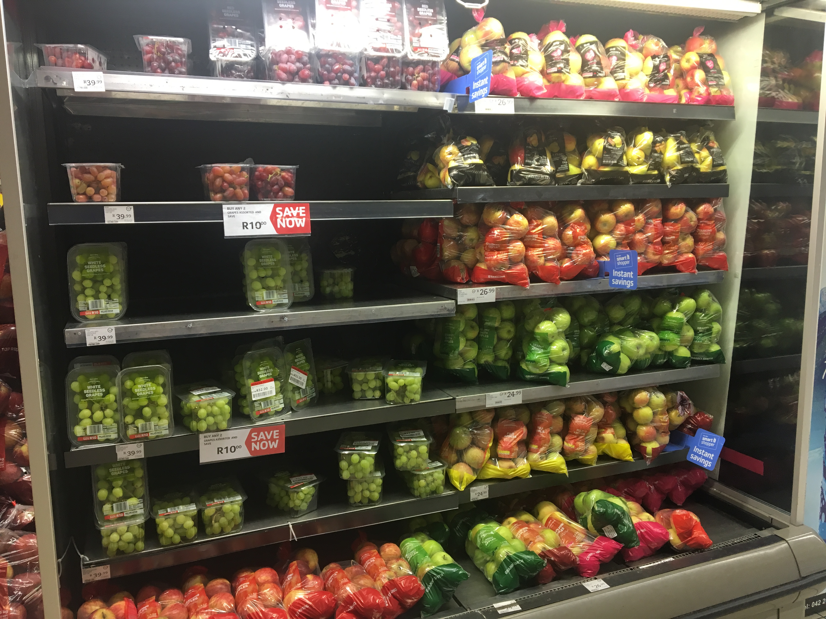
Notes:
And why? Number 1 it is cheap, cheaper in most cases than paper, glass and metal. Number 2 it has more applications and number 3 it works well to prolong shelf life. BUT there is a dark side to this….plastic packaging is the number one debri found on beaches, in rivers and on land. The impacts are devastating. Plastic waste has become the number 1 environmental issue in the last 2 years and the backlash from consumers has been enormous.

Slide 4
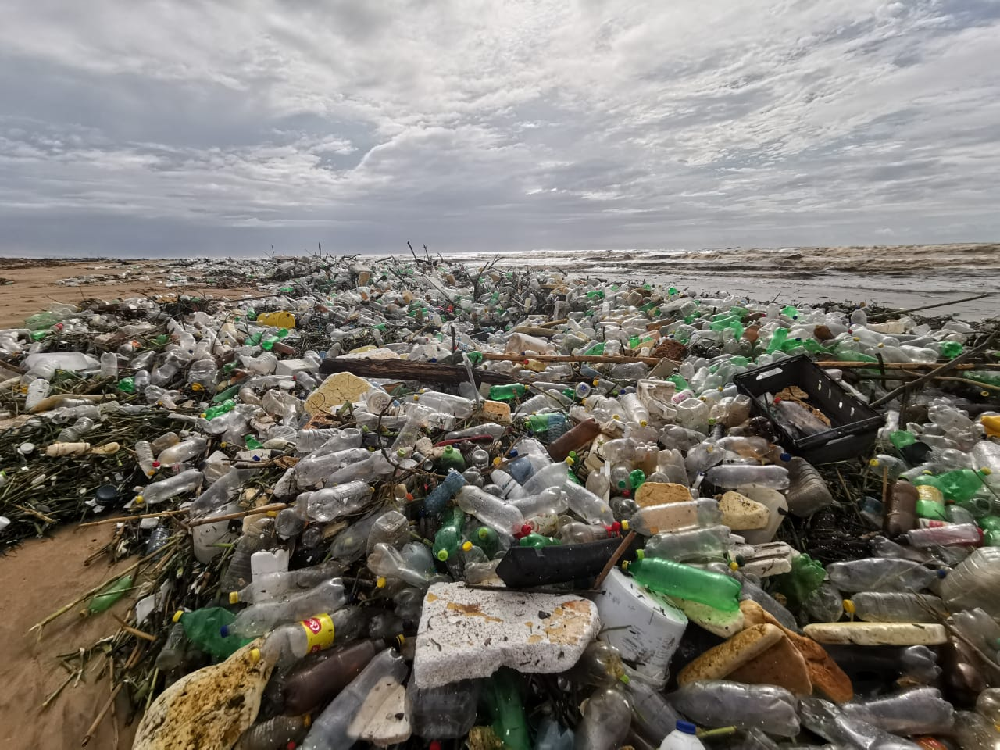
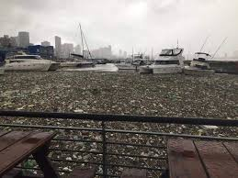
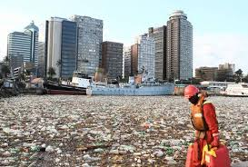
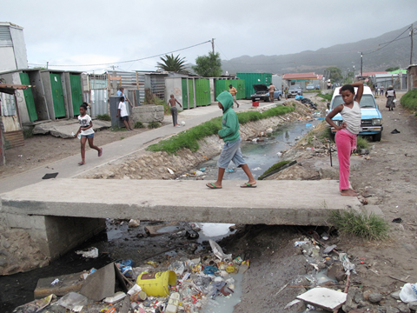
Plastic pollution: the facts
© Eddie van Os: Polyco
© Annabe Pretorius: Plastics SA
6 June 2019
Notes:
Durban recently experienced a flooding event leading to thousands of tonnes of plastic waste entering the harbour and beaches. We know these events are not once off and high rainfall events occur annually leading to plastic waste being washed into the ocean from coastal settlements. The boats in the harbour couldn’t move as the plastic was getting caught in their engines. A photo of this informal settlement in Cape Town is another example of the waste generated at all socio-economic levels.

Slide 5
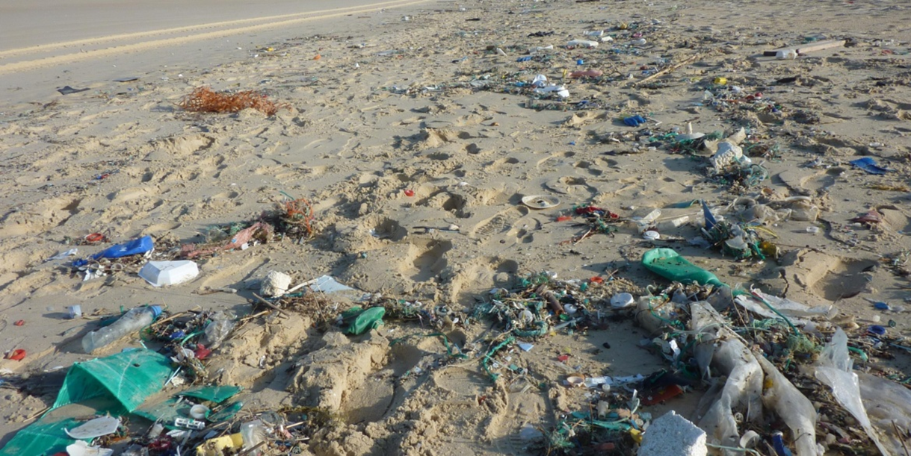
Plastic pollution: beaches
6 June 2019
Notes:
At a global scale 9 million tonnes of plastic waste enters the ocean each year. I’m sure when you walk along beaches here in South Africa that this is a very familiar sight. The environmental impacts are significant.

Slide 6
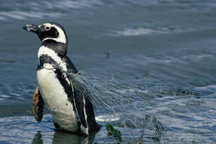
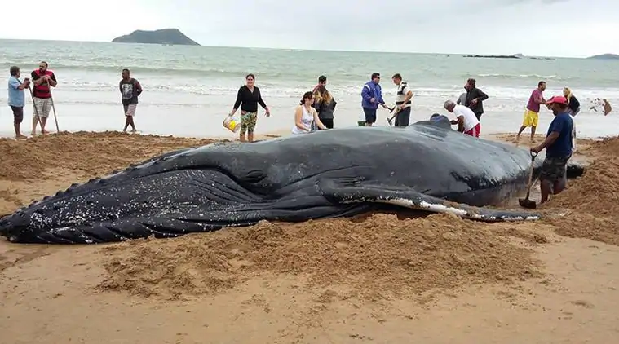
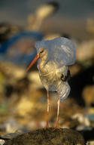
Plastic pollution: marine life
6 June 2019
Notes:
Along with marine organisms ingesting plastics, becoming entangled in plastic packaging and ghost fishing gear there are the more non visual impacts. Recent research has found that exposure to chemicals leaching from plastic in the ocean has disrupted the functioning of photosynthetic bacteria which produces 10% of the planets oxygen. The oceans produce 50% of the oxygen in the atmosphere and this means that every second breath we take is due to the oceans. Plastic has been found in the Mariana trench at a depth of 10km and the marine life in this trench have been found to have plastic in their digestive tracts.

Slide 7
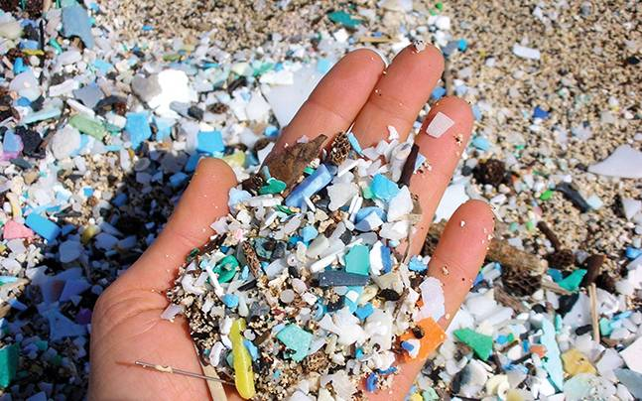
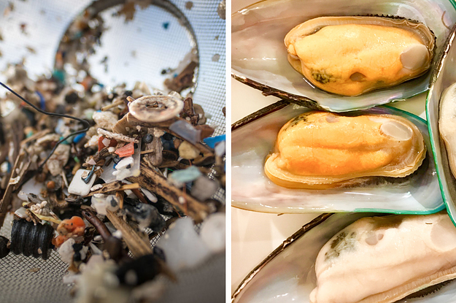
Plastic pollution: microplastics
6 June 2019
Notes:
What we usually see in the natural environment are visible plastic items which are called macro plastics. However, plastic waste breaks up through exposure in the environment (this includes wave action, UV and other physical means such as tyres) leading to the formation of micro plastics. Microplastics are also found in cosmetics and toothpaste amongst others and are becoming more and more prevalent in the environment. Micro plastics have been found in our drinking water specifically bottled water, in soils, the air and in our food. And the research is only just starting on what the impacts of all this plastic around is has on human health.

Slide 8
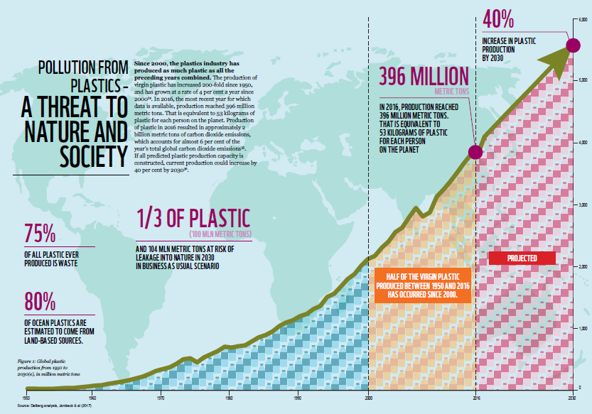
6 June 2019
Notes:
What has led to all this plastic in the environment? As you can see the production of virgin plastic has increased 200 fold since 1950 with 75% of all plastic ever produced now waste. Don’t you think this graph looks eerily similar to the concentrations of greenhouse gasses in the atmosphere? Only difference is that greenhouse gasses have been increasing steadily since 1850 but plastics have shown exponential growth since 1980! Plastic is cheap- and is getting cheaper due to the cost of raw materials used to produce plastic has declined substantially over the last decade. If we continue on the current business as usual path there will be 40% more plastic waste generated in the next 10 years.

Slide 9
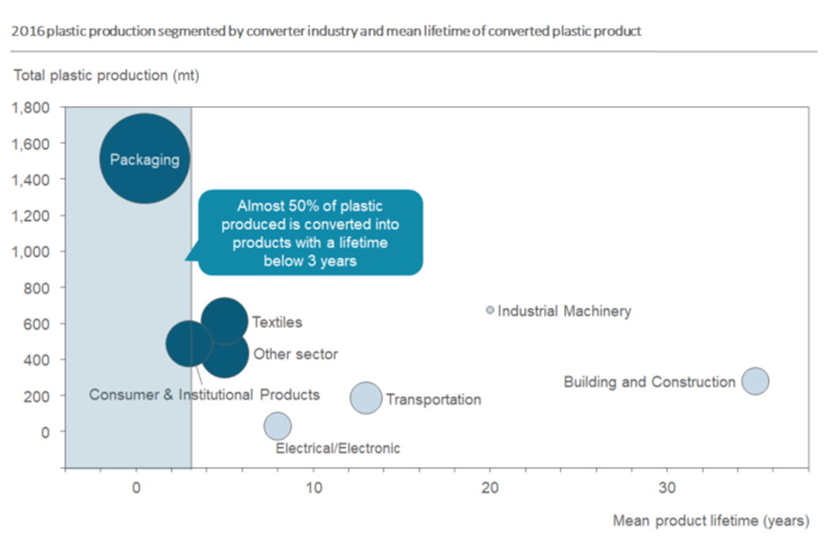
Plastic production: the facts
6 June 2019
Notes:
What does that mean to the already critical levels of plastic in the environment? One can clearly imagine that the current waste management infrastructure and capacity can in no way keep up with the growing volumes of plastic waste of which plastic packaging – specifically single use – makes up the largest volume. Single use plastics are designed to only be used once before being thrown away. Up until recently and even now manufacturers, retailers and most industries when designing packaging do not consider what happens with it is after use. 80% of the environmental impacts of plastic packaging or any packaging for that matter are determined at the design stage.

Slide 10
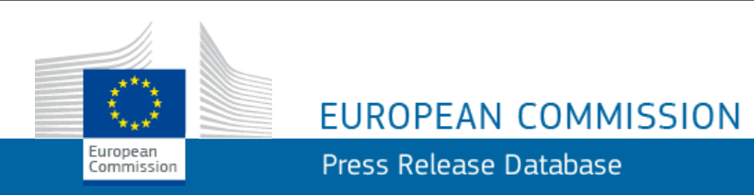
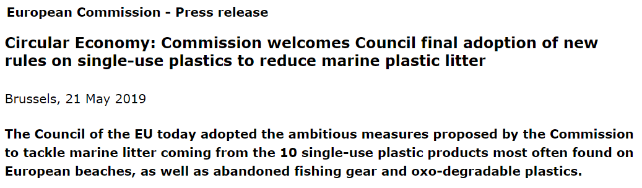
Plastic packaging: International responses
6 June 2019
Notes:
What is happening on a global, regional and local level with regards to addressing the plastic challenge? On 21 May the European Union Council adopted the ambitious EU Plastics Strategy measures proposed by the EU commission. This strategy includes the following:
A ban on selected single-use products made of plastic including: cotton buds, cutlery, plates, straws, stirrers, sticks for balloons, as well as cups, food and beverage containers made of expanded polystyrene and on all products made of oxo-degradable plastic.
Measures to reduce consumption plastic packaging and specific labelling of certain products.
Extended Producer Responsibility schemes covering the cost to clean-up litter, applied to products such as tobacco filters and fishing gear.
Increase targets for recycled content in plastic packaging and design for circular economy such as attached bottle caps to beverage bottles.

Slide 11
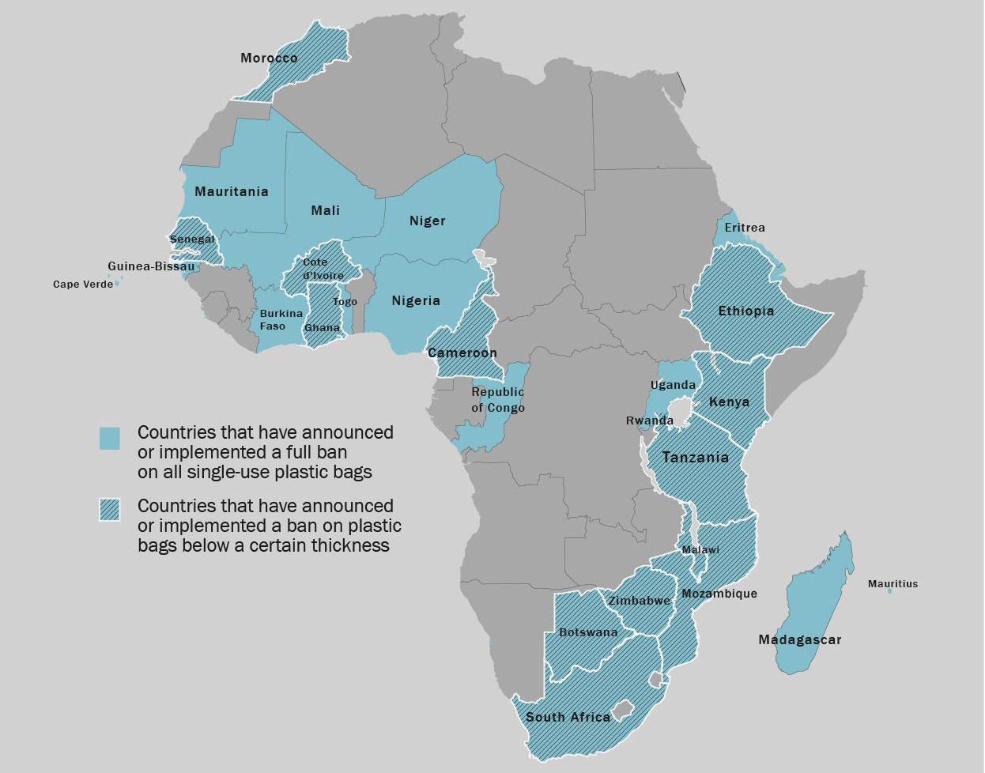
Plastic packaging: regional responses
6 June 2019
Notes:
At a regional level the African continent has been at the forefront on addressing problematic plastics, specifically plastic carrier bags. These countries are using bans as a means to address plastic waste generation as this is a significant challenge in developing countries with changing consumption patterns and weak waste collection services. As of May 2019, 34 African countries have passes legislation banning plastic bags (all or certain bags below a certain thickness). Besides plastic bags, Rwanda is aiming to be plastic free in the near future and was the first country to ban plastic bags in 2008. Bearing in mind that the African export market for fruit is growing.

Slide 12
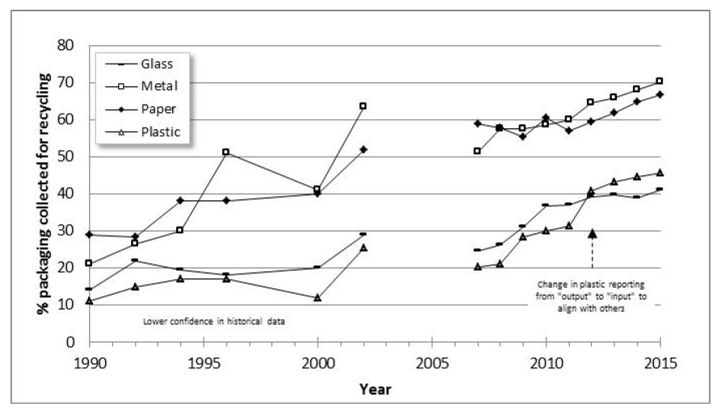
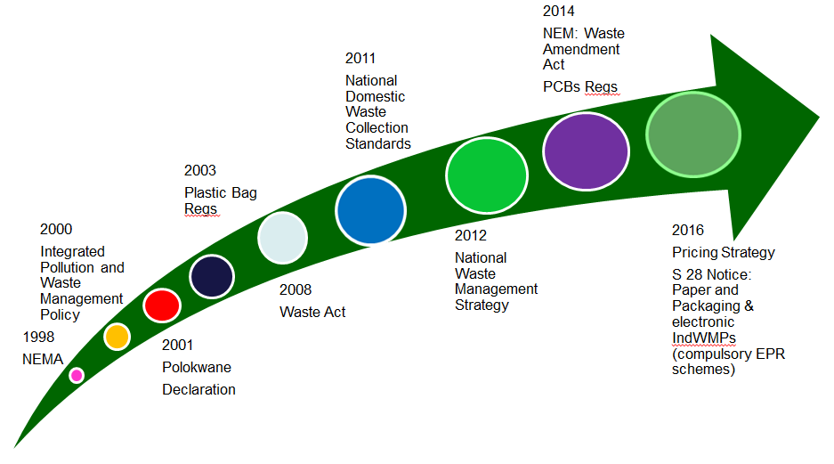
Plastic packaging: national legislation & recycling
6 June 2019
Notes:
In South Africa there is also a great deal going on with regards to waste legislation. Since 2001 there has been significant growth in waste recycling mainly due to informal waste collection which we know as the waste pickers. This informal waste collection is responsible for between 80-90% recovery of post consumer material. One can see a steady increase of waste materials collected for recycling since 2000 but still much is to be done. Since 2008 the various waste legislation and strategies support waste minimization however the flood of regulation has placed a burden on the private sector and has been seen to have hindered the transition to reuse, recycling and recovery.

Slide 13
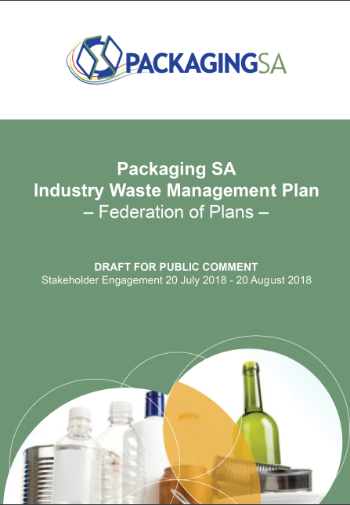
Plastic packaging: packaging IndWMP
EPR levies on packaging
materials
Targets on collection rates
for recycling
6 June 2019
Notes:
The Packaging Industry Waste Management Plan submitted by the packaging and plastic industry last year is still under review and includes an increased levy on plastics which will filter down the value chain if approved and new post consumer material collection rates.

Slide 14
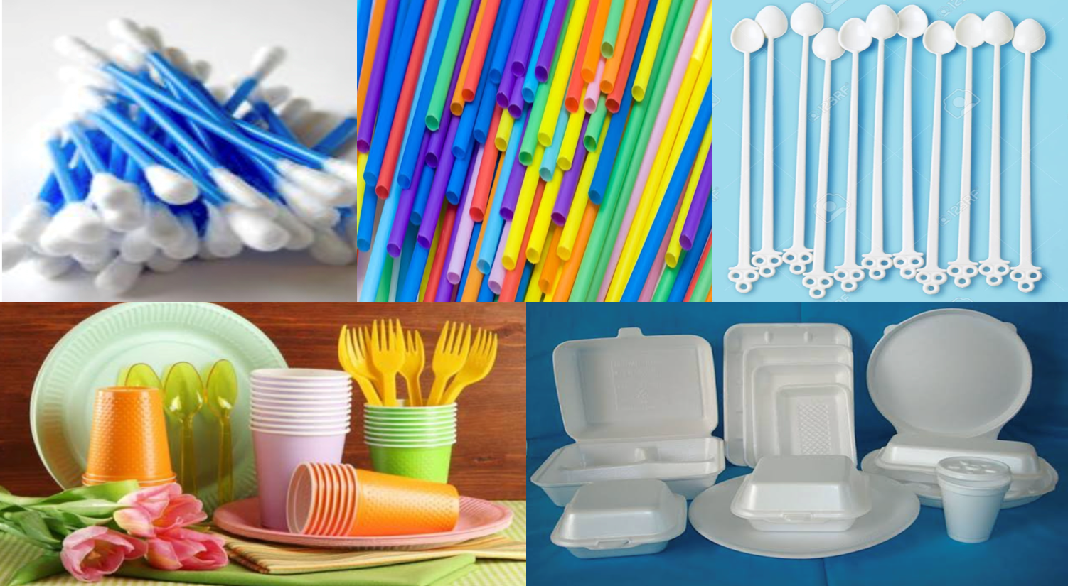
Plastic packaging: national response
Proposed ban on plastic items:
6 June 2019
Notes:
Recently the parliament portfolio committee together with the Department of Environment Forestry and Fisheries (previously DEA) proposed a phase out of 6 items; straws, stirrers, plastic eating utensils, cotton buds and microbeads in cosmetics.

Slide 15

Plastic packaging: Operation Phakisa
Infrastructure investment: MRFs and pelletisation/
recycling plants
Product design and waste minimisation:
Increase recyclability of packaging
Increase use of packaging recyclate
6 June 2019
Notes:
The Chemicals and Waste Economy Phakisa, which was launched by national government in March this year aims to reduce negative impacts on the environment, while growing the GDP contribution
and creating jobs. With regards to plastic packaging there are planned infrastructure investments for the geographical expansion of Material Recovery Facilities and palletisation plants. Interventions in packaging design to minimise waste generation include increasing the recyclability of packaging and use of packaging recyclate. This will be done through developing national packaging design guidelines which will become standards by 2022 and setting up a packaging certification scheme.

Slide 16
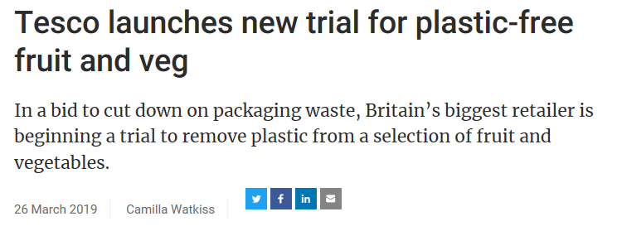
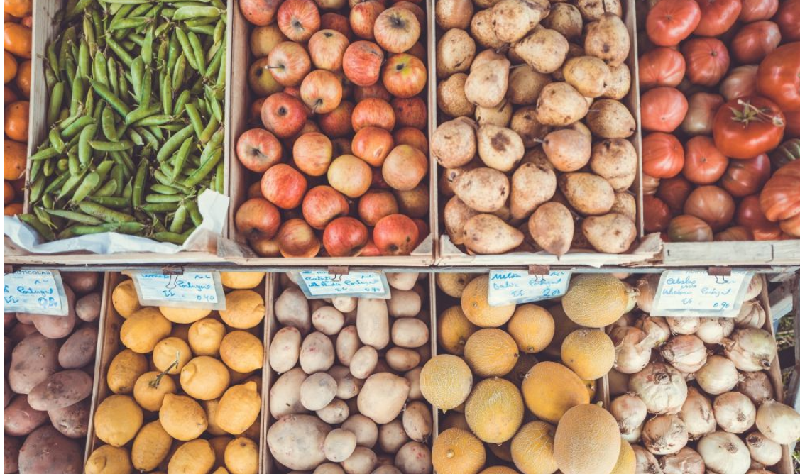
Plastic packaging: retailer response
6 June 2019
Notes:
In the industry I’m sure you have seen the response from international retailers on this issue? Tescos is trialling plastic free fruit and vegetables in store

Slide 17
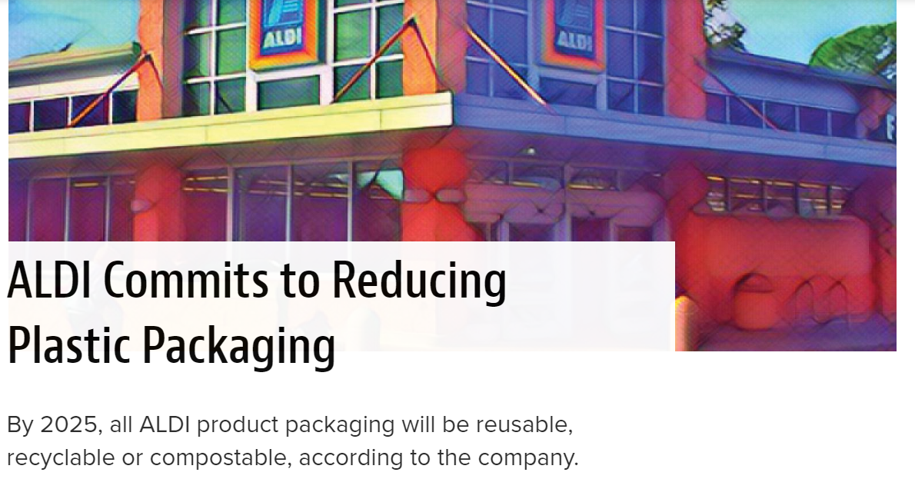
Plastic packaging: retailer response
6 June 2019
Notes:
Aldi is committing to reduce plastic packaging with all packaging either being reusable or recyclable by 2025

Slide 18
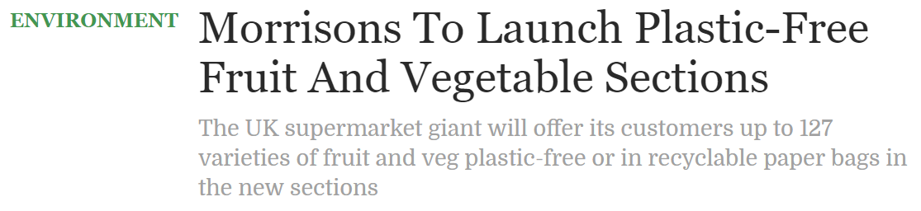
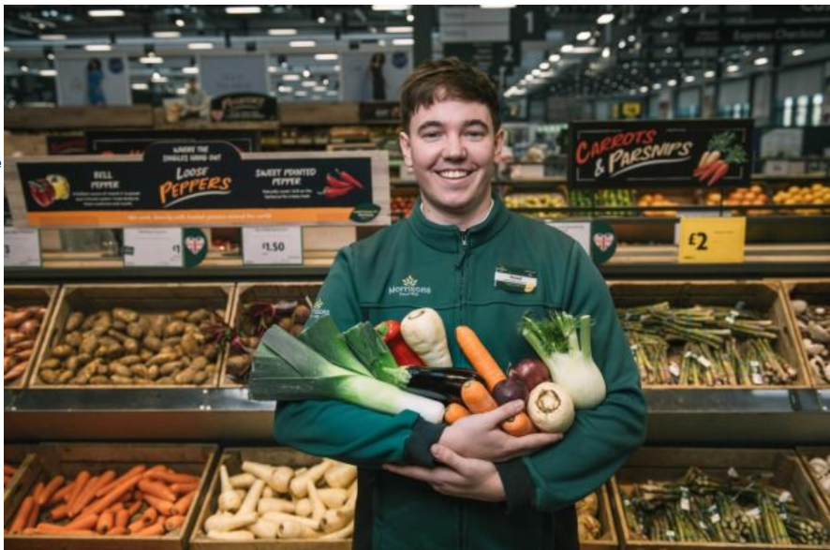
Plastic packaging: retailer response
6 June 2019
Notes:
Morrisons is launching plastic free fruit and vegetable sections in their stores. And I heard yesterday that Waitrose is also starting to introduce plastic free aisles for fruit and veg.

Slide 19
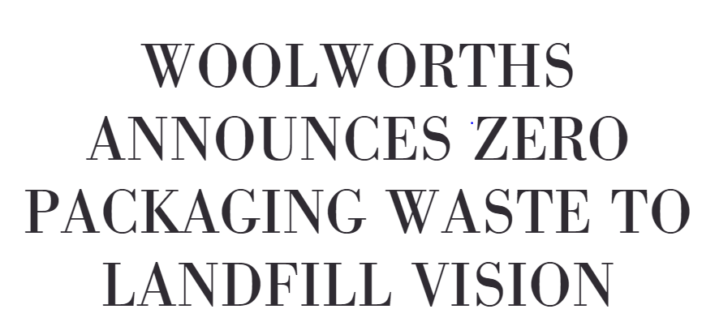
Plastic packaging: local retailer response
All packaging 100% recyclable or reusable by 2022
Phase out of single use plastic carrier bags by 2020
6 June 2019
Notes:
And the response from local retailers have been quite similar with Woolworths announcing a commitment around plastic packaging and the phase out of plastic carrier bags. And I’m sure you have asked yourself this question: how will these retailer plastic strategies affect the quality and shelf life of my fruit? And what packaging from the pack house to the distribution centres and stores will be acceptable?

Slide 20
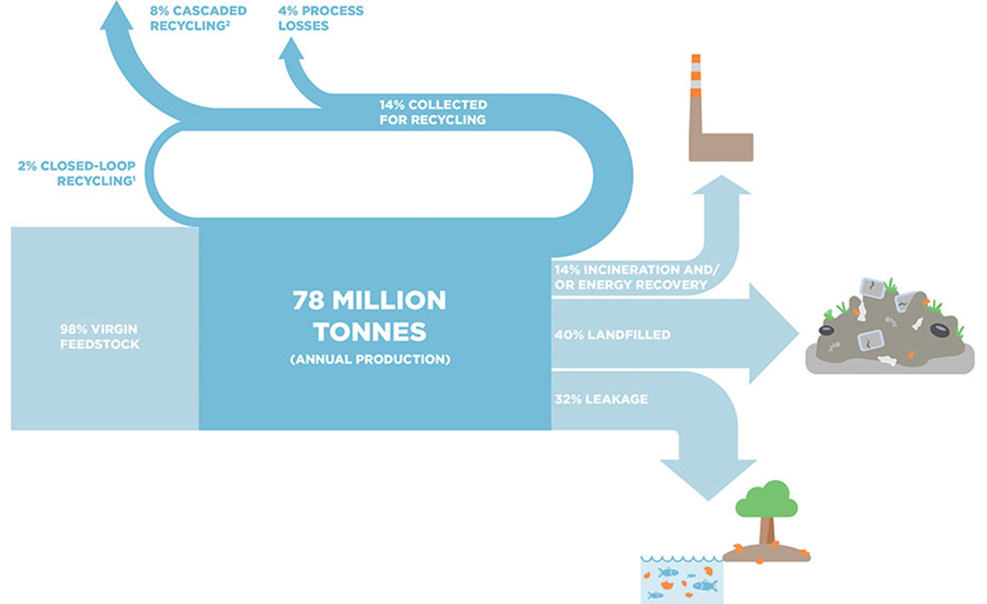
Linear Plastic Economy
6 June 2019
Notes:
The current flow of materials, not just plastics is based on a linear economy of make, take and dispose. The global linear plastics economy means that the majority of plastic lands up either being incinerated, landfilled or dumped or leaks into the environment. This flow of plastic subsequently leads to the production of more plastic due to the loss of the material to the environment and other waste disposal. The result: we are beginning to literally drown in our waste.

Slide 21
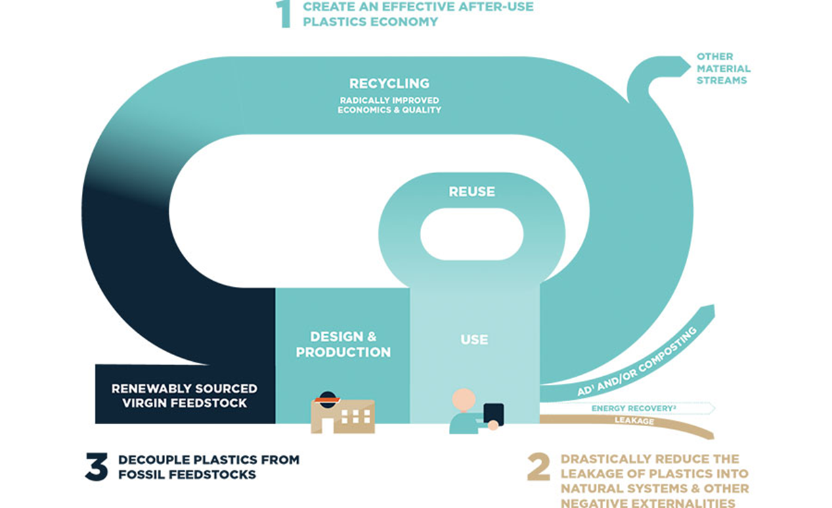
Circular Plastic Economy
6 June 2019
Notes:
How can we change this linear flow? The circular economy concept which has been around since the 1960s proposes a shift from a linear throwaway pattern to a circular plastics economy. This has been proposed as a solution to keep plastic packaging out of the environment and keep the value of this material in the system. This includes a change in business models to support designing for recyclability and reuse and not just designing packaging to look pretty. It is imperative then that all stakeholders in the value chain start adopting this concept collectively – are you discussing these opportunities with your suppliers and clients?

Slide 22
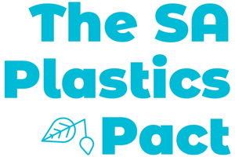
Industry initiatives: The South Africa Plastics Pact
Proposed targets:
Target 1: identify problematic plastics and agree to address by 2021;
Target 2: 100% plastic packaging to be reusable, recyclable or compostable by 2025;
Target 3: 70% plastic packaging effectively recycled;
Target 4: 30% average recycled content in plastic packaging
6 June 2019
Notes:
WWF is committed to support the adoption of a circular plastics economy in South Africa. One of WWFs interventions at the industry level is the initiation of a voluntary plastic packaging commitment. The South African Plastic Pact is a platform for cross sector collaboration to address the plastic pollution challenge. This initiative aligns with the Ellen MacArthur New Plastics Economy Global Commitment with the following proposed national targets that each sector in the plastics value chain agrees to. Talk about the targets as they appear on the screen. This pact will form part of a network of international pacts such as the UK Pact, French, Dutch and Chilean

Slide 23
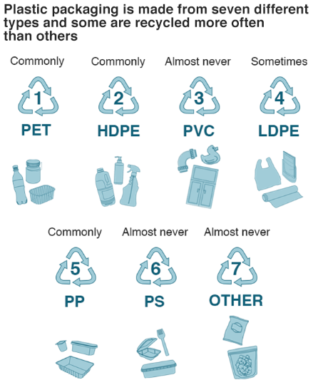
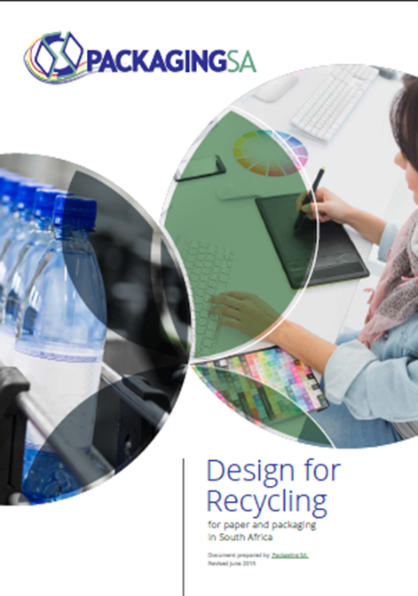
Design for Recycling Guideline
Commonly
6 June 2019
Notes:
To put these targets into practice in supporting a circular economy for plastics your organisation should please use the national Design for Recycling Guideline which is freely available from the Packaging SA website. General principles for plastic recycling include: Material combination and selection, the separability of composite materials such as multi layers, ease of emptying and Labels, printing inks and adhesives used. Just looking at the plastic packaging materials that are currently recycled in South Africa also gives you a good idea of what is in and what is out

Slide 24
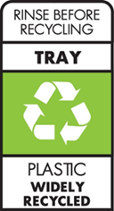
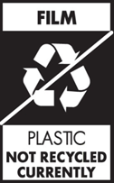
On Pack Recycling Labels and Material identification codes
** Special instructions
1. Packaging component
2. Recyclability Icon
3. Packaging material
4. Is this recycled?
Recycled in practice in South Africa at the moment
6 June 2019

Slide 25
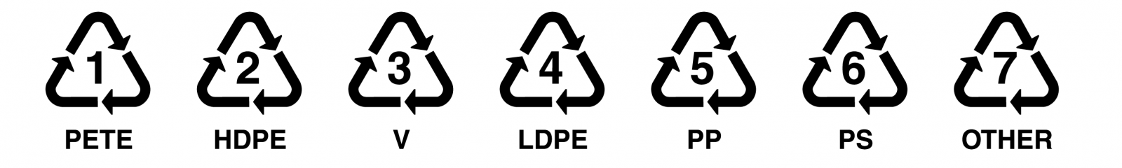
On Pack Recycling Labels and Material identification codes
Some materials have material identification codes which identify the material. This is important for waste collectors and recyclers but not for consumers.
PVC
17%
ABS
E/VAC
POM
PC
PETG
PA
PET&PA
PE&PA
PE&E/VAL
  Plastics have resin codes.
(https://en.wikipedia.org/wiki/Recycling_codes)
6 June 2019

Slide 26
International guidelines
Red - Exit (poor for recycling and potentially harmfull) | Amber – Hold (until infrastructure or scientific developments take place) | Green – Preferred (easily recycled, can have high recycled content)
PVC & Polystyrene | Home compostable E.g. Cellulose, Mater-bi | Sustainably sourced wood, board, paper & glassine
Oxo-degradable materials | OPP – Oriented polypropylene (BOPP) | PET
Rigid water soluble plastics | PP – Polypropylene (for certain food applications) | Glass
PLA – Polyactic acid | Complex laminates/multi-layer films | PP
Industrial compostable | PVdC (Not PVC) | HDPE & LDPE
Polycarbonate | New materials | PE – Polyethylene (flexible film)
Acrylic |  | Steel & Aluminium
Black plastics
6 June 2019
Notes:
Going abroad these are so far the guidelines that fruit exporters are receiving from international retailers who are signatories to the Plastic Pact Network. You have red materials that will be removed by end of 2019. The amber materials where alternatives will be investigated or only used where absolutely necessary. The green materials will continue to be used and be replacements for the red list. General movement to simplicity away from complex and new materials.

Slide 27
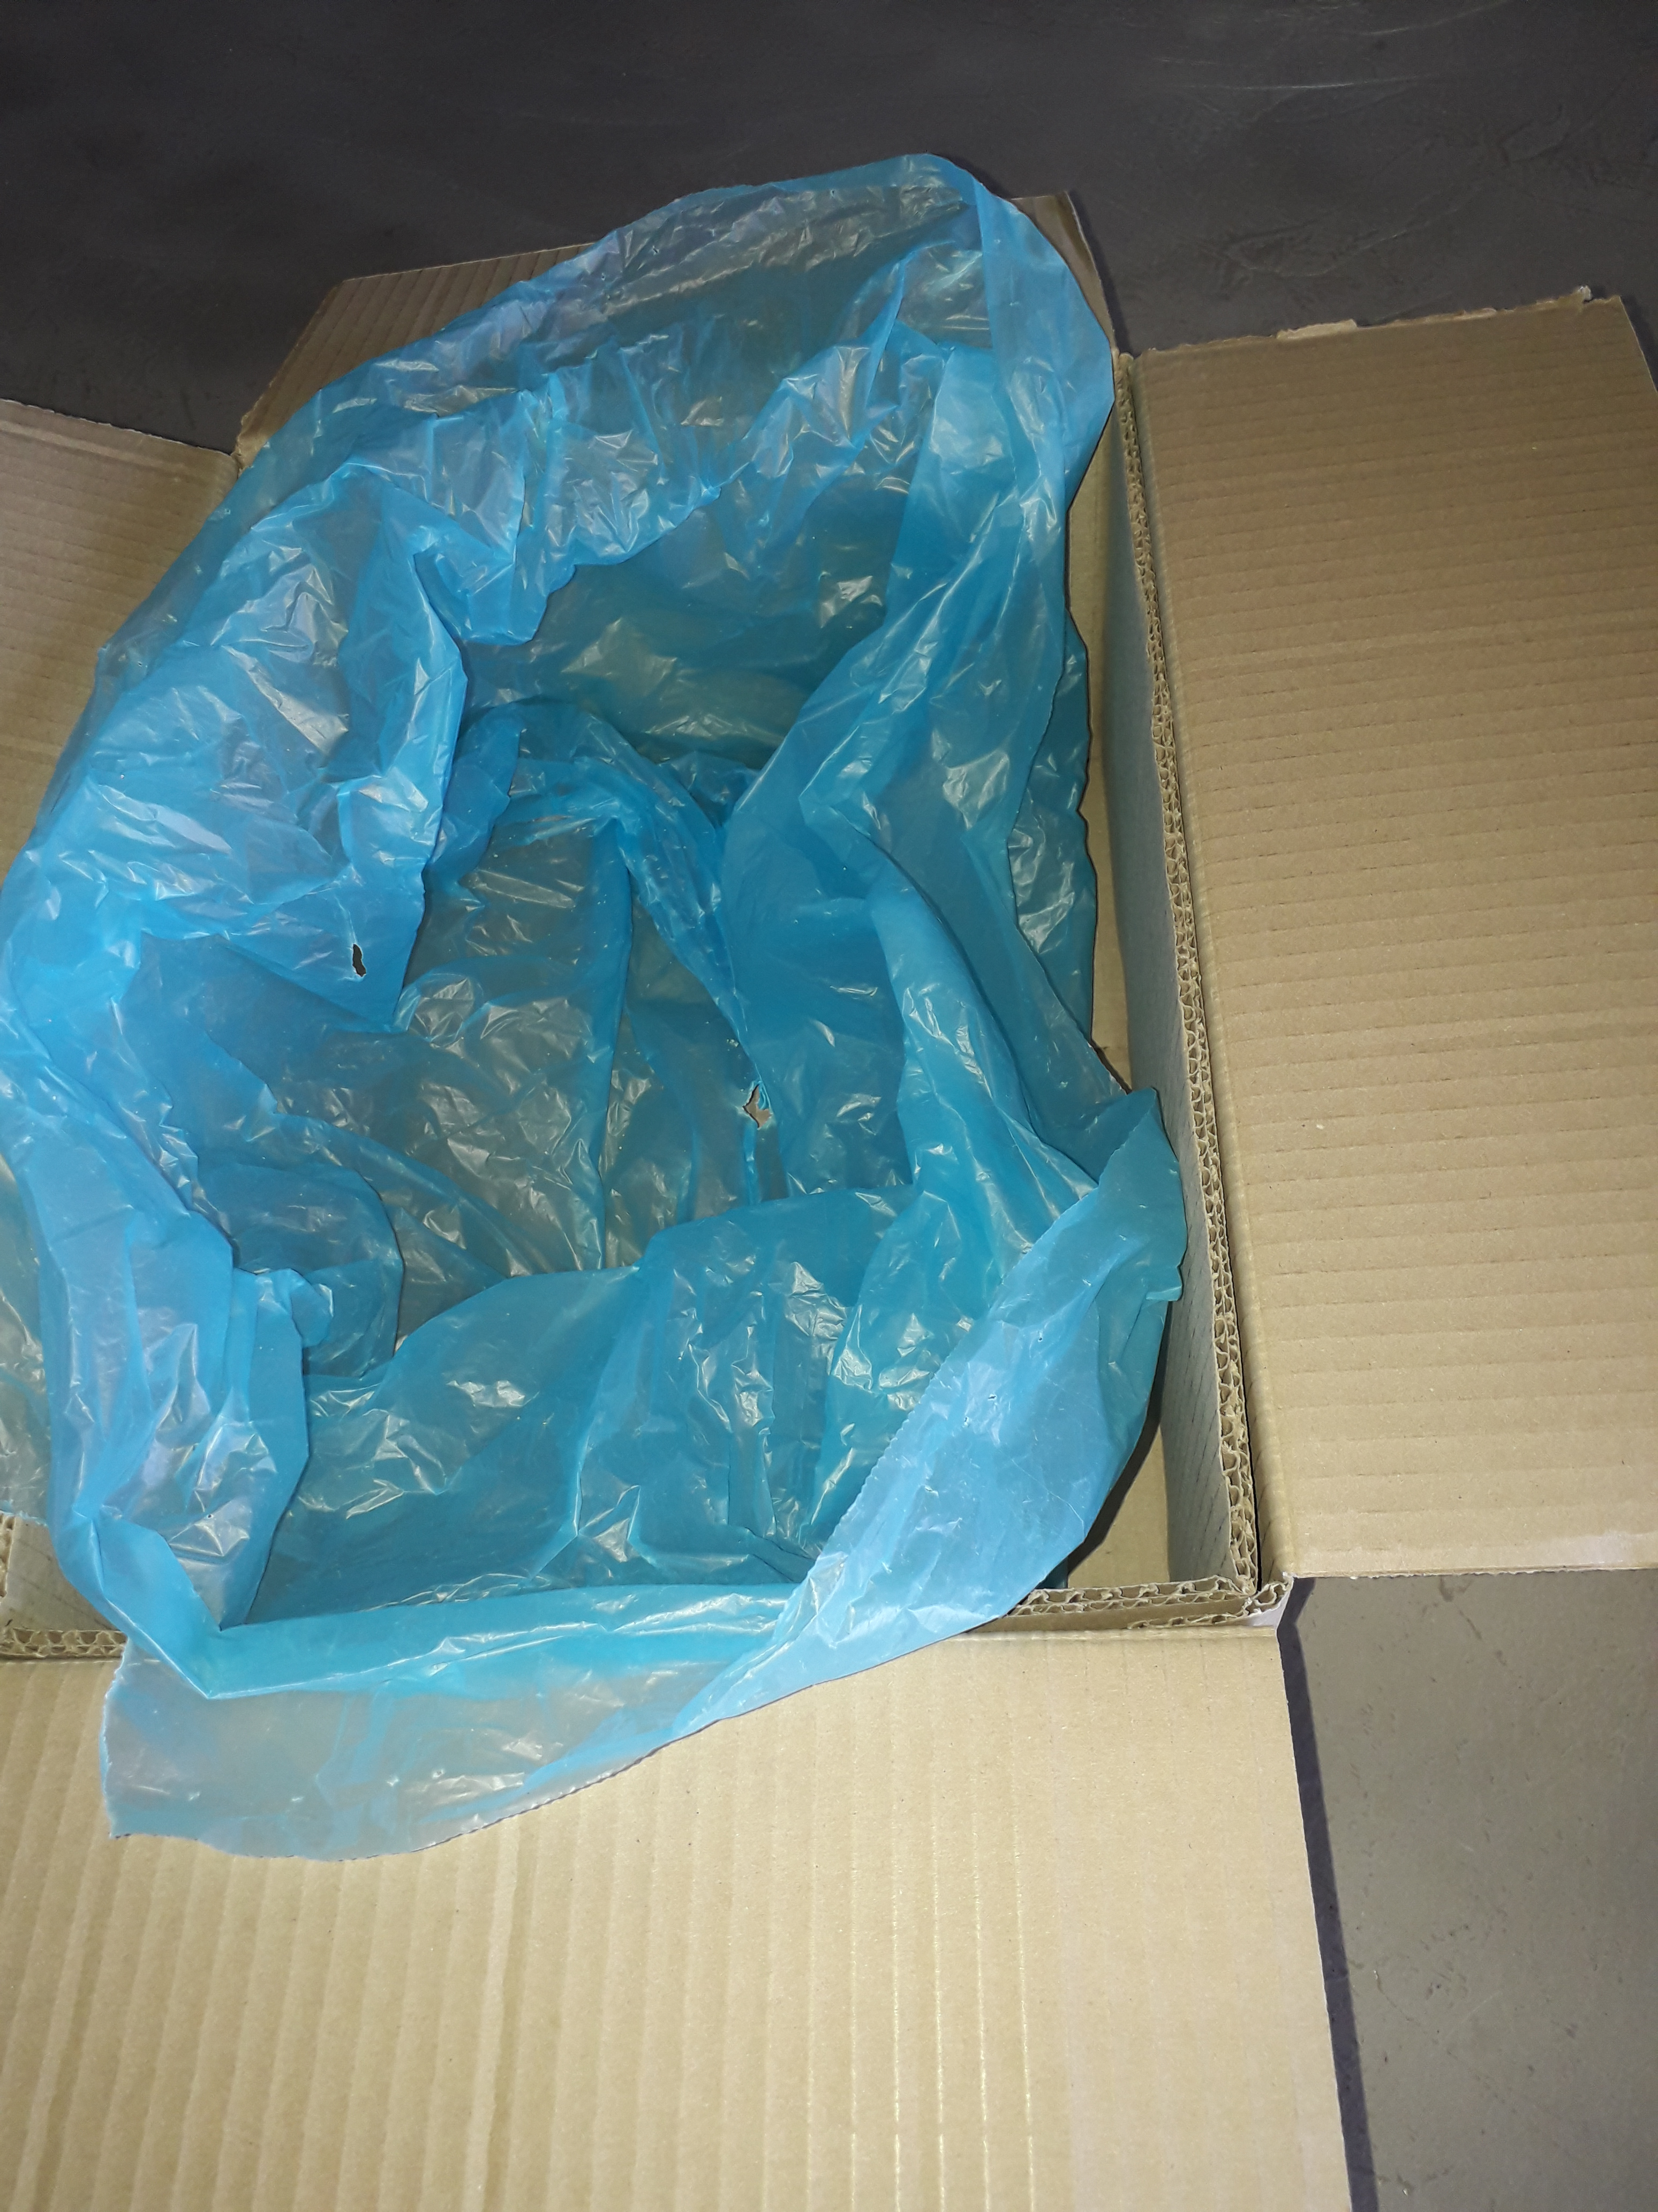
Possible response from fruit industry to plastic packaging
Box liners:
Clear bags
Only 1 material i.e. LDPE
Recycled content
6 June 2019
Notes:
Let’s take a look at what packaging is currently being used in the apple and pear industry and what are perhaps better alternatives to align with this circular plastic economy concept. Box liners: ideally you need a clear bag because clear plastic can be used in many other products whereas coloured bags have limited markets such as refuse bags which are black. Ensure that there is only a single material, in this example LDPE which is widely recycled in South Africa. Most multilayers, composites are not recycled. An added bonus would be if the bag has recycled content which aligns with national waste strategy Phakisa and the industry intiatives.

Slide 28
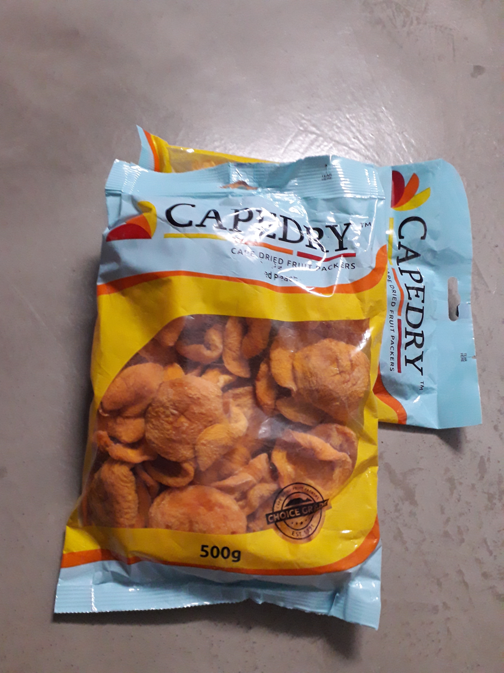
Possible response from fruit industry to plastic packaging
Fruit bags:
Minimal printing
Single material (no multilayers/ laminates)
Recycled content
On Pack Recycling Label
Material identification code
6 June 2019
Notes:
Fruit bags: minimal printing to minimize the cost of recycling and keep the material at a higher value. Consider using a sleeve or wrap around label to not ‘contaminate’ the main packaging. Again rather use a single material in this case either LDPE or HDPE instead of multilayers which are not recycled. And ensure some degree of recycled content.

Slide 29
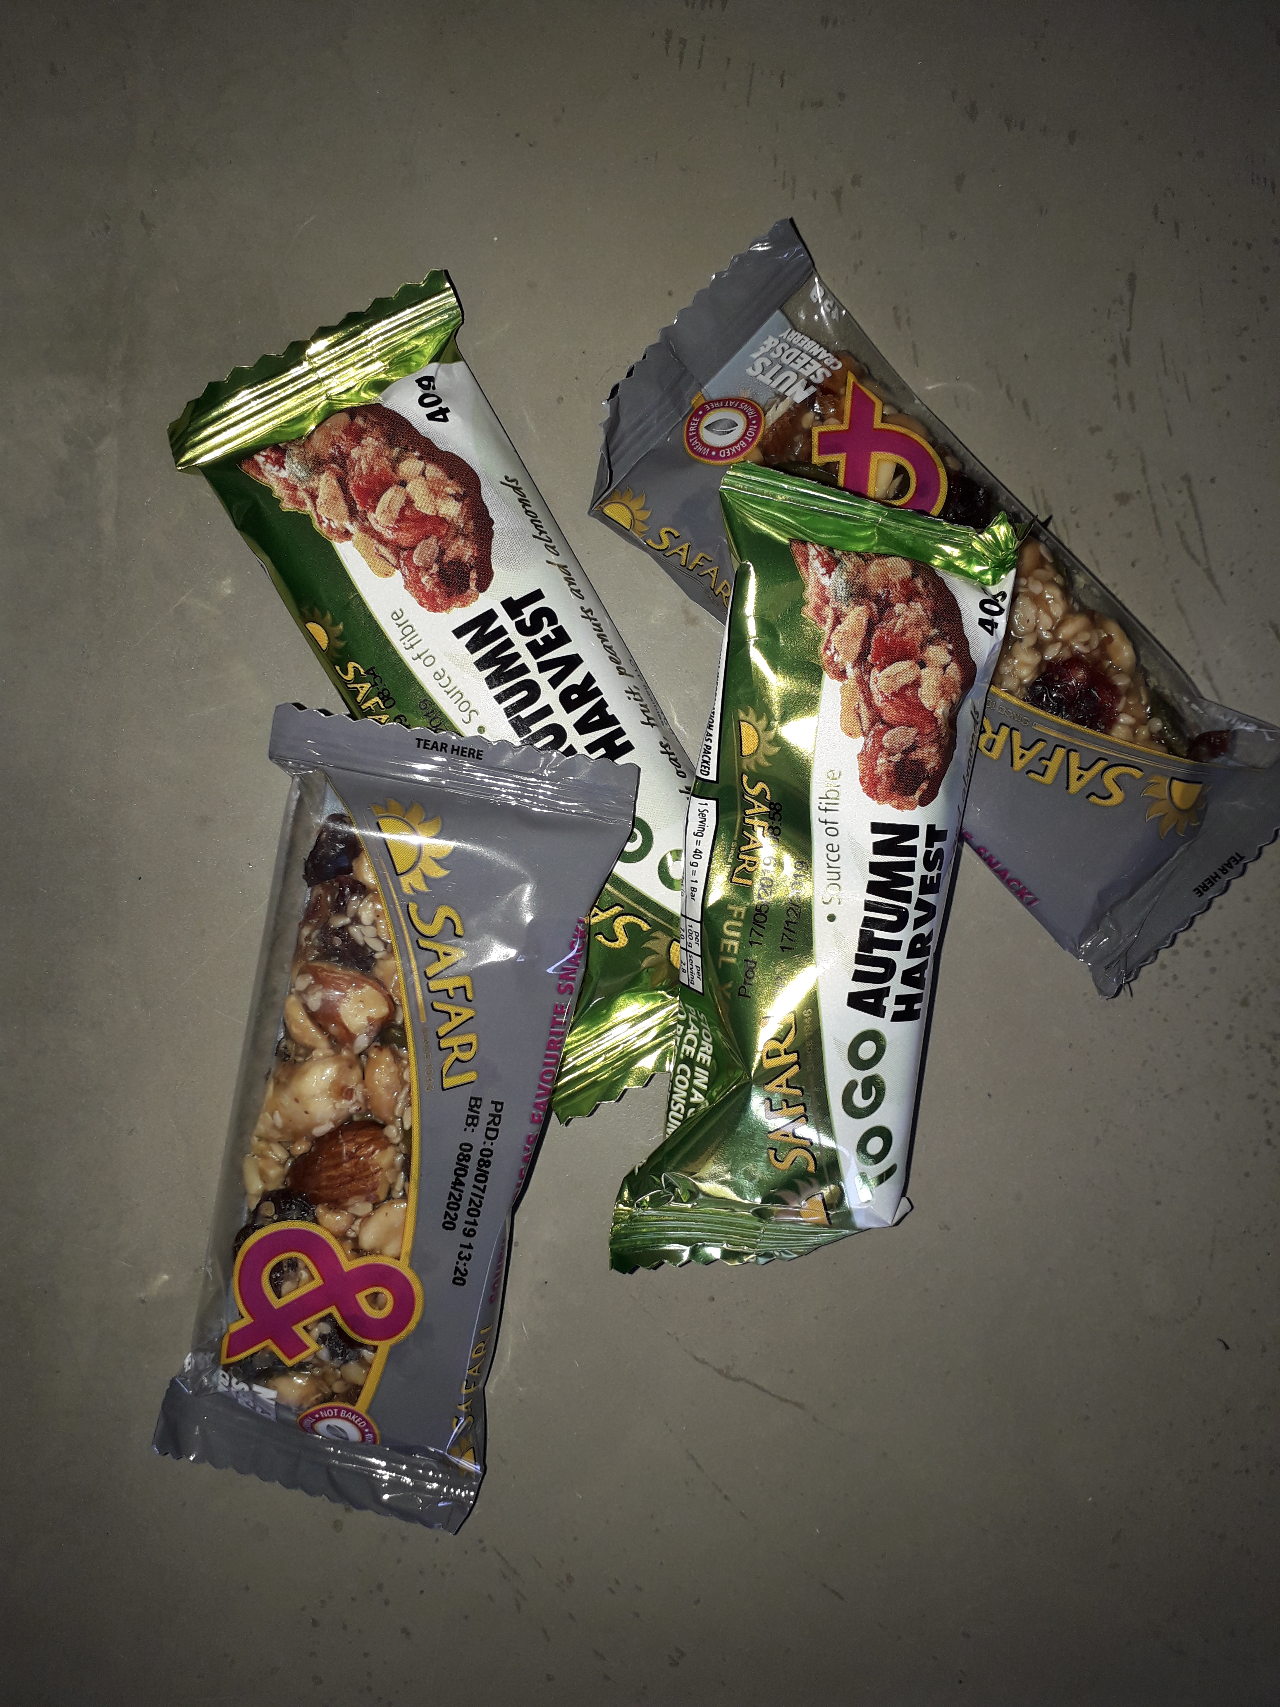
Possible response from fruit industry to plastic packaging
Snack wrappers:
Multi layers not recycled
Light weight
Not collected and prone to litter
6 June 2019
Notes:
Flow wrap is in the amber materials and are on hold so do not consider new lines using this packaging.

Slide 30
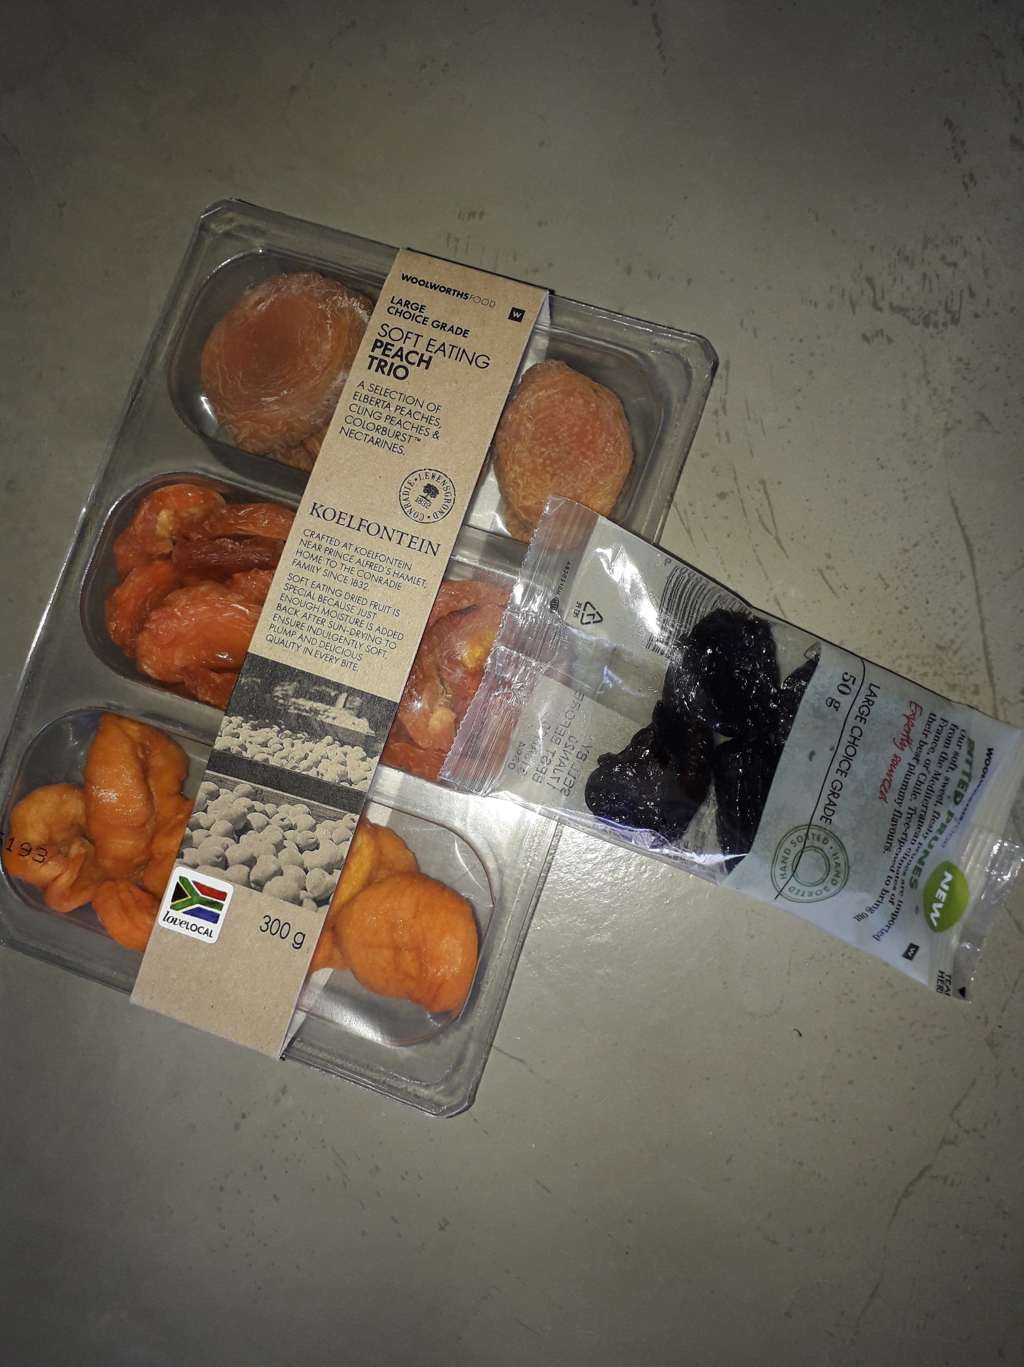
Possible response from fruit industry to plastic packaging
Plastic punnet:
Move away black plastic due to low value
PET thermoform trays not currently recycled.
Recycled content from local recyclate
6 June 2019

Slide 31
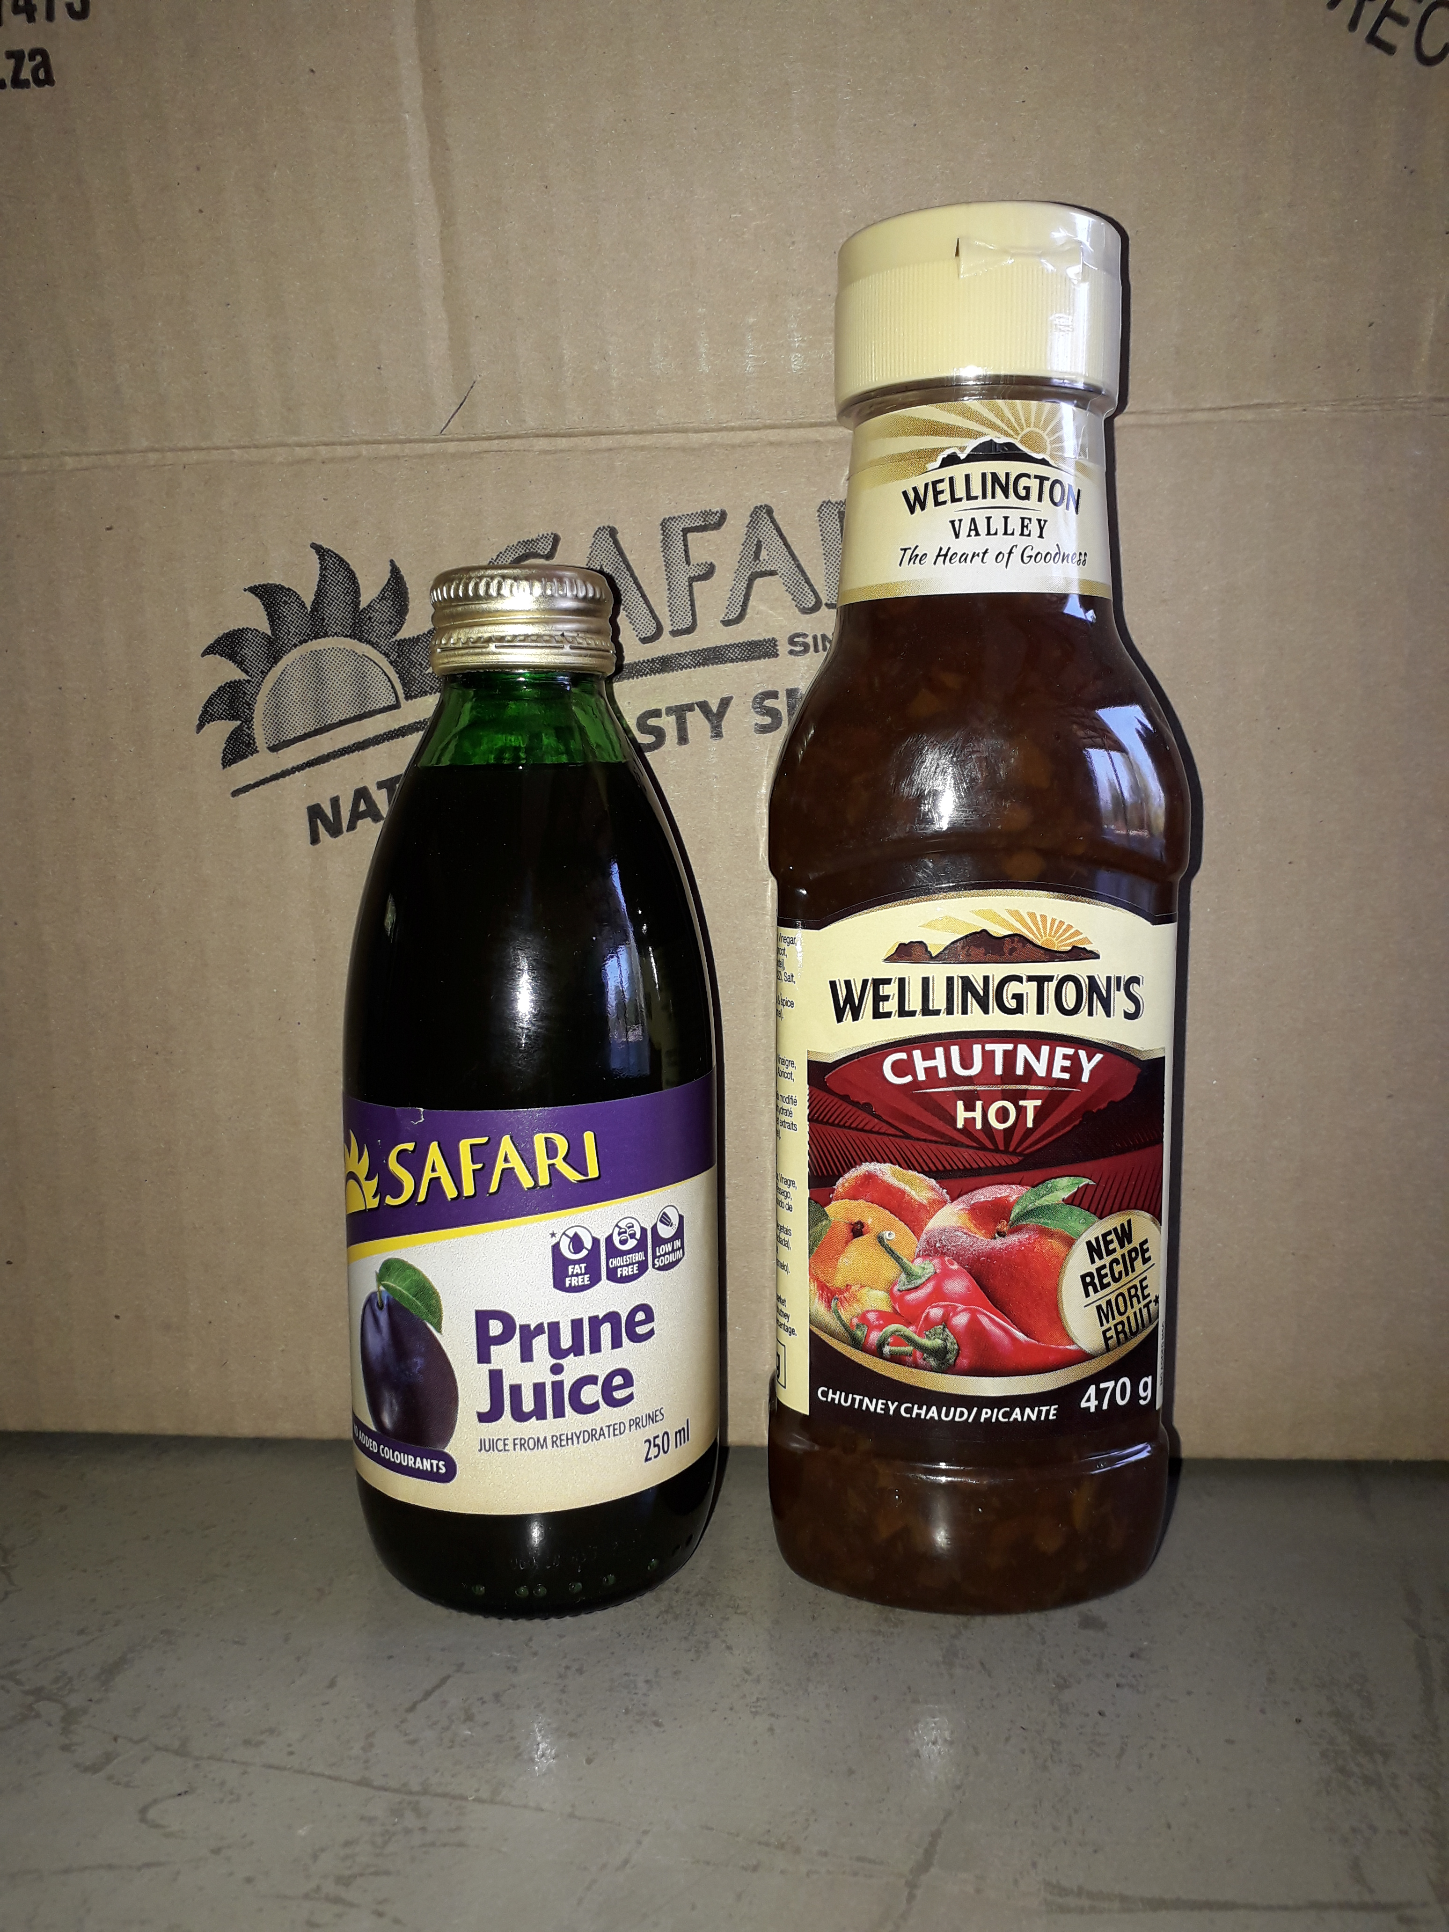
Possible response from fruit industry to plastic packaging
Glass vs. Plastic?
Dependent branding
Ensure plastic is fully recyclable in SA (PET, HDPE) and adhere to Design for Recycling guidelines
6 June 2019

Slide 32
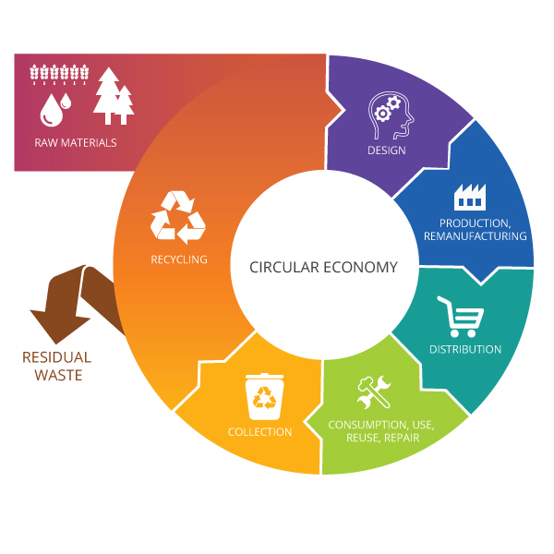
What next?
Design smarter and support circular plastics economy!
“It always seems impossible, until it is done.”
Nelson Mandela
6 June 2019
Notes:
Looking at our current situation and our relationship with plastic packaging we need to keep in mind the trade-offs between extending shelf life of product, versatility and affordability and the impacts of the waste generated. Let’s design smartly and not take the easy route which will generate even more waste. The packaging landscape is changing and the sooner you get on board the better for your product.

Slide 33
Thank you
www.panda.org
© 2010, WWF. All photographs used in this presentation are copyright protected and courtesy of the WWF-Canon Global Photo Network and the respective photographers.

Slide 34
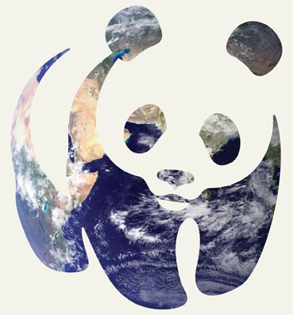
WWF IN SHORT
+100
+5,000
WWF is in over
100 countries, on
5 continents
WWF has over
5,000 staff worldwide
1961
+5M
WWF was founded
In 1961
WWF has over
5 million supporters
Photo: © NASA
Hortgro Symposium
6 June 2019

