Slide 1
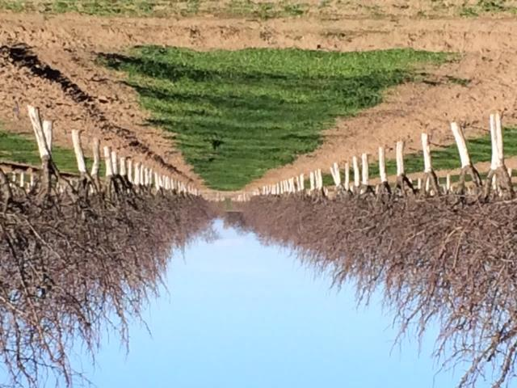
Breeding Superior Prune Cultivars
Ted DeJong
Professor, Emeritus
University California, Davis

Slide 2
UC Prune Breeding Program History
Started by Dr. Ted DeJong and Jim Doyle in 1985
Jim Retired
  Carolyn Debuse took over in 2000
Released 2 Cultivars in 2000: Tulare Giant & Sutter
  Released pollinizer for Tulare Giant 2004: Muir Beauty
Sarah Castro took over in 2008
Average evaluation of ~1,000 seedlings per year
Last few years have produced a minimum of 25 new selections/year grafted to our selection block
The project is mainly carried out with funding from the California Prune Board.

Slide 3
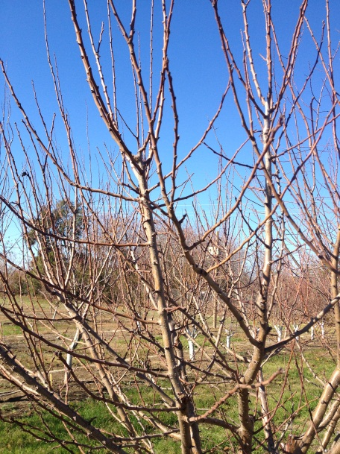
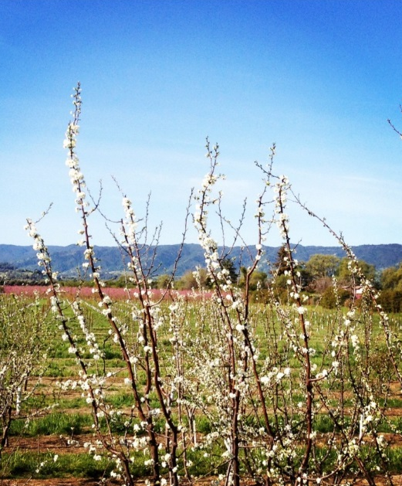
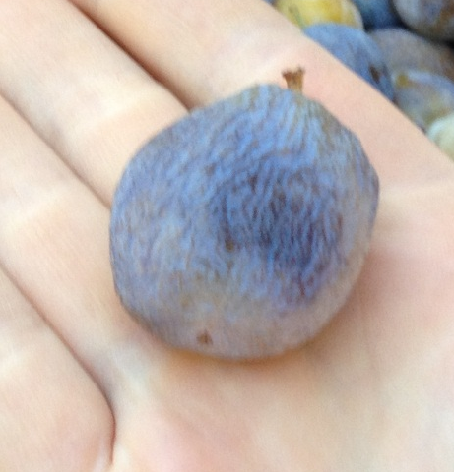
Current Program Objectives
Reduce Grower operation costs by introducing new, more efficient cultivars
  Reduce pruning
  Reduce drying costs
  Change bloom & harvest
  time

Slide 4
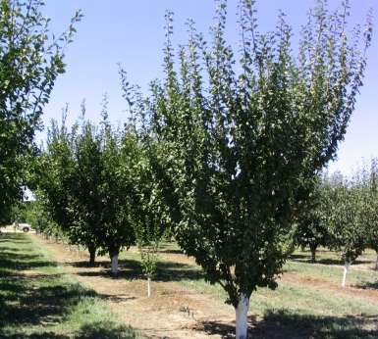
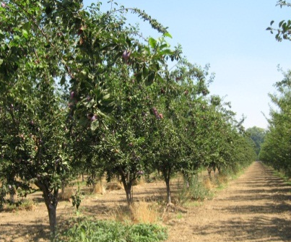
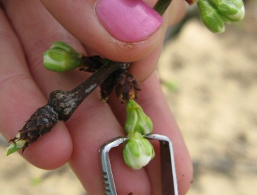
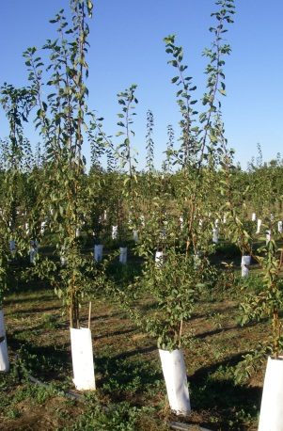
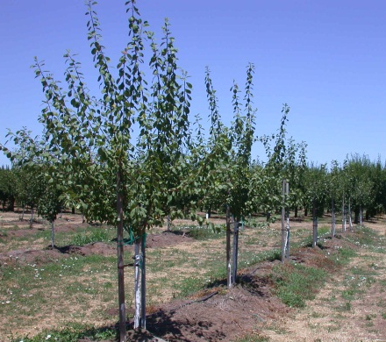
Cultivar Development Process
Level 1
Seedling Block (4-6 yrs)
Level 2
Selection Block (Kearney & Winters)
(3-6 yrs)
Level 3
Grower’s Orchards
(4-7 yrs)
Level 4
Patented or large grower plantings
Pollination
Notes:
This is the development process that we put our trees through in our program. We make controlled crosses then plant the progeny of those crosses in our Level 1 Seedling block. Once those trees look to be promising, we then promote them to Level 2 and they are grafted in our selection blocks at Kearney and Winters. When at the selection block, the trees are evaluated for their fruit attributes as well as their tree structure. If those attributes are positive, we will then graft test trees in Grower’s Orchards to insure that these trees will be successful in other parts of the state. We also want to insure that the grower like the tree. Once those small trials are successful, we then will promote the tree to Level 4, this is where we work with the processors to perform a large scale over 40 acre (16 ha) trial. Once the processor approve of the fruit, then the tree can be patented and released.

Slide 5
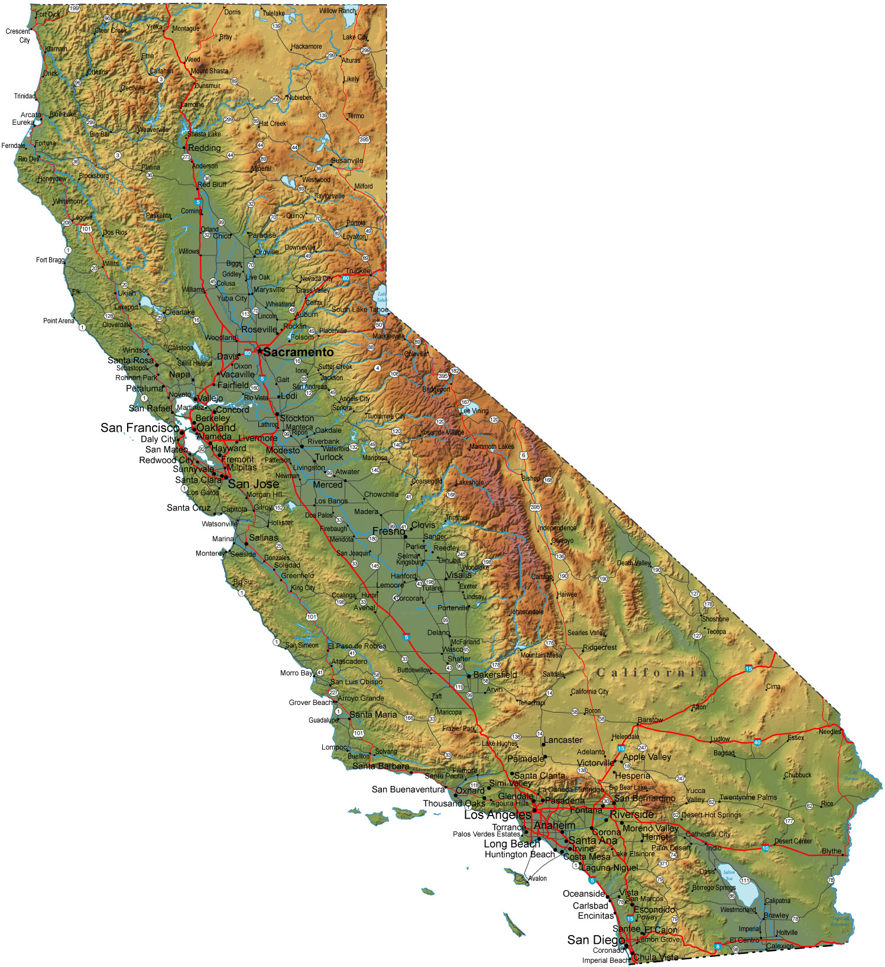
Level 2
Selection Testing: 2 Locations in California
North Valley:
Wolfskill Experimental Orchards
Winters, California
Trees in selection blocks are tested for fresh & dried fruit attributes as well as the tree structure and ability to withstand high heat.
Kearney Ag Station can get to 43C during the summer!!
San Joaquin Valley
Kearney Agricultural Station
Parlier, California
Notes:
In our Level 2 selection testing we have two orchards in California. One in Winters, CA which will be on the tour today. The other is at the Kearney Agricultural Station in Parlier CA. That orchard will be on Friday’s tour. Trees in selection blocks are tested for fresh & dried fruit attributes as well as the tree structure and ability to withstand high heat. Testing the trees at two locations insures the fruit will be able to be grown up and down the state. Also, it gets extremely hot at Kearney over the summer. It can get as hot as 43C over the summer. This is a great stress test for our trees. Many trees are rouged out for problems with Pit Burn from the heat.

Slide 6
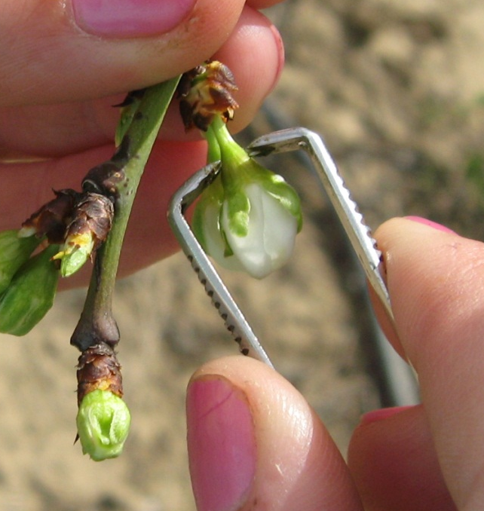
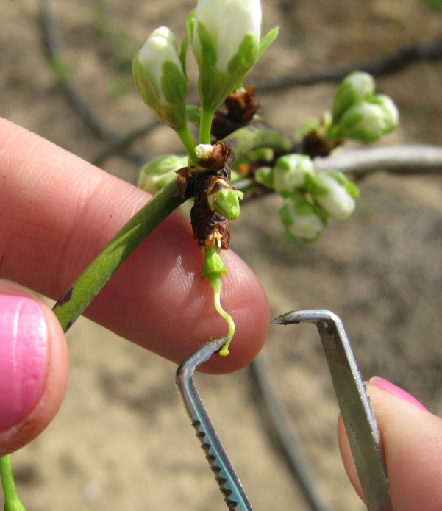

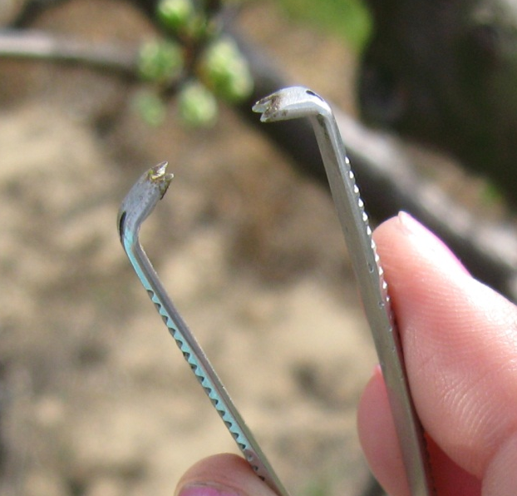
Bloom Protocol: Emasculation
Notes:
These are pictures depicting the our emasculation method while performing controlled crosses. We remove all of the flower parts with the exception of the stigma, which is then pollinated.

Slide 7
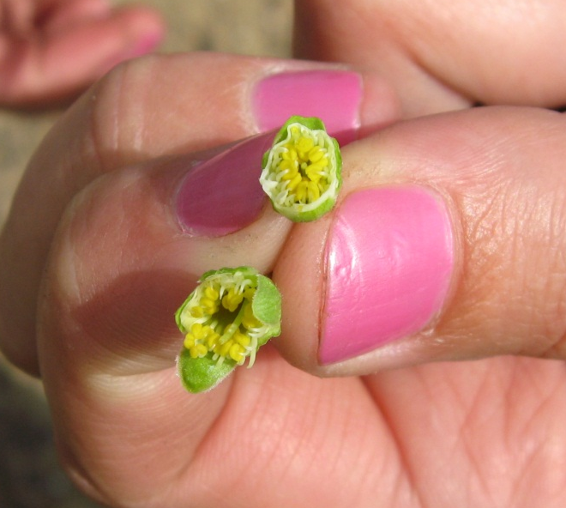
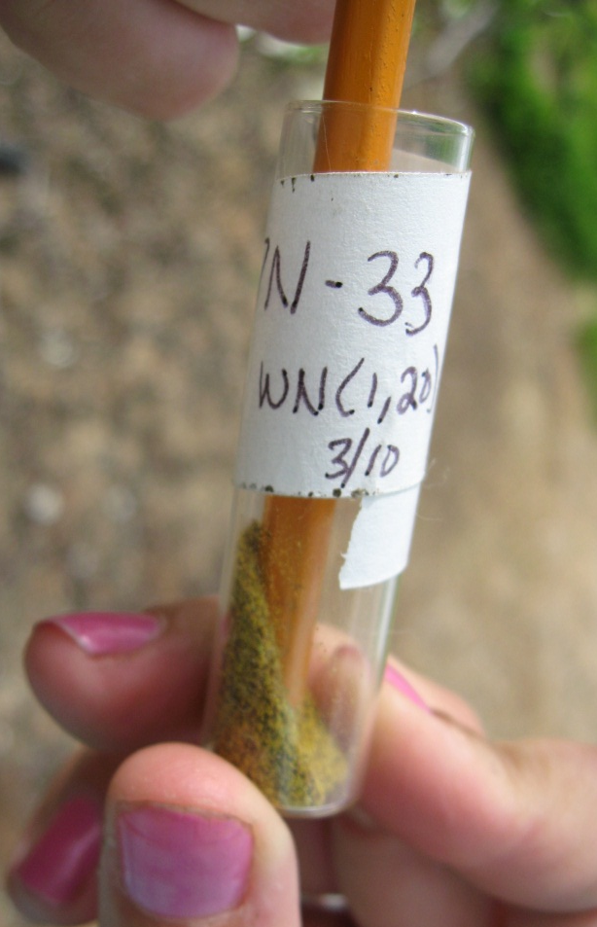
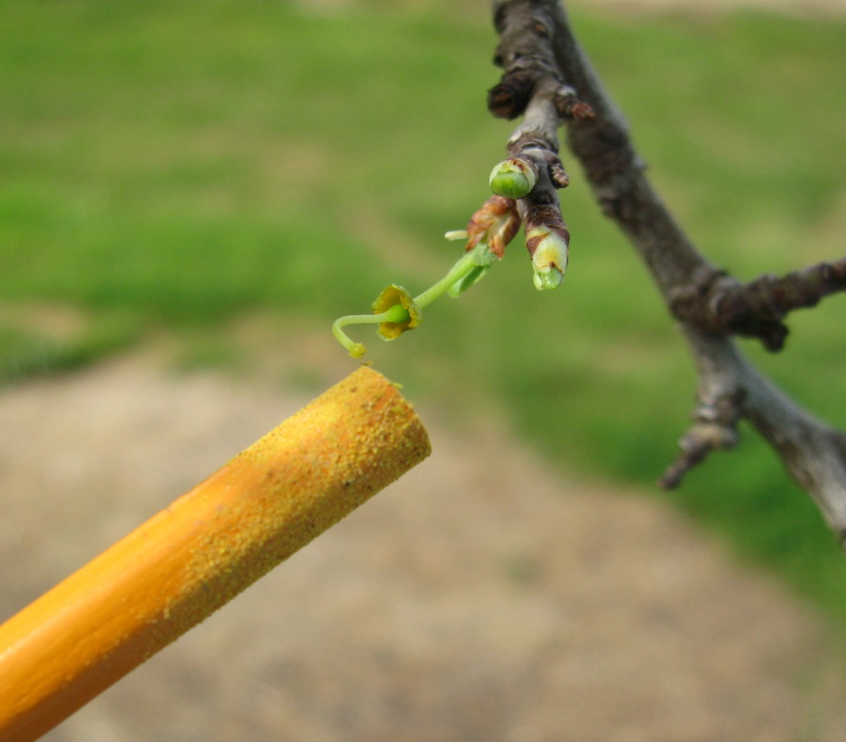
Controlled Cross Pollination
Notes:
Here are pictures showing the pollination method. We will emasculate a whole branch and then pollinate it.

Slide 8
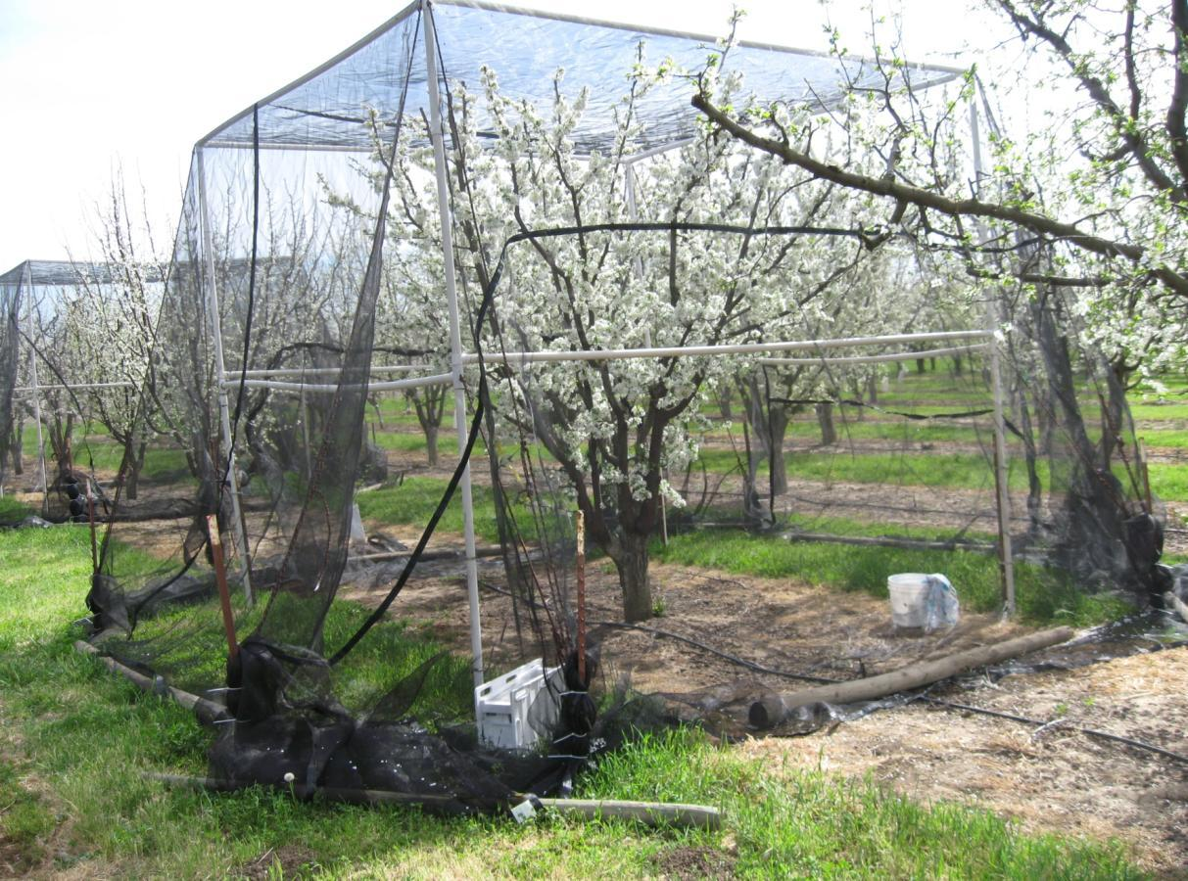
Bloom Cages
Used to determine pollen self-compatibility
Cages designed and created by Carolyn Debuse
Notes:
We need to test all of our promising cultivars for the ability to self pollinate. We do this by caging individual trees with screen and placing bees within the screen.

Slide 9
Seedling Block Evaluations
Fruit maturity date
Fruit size and shape
Fruit defects (fruit end and side cracks, pit burn)
Fresh fruit attributes:
  Flavor
  % soluble solids (sugar content)
  Juicyness
  Pit size and tightness (freestone or clingstone)
  Skin toughness
  Flesh density
Dried fruit attributes
  Dry away ratio (fresh/dry weight ratio)
  Process-ability
  Look & taste
  Flesh and skin durability

Slide 10
Selection Block Evaluations
Bloom date
Harvest date
Tree Structure
Fresh Fruit Attributes
  Flavor
  % soluble solids (sugar content)
  Juicyness
  Pit size and tightness (freestone or clingstone)
  Skin toughness
  Flesh density
Dried Attributes
  Dry away ratio (fresh/dry weight ratio)
  Process-ability
  Look & taste
  Flesh and skin durability

Slide 11
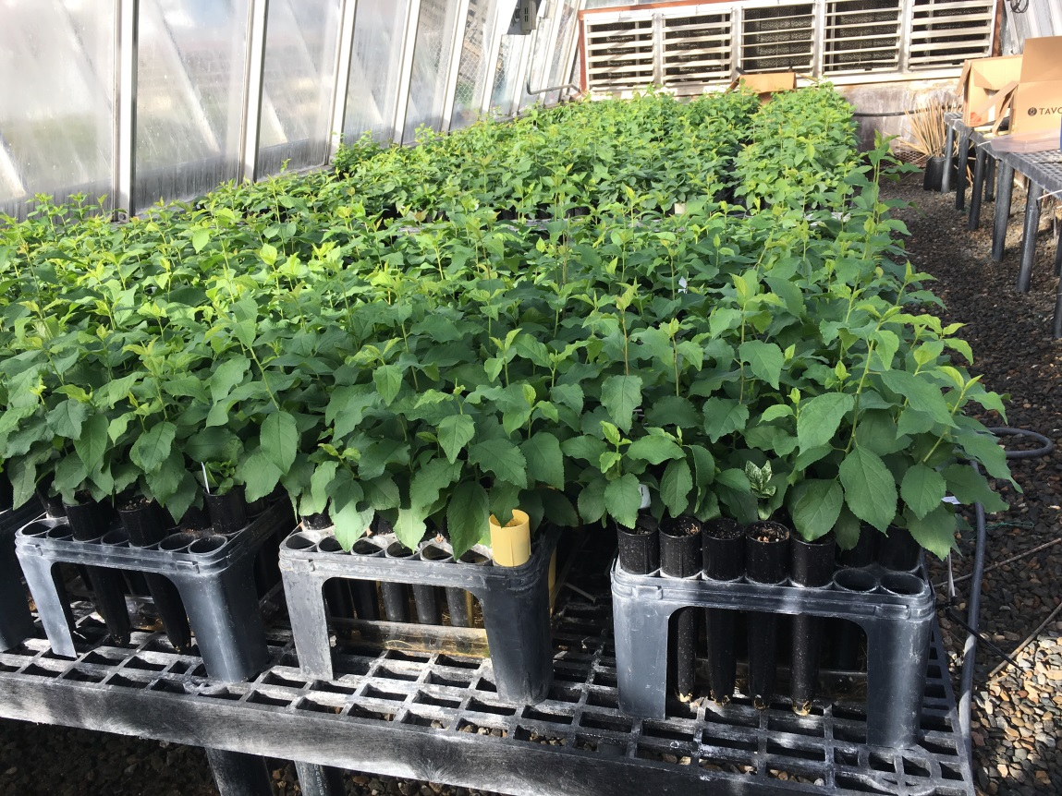
Program Inventory
Block | Acres | Year Planted | Seedlings Planted | Seedlings Remaining
I | 3 | 2008-2012 | 2,656 | 650
J | 4 | 2013-cont. | 5,022 | 3,371
Seeds |  | 2016 |  | (1,660)
 |  | 2017 |  | (5,875)
Totals | 7 |  | 7,678 | 4,021
Level of Testing | Number of Items | Number of new 2017 additions
Level 1 | 4,021 | 1,660 (5,875)
Level 2 | 109 | 34
Level 3 & 4 | 4 | 3
Fresh Items | 11 | 2
Breeding Items | 82 | 5
Germplasm Items | 80 | 8
Items Removed | 20

Slide 12
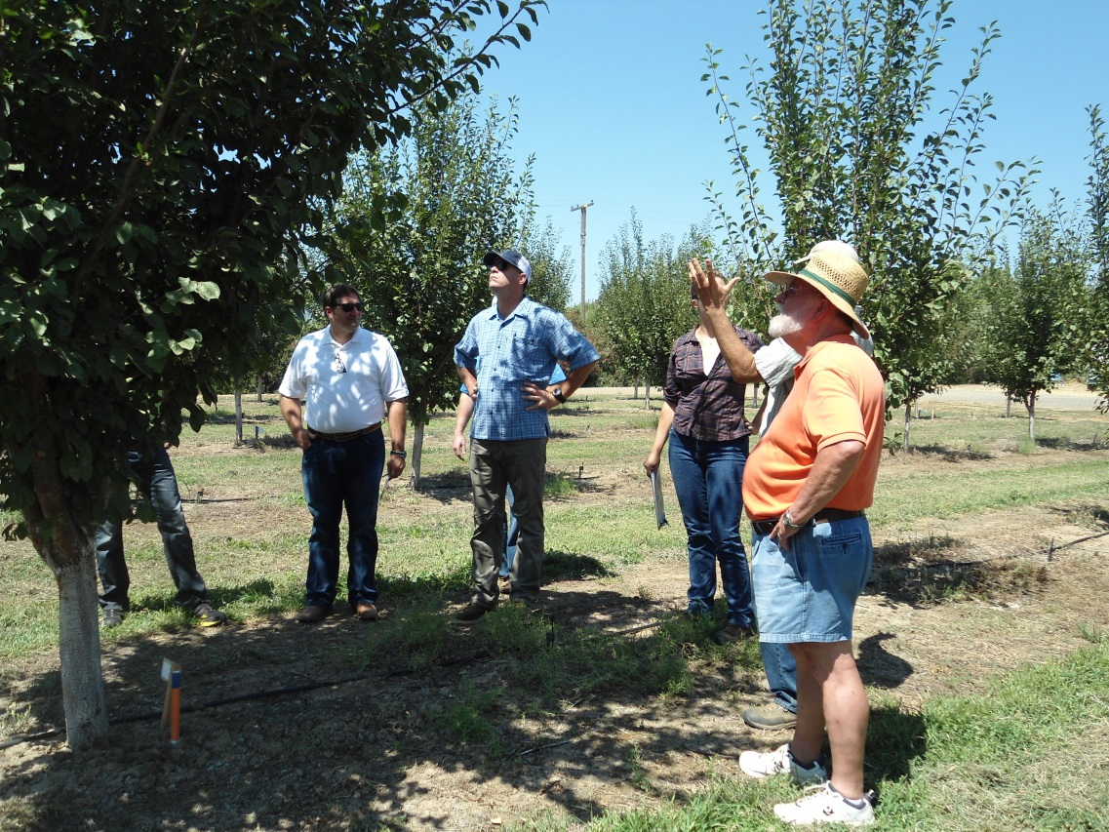
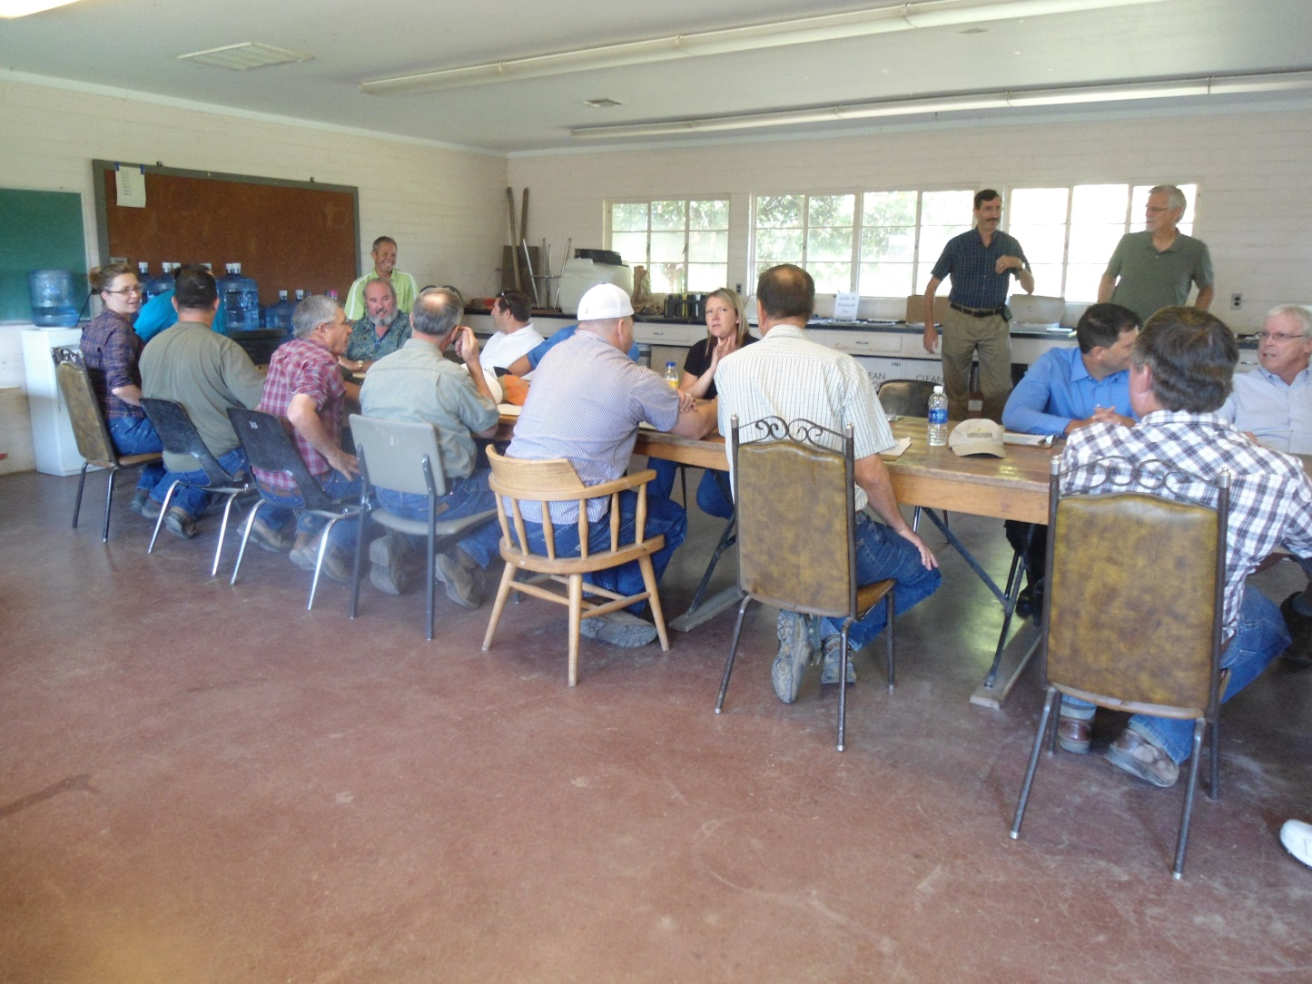
We work closely with the CA Industry
Field meetings held in summer at Wolfskill Experimental Orchards in Winters, CA

Slide 13

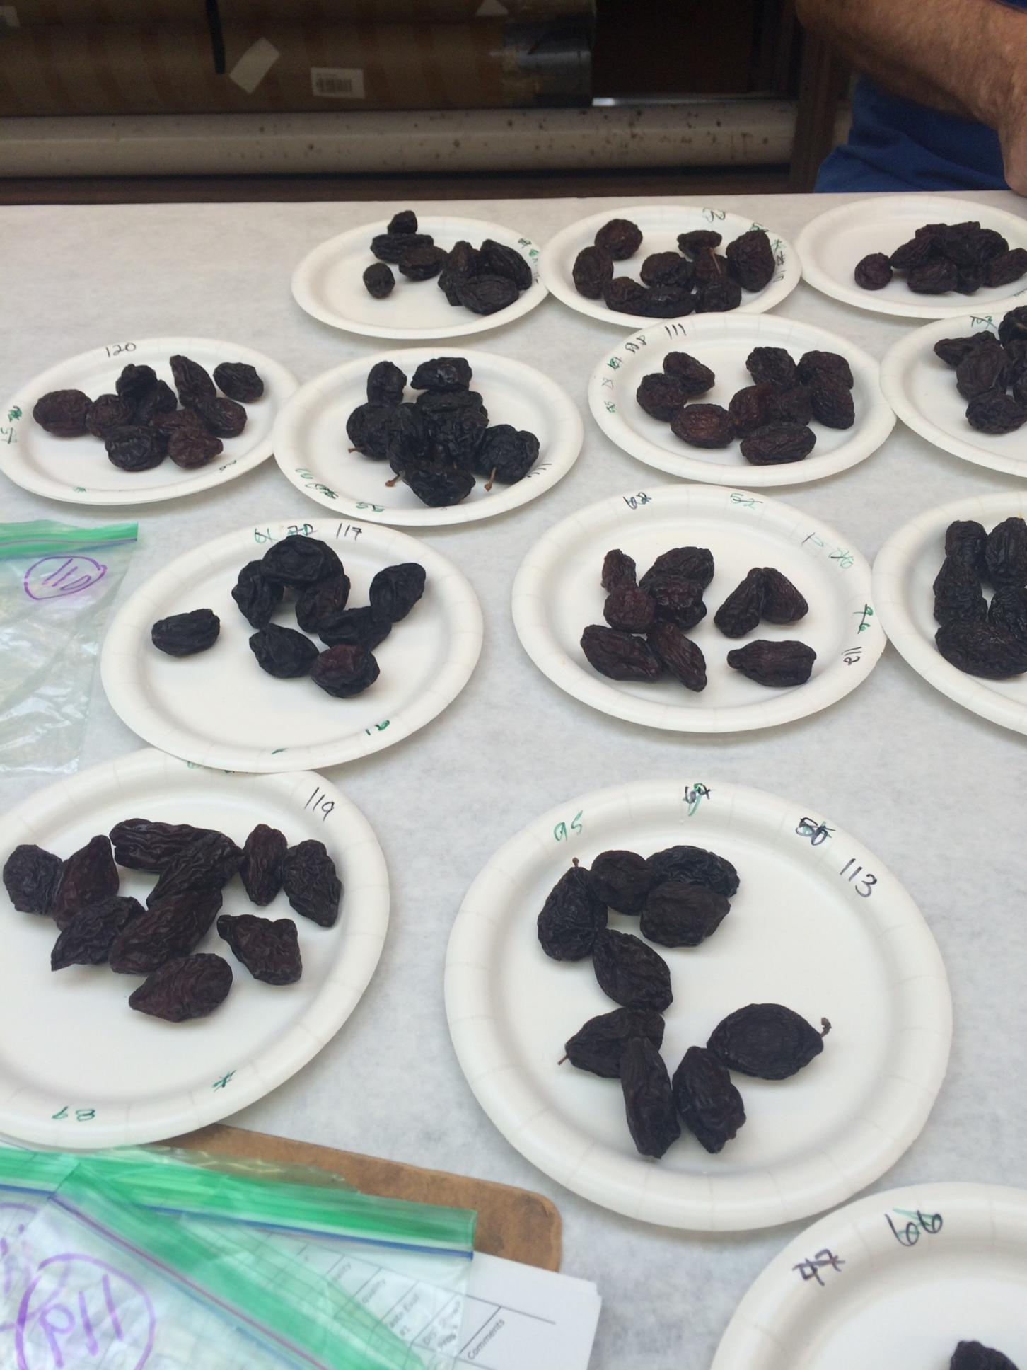
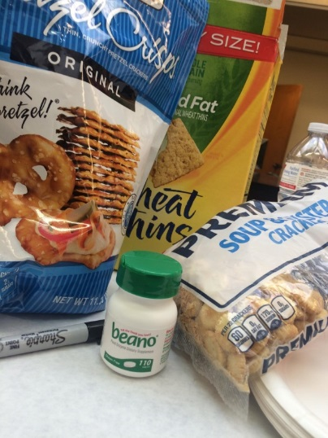
In house dried fruit tastings in Fall.
Usually >200 selections evaluated by Ted and Sarah
Rated for: Skin color, Wrinkles, Skin Peel, Surface Brightness, Shape, Pit Size, Pit Type, Flesh Color, Flesh Quality, Skin Quality & Taste.
Report to CPB and CPB Research Committee dried fruit tasting of top items in late Fall.
(Usually about 10 selections)

Slide 14
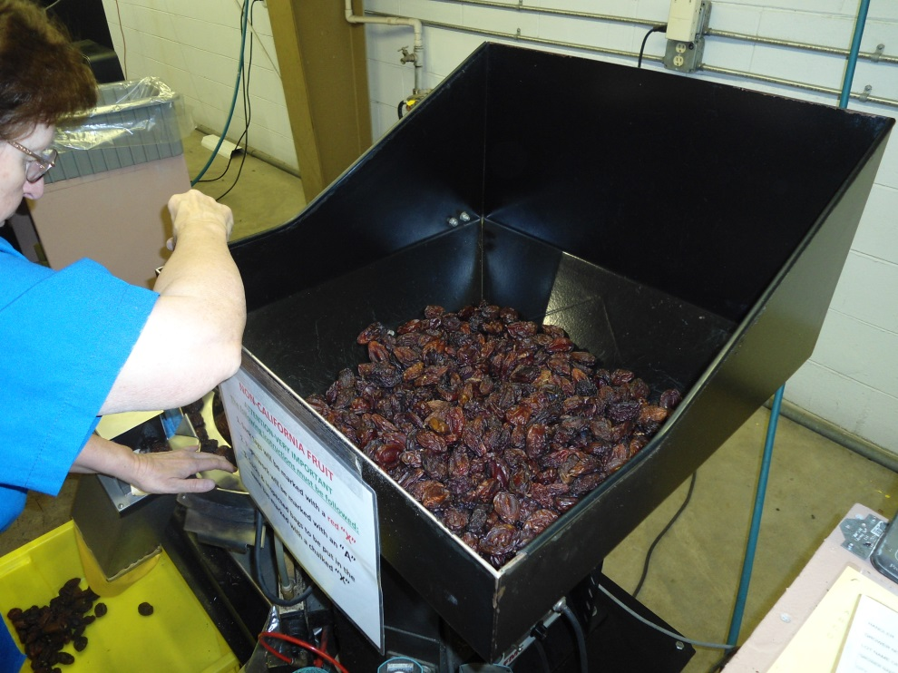
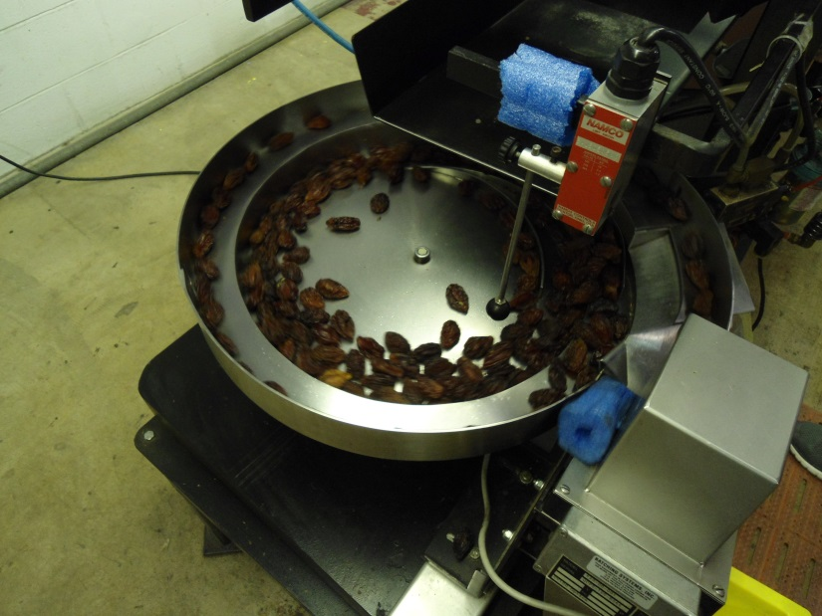
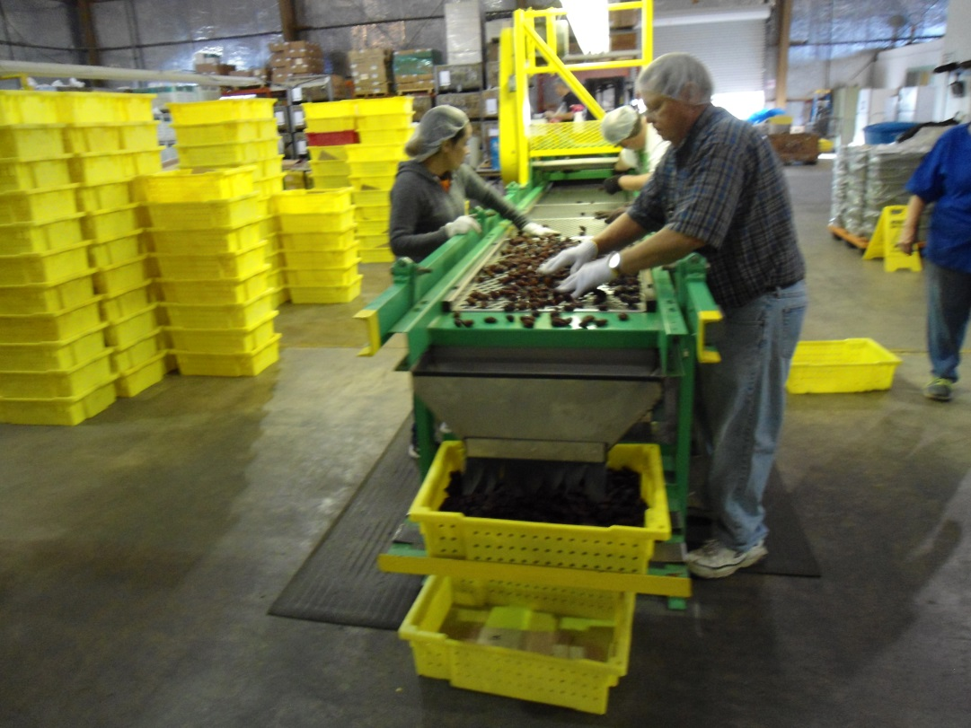
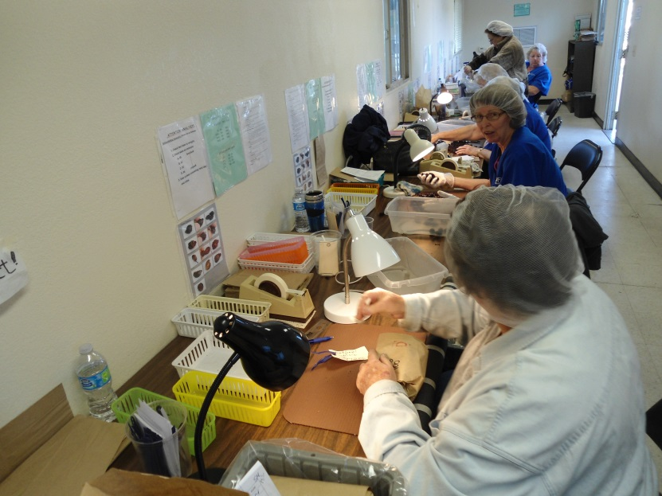
Dried Fruit Association Grading

Slide 15
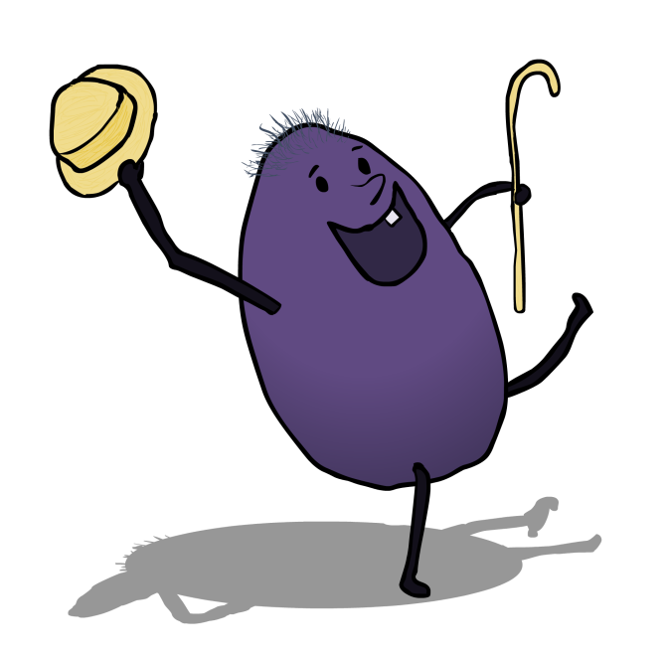
How are we doing?
Reduced drying costs:
All of our top selections have a dry
away ratio of 3 or less
35% of our top items have a dry
away ratio of 2.5 or less
  Level 1: 8 out of 34
  Level 2: 5 out of 8
  Level 3: 3 out of 4

Slide 16
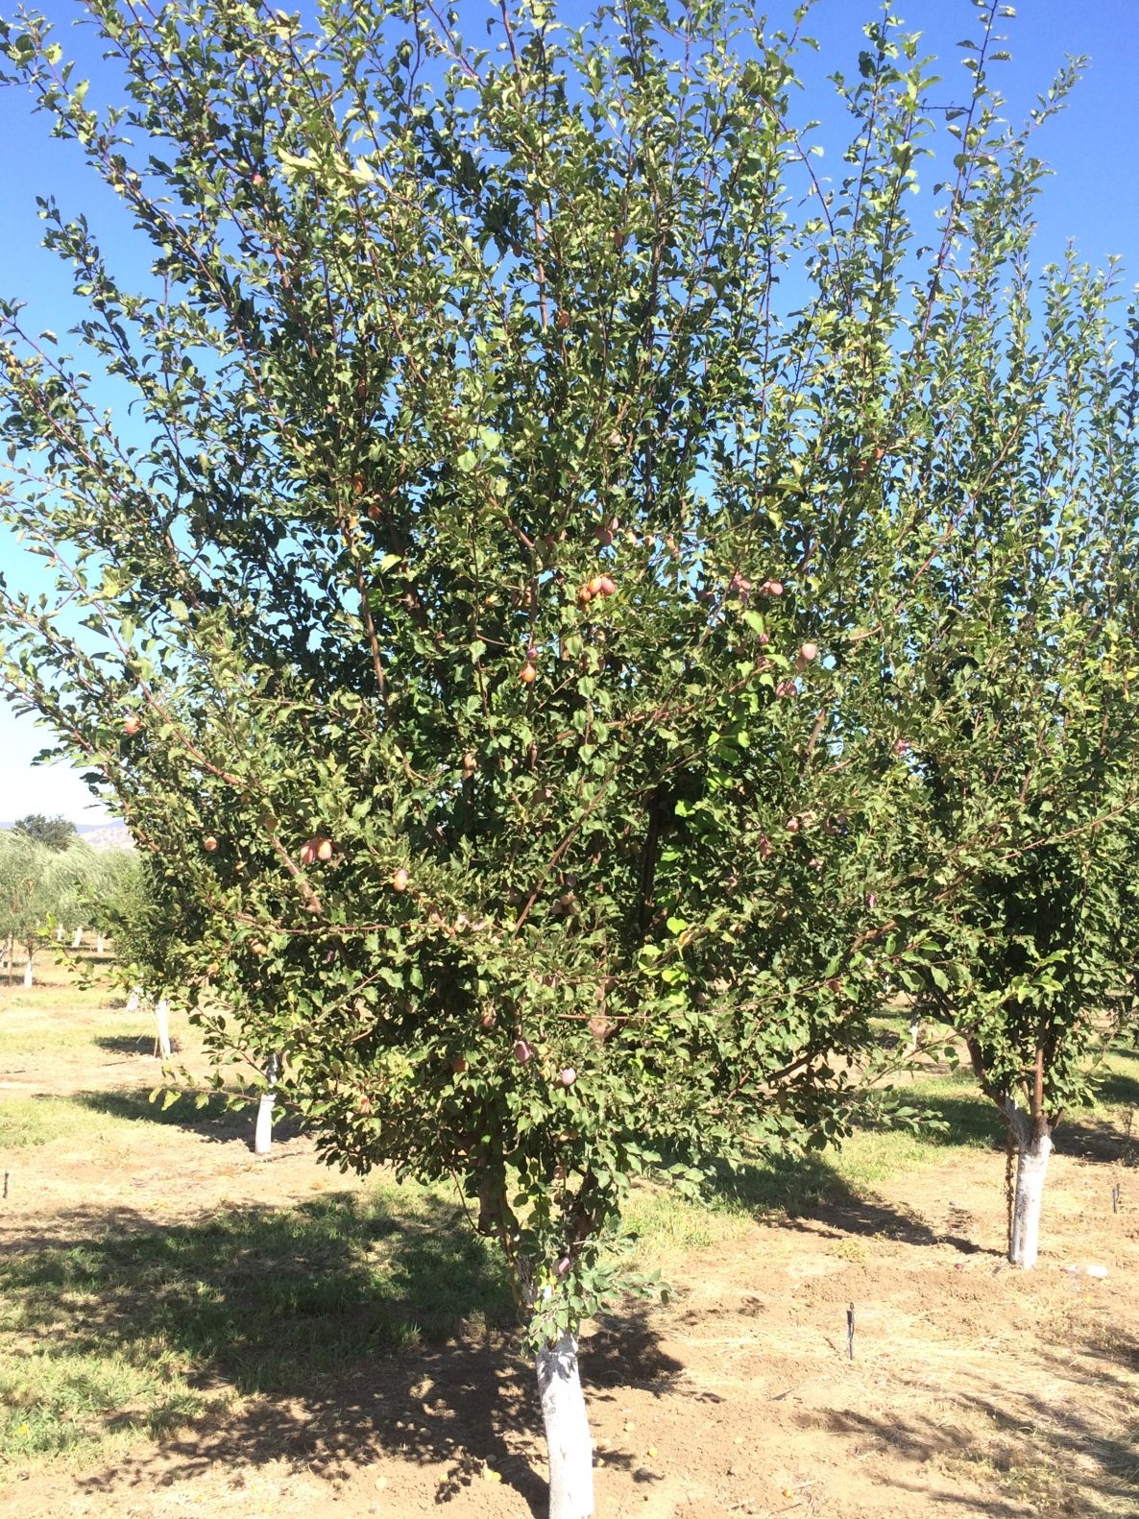
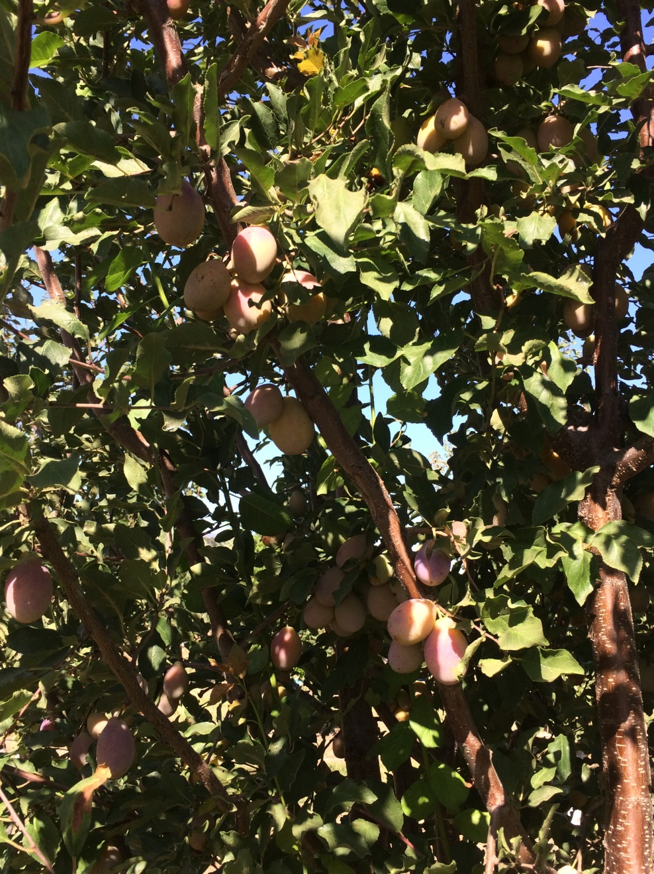
H13S-58

Slide 17
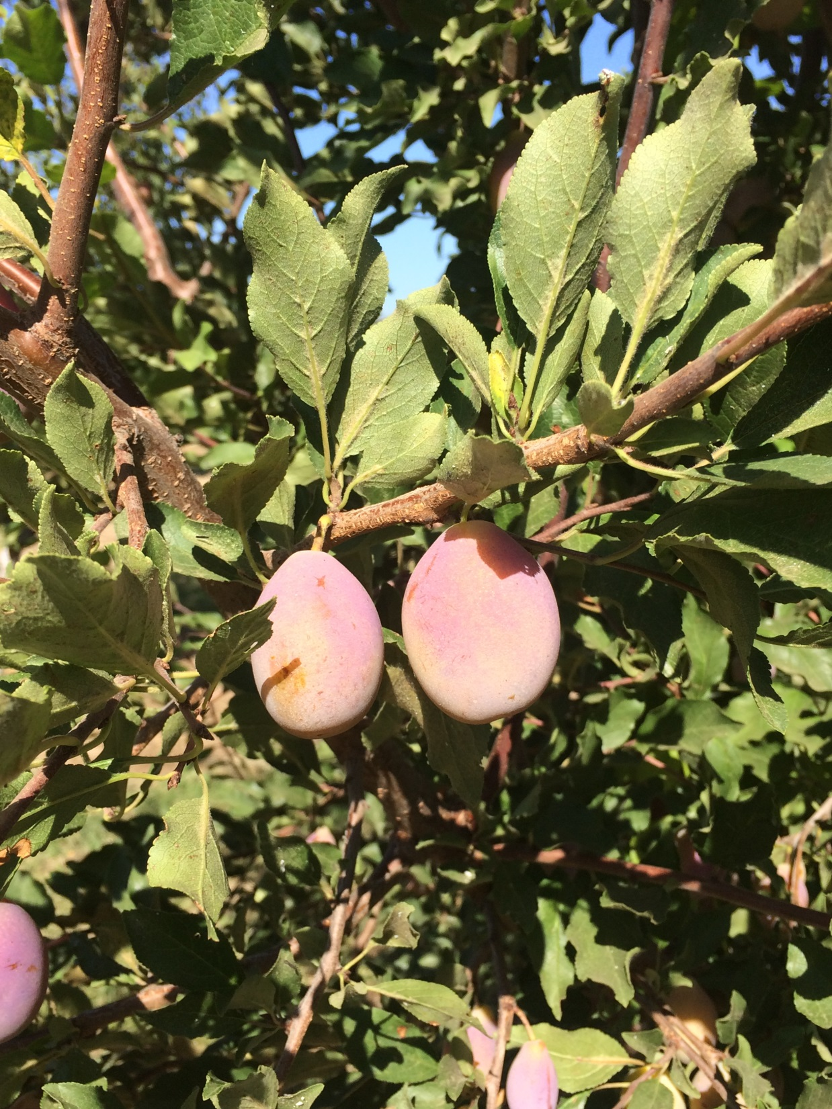
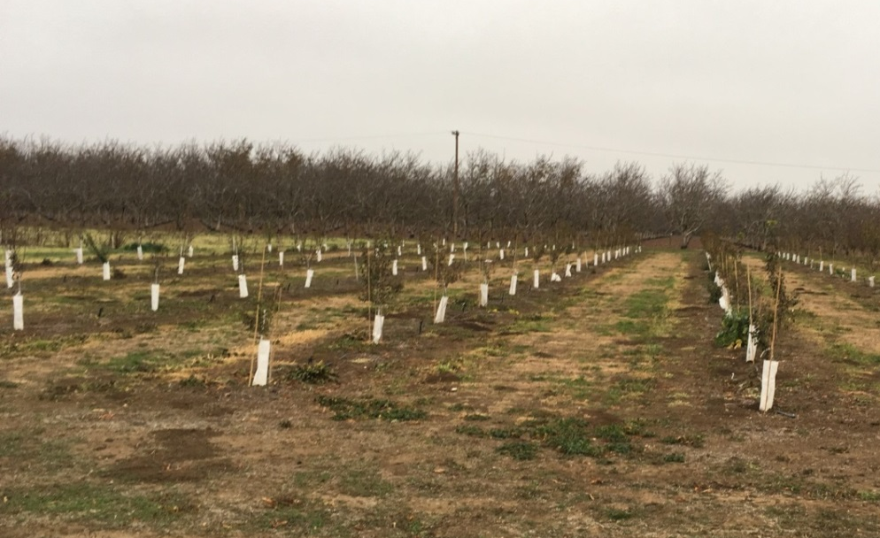
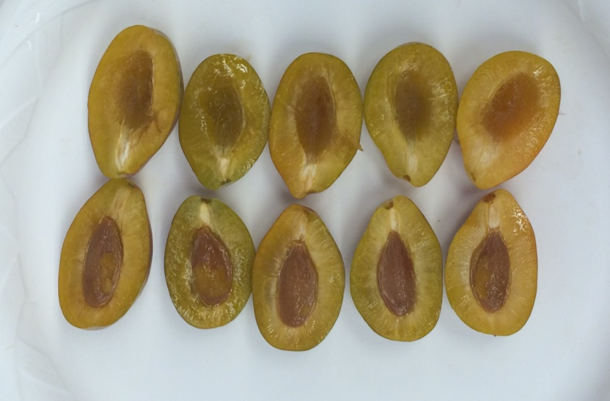

Slide 18
H13S- 58: 2014 - 2017
Date | Location | Days from Imp. French | Weight (g/ft) | Pressure | Sugar in Brix | Dry away ratio | Dried size ct/lb
8/29/2014 | Kearney | +11 | 21.8 | 4.9 | 28.7 | 2.6 | 55.5
8/3/2015 | Winters | -7 | 22.4 | 5.8 | 24 | 2.6 | 52.9
8/7/2015 | Kearney | +5 | 27.5 | 3.3 | 30.2 | 2.4 | 46.1
7/20/2016 | Kearney | -20 | 29.9 | 4.7 | 22.8 | 2.9 | 46.4
8/8/2016 | Winters | -4 | 27.6 | 3.1 | 20 | 2.3 | 40.4
8/15/2016 | Winters | +3 | 24 | 3.2 | 30.3 | 2.2 | 45.2
8/10/17 | Kearney | -6 | 29.6 | 4.3 | 26.0 | 2.4 | 40.4
8/31/17 | Kearney | +15 | 26.2 | 3.0 | 31.2 | 2.2 | 41.1
8/21/17 | Winters | +1 | 23.2 | 4.4 | 24.0 | 2.5 | 49.2
8/28/17 | Winters | +8 | 21.7 | 5.4 | 27.9 | 2.7 | 61.1
9/5/17 | Winters | +16 | 20.0 | 6.1 | 30.9 | 2.5 | 53.3

Slide 19
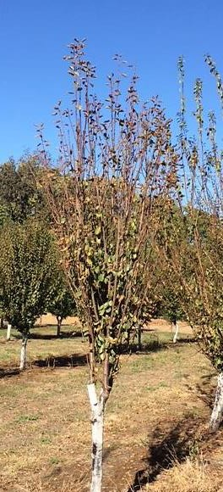
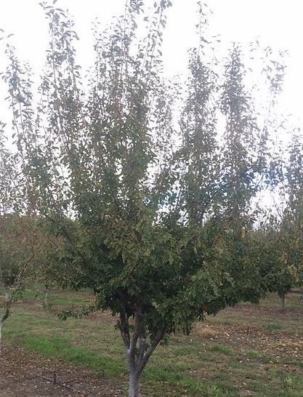
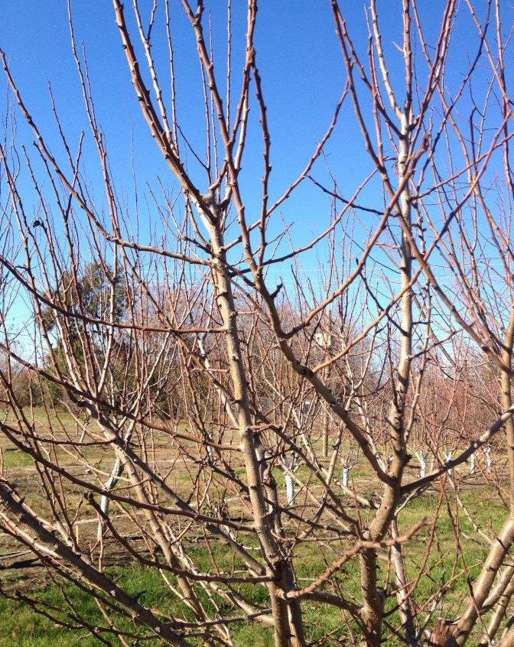
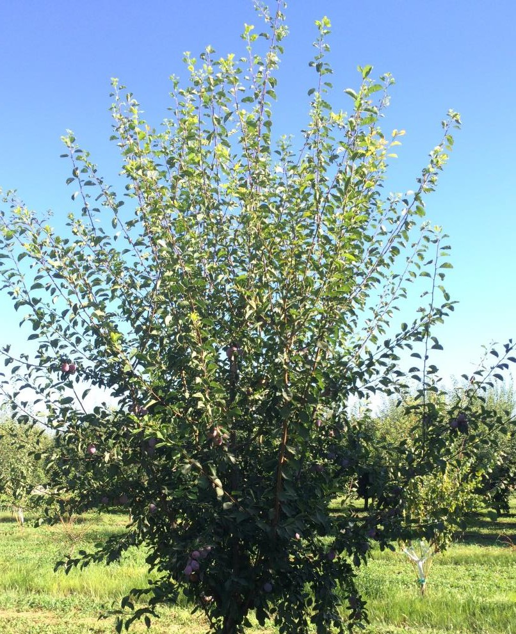
Reduce pruning costs
Short internodes
Spreading upright
Columnar
The program has trees with many different structural types. Some have potential to fit different management systems such as mechanical pruning, or minimal pruning.
Thin secondary wood

Slide 20
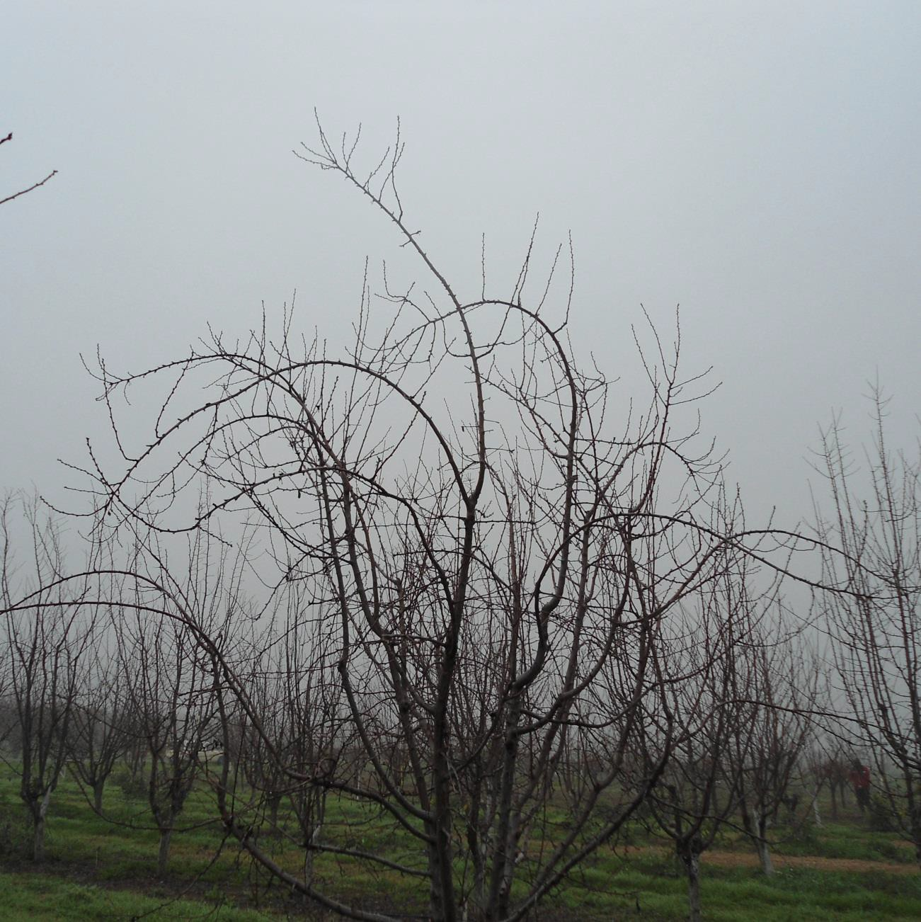
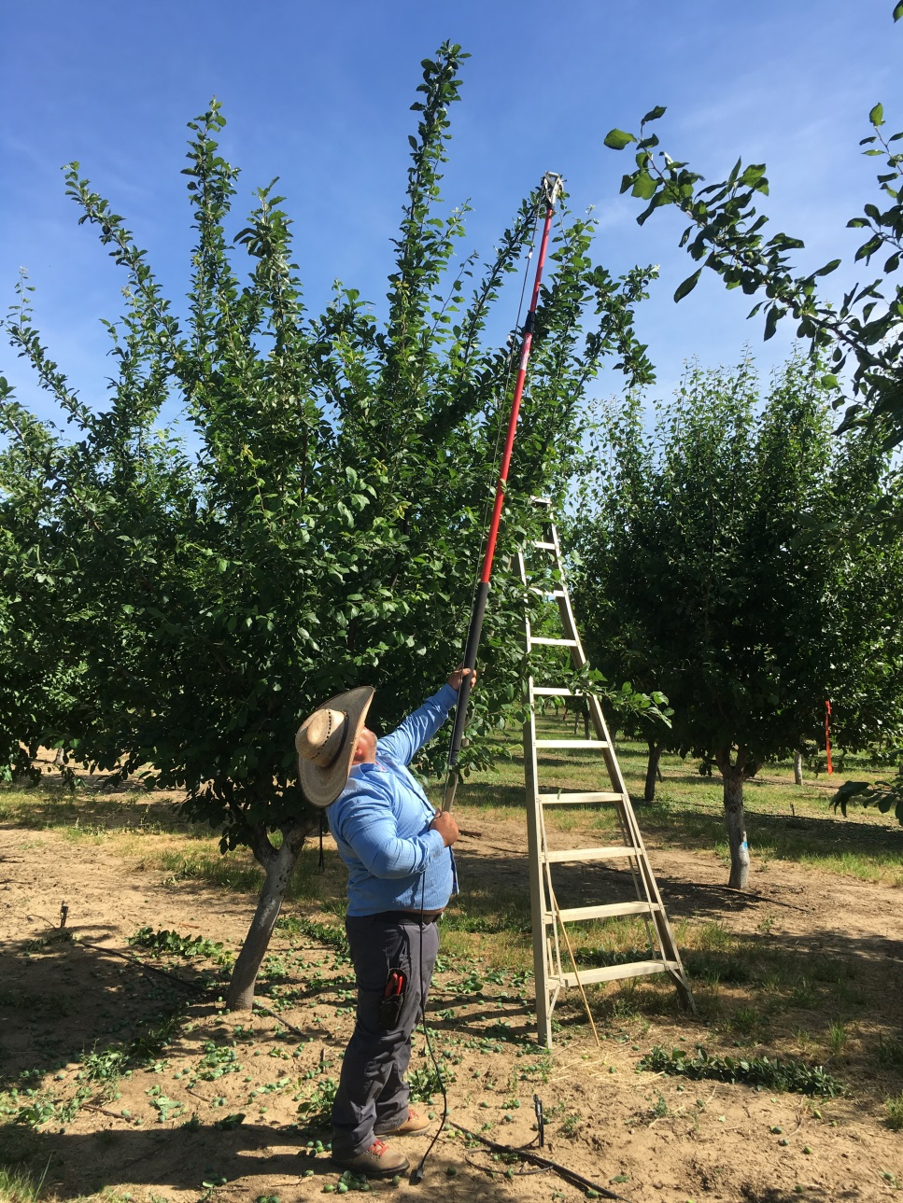
Pruning
Precocity in trees limits suitability for long pruning

Slide 21
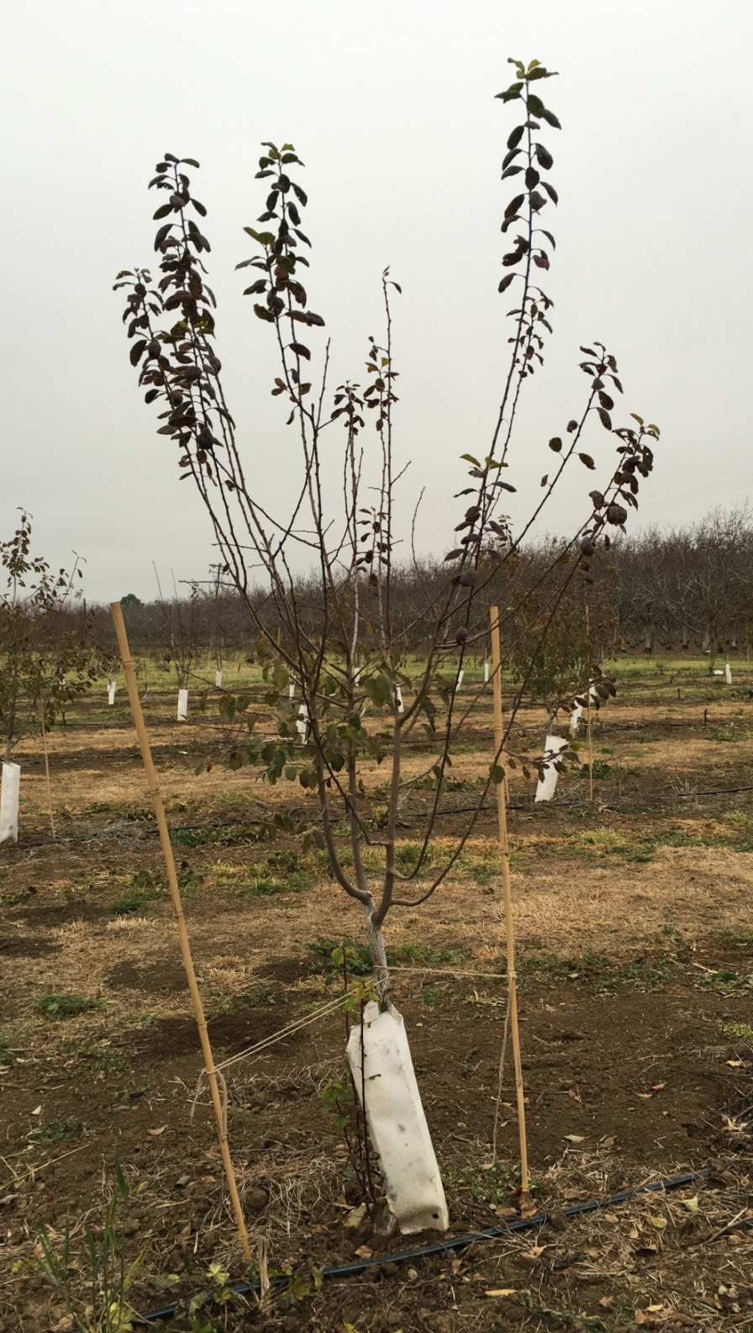
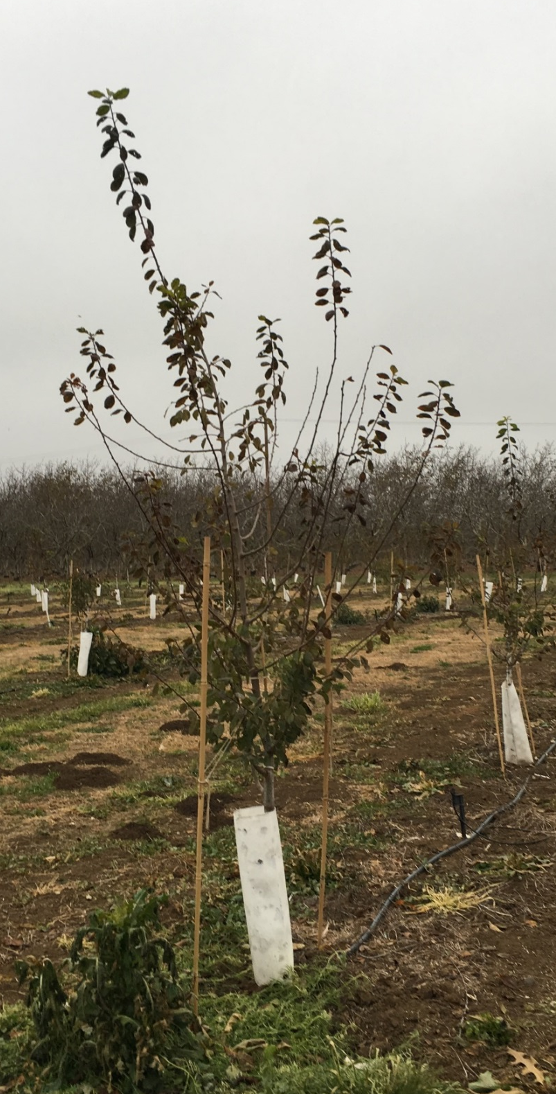
Central leader
Conventional

Slide 22

BLOOM
Spread the risk of potential crop failure from weather problems during bloom

Slide 23
Bloom Data
Item Name | 2017 Full Bloom Date (90%) | Days in Bloom 2017 | Days from Imp. French 2017 | Average Days from Imp. French
G37S- 45 | 14-Mar | 9 | -5 | -6
F11S- 38 | 16-Mar | 9 | -3 | -10
G43S- 15 | 15-Mar | 11 | -4 | -7
H13S- 65 | 13-Mar | 12 | -6 | -10
H13S- 58 | 19-Mar | 11 | 0 | -4
H21N-101 | 12-Mar | 11 | -7 | -9
H9S-27 | 15-Mar | 7 | -4 | -6
H16N- 83 | 15-Mar | 11 | -4 | -10
H3S- 70 | 14-Mar | 15 | -5 | -9
H18N- 42 | 15-Mar | 13 | -4 | -8
G21N-20 | 20-Mar | 11 | +1 | +2
H7S- 1 | 19-Mar | 9 | 0 | 0
H10N- 88 | 12-Mar | 9 | -7 | -9

Slide 24
Bloom Spread 2016 & 2017

Slide 25
Bloom Spread 2013-2017
With chill portions & Chill hours

Slide 26
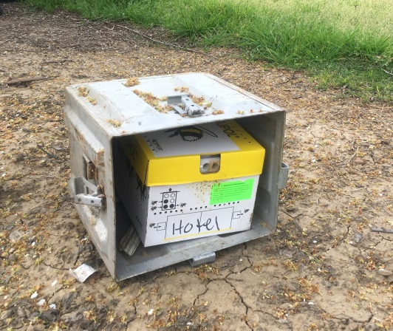
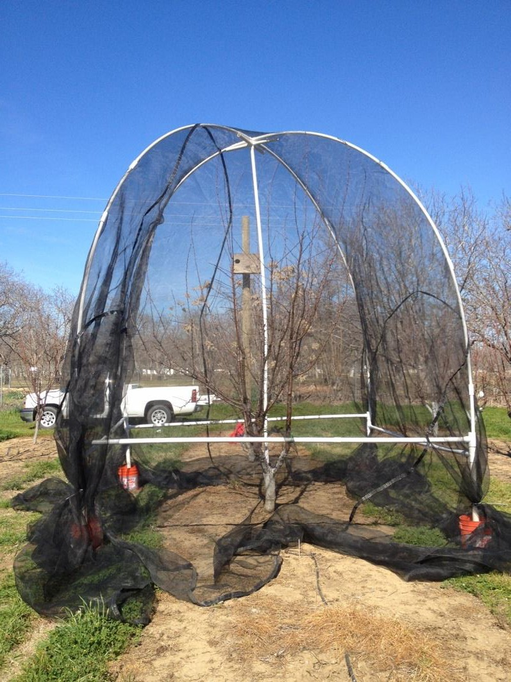
Pollination Compatibility
Items to cage 2018: G37S-45, G43S-15, H13S-65, & H13S-58
Pollen compatibility issues has inspired a USDA SCRI grant preproposal (Submitted 12/8/17) that would be a collaboration between UCD, UCB, USDA-ARS, Clemson & Oklahoma State

Slide 27
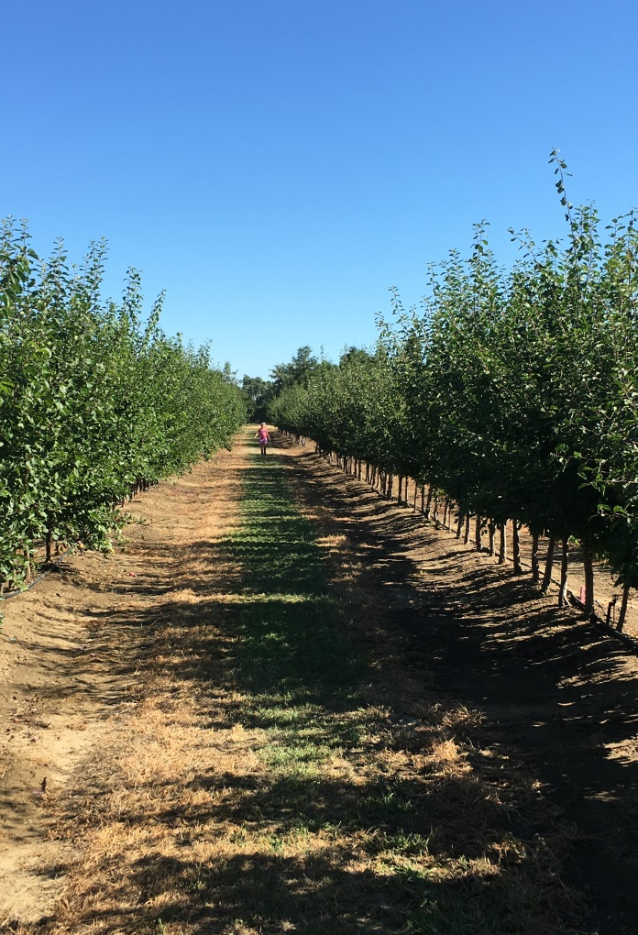
Seedling
Selections
Harvest date | Item name | Days +/- French | Weight (g/frt) | Pressure | Sugar in Brix | Dry away ratio | Dry count per lb.
7/18 | I1S- 39 | -37 | 26.4 | 3.8 | 23.2 | 2.9 | 51.7
7/30 | I15S- 33 | -26 | 30.8 | 4.4 | 24.8 | 3.0 | 50.9
8/8 | J1S- 96 | -17 | 30.0 | 5.0 | 26.5 | 2.7 | 42.8
8/10 | I13N-18 | -15 | 28.0 | 2.7 | 22.1 | 3.0 | 49.9
8/10 | I11N- 4 | -15 | 21.6 | 1.8 | 24.2 | 2.8 | 56.9
8/10 | I4N-6 | -15 | 31.9 | 3.7 | 22.5 | 3.0 | 43.6
8/10 | I6N- 69 | -15 | 25.2 | 6.4 | 21.4 | 3.1 | 46.0
8/11 | I7N- 5 | -14 | 26.5 | 6.0 | 32.5 | 2.0 | 41.4
8/11 | I9N- 73 | -14 | 26.8 | 2.8 | 26.7 | 2.4 | 51.8
8/11 | I7S- 29 | -14 | 26.7 | 4.1 | 20.6 | 3.0 | 54.3
8/11 | J3N-140 | -14 | 34.2 | 3.8 | 23.5 | 2.9 | 42.5
8/11 | J3S- 60 | -14 | 24.0 | 2.4 | 25.7 | 2.6 | 53.1
8/15 | I4N- 6 | -10 | 29.9 | 2.7 | 23.7 | 2.9 | 46.3
8/15 | J4N-189 | -10 | 38.1 | 5.2 | 24.0 | 2.8 | 33.5
8/15 | J6N- 174 | -10 | 25.6 | 6.0 | 25.3 | 2.6 | 48.8
8/15 | J6N-124 | -10 | 25.2 | 4.5 | 22.3 | 2.9 | 50.8
8/15 | J7N-116 | -10 | 24.4 | 5.2 | 25.1 | 2.7 | 57.7
8/15 | J6N- 118 | -10 | 34.0 | 6.5 | 24.2 | 2.6 | 30.3
8/23 | I14N- 23 | -2 | 25.3 | 4.9 | 23.8 | 3.0 | 57.0
8/23 | I14N- 31 | -2 | 20.5 | 2.1 | 26.4 | 3.0 | 72.5
8/23 | I5S- 27 | -2 | 33.4 | 5.1 | 26.7 | 2.7 | 37.7
8/23 | I14S- 28 | -2 | 20.7 | 5.0 | 26.6 | 2.4 | 52.9
8/24 | I2S- 44 | -1 | 25.2 | 3.6 | 23.8 | 2.9 | 50.0
8/29 | I12N- 78 | +4 | 24.8 | 5.9 | 29.7 | 2.5 | 47.5
8/29 | I14S- 52 | +4 | 41.9 | 4.4 | 26.7 | 2.3 | 24.4
8/29 | I14S-58 | +4 | 31.2 | 5.5 | 24.5 | 2.9 | 44.8
8/29 | I12N- 46 | +4 | 28.5 | 7.0 | 28.1 | 2.6 | 41.5
8/29 | J2S- 62 | +4 | 25.7 | 3.5 | 27.0 | 2.6 | 52.0
8/29 | J5S- 104 | +4 | 28.5 | 5.8 | 27.6 | 2.6 | 43.7
8/29 | J6S- 54 | +4 | 22.6 | 6.6 | 29.1 | 2.4 | 50.4
9/7 | I8S- 28 | +13 | 38.0 | 3.9 | 25.7 | 2.9 | 45.5
9/7 | J1S- 46 | +13 | 24.3 | 5.5 | 29.3 | 2.4 | 48.6
9/7 | I12S- 58 | +13 | 38.3 | 5.0 | 25.4 | 2.8 | 36.2
9/7 | J1S- 22 | +13 | 28.7 | 3.0 | 30.6 | 2.3 | 35.2
33 selected as potential cultivars

Slide 28
Top Selection Block Items
Harvest date | Item Name | Days +/- French | Weight (g/frt) | Pressure | Sugar in Brix | Dry away ratio | Dry count per lb.
7/11 | H21N-101 | -36 | 25.5 | 0.9 | 32.1 | 2.4 | 55.5
8/21 | H18N- 42 | +1 | 22.3 | 2.8 | 29.9 | 2.5 | 55.1
8/21 | H9S-27 | +1 | 20.6 | 5.1 | 28.8 | 2.4 | 52.5
8/21 | H16N- 83 | +1 | 37.7 | 3.7 | 24.9 | 2.6 | 31.2
8/22 | H3S- 70 | +2 | 21.4 | 4.1 | 22.5 | 3.0 | 68.9
8/28 | H18N- 42 | +8 | 24.3 | 2.3 | 30.5 | 2.3 | 51.8
8/28 | G21N-20 | +8 | 27.8 | 4.9 | 24.2 | 2.9 | 41.6
9/5 | H7S- 1 | +14 | 27.1 | 6.7 | 32.4 | 2.4 | 37.9
9/6 | H10N- 88 | +15 | 31.0 | 4.4 | 28.3 | 2.4 | 34.6

Slide 29
Tops selections in 2017
Tasting number | Test date | Name | days from French | weight (g/fruit) | Pressure | BRIX | count per lb | dry away ratio | Avg. taste evaluation (1=bad, 5=excellent)
1 | 7/7 | H21N-101 | -34 | 25.4 | 3.8 | 32.3 | 44.5 | 2.3 | 3.8
2 | 8/8 | G37S- 38 | -4 | 31.1 | 4.1 | 22.8 | 42.5 | 2.7 | 3.0
3 | 8/8 | H13S- 58 | -4 | 27.6 | 3.1 | 20.0 | 40.4 | 2.3 | 3.5
4 | 8/8 | H13S- 65 | -4 | 37.0 | 2.9 | 24.3 | 31.1 | 2.7 | 3.8
5 | 8/8 | H5N- 83 | -4 | 30.0 | 2.9 | 26.4 | 37.9 | 2.4 | 3.3
6 | 8/15 | H16N- 83 | 3 | 39.9 | 3.1 | 29.6 | 33.7 | 2.4 | 3.5
7 | 8/15 | H8S- 75 | 3 | 25.7 | 6.0 | 35.5 | 41.8 | 2.2 | 3.0
8 | 8/23 | G26N- 8 | 11 | 37.0 | 7.9 | 25.6 | 37.2 | 2.6 | 3.3
9 | 8/23 | G27N-31 | 11 | 26.9 | 5.5 | 23.7 | 47.4 | 2.9 | 4.0
10 | 8/23 | H15N- 92 | 11 | 31.5 | 6.7 | 27.9 | 36.0 | 2.6 | 3.3
 | 8/8 | Imp. French | +/-3 | 34.2 | 2.9 | 27.9 | 35.1 | 2.5 | 2.0

Slide 30
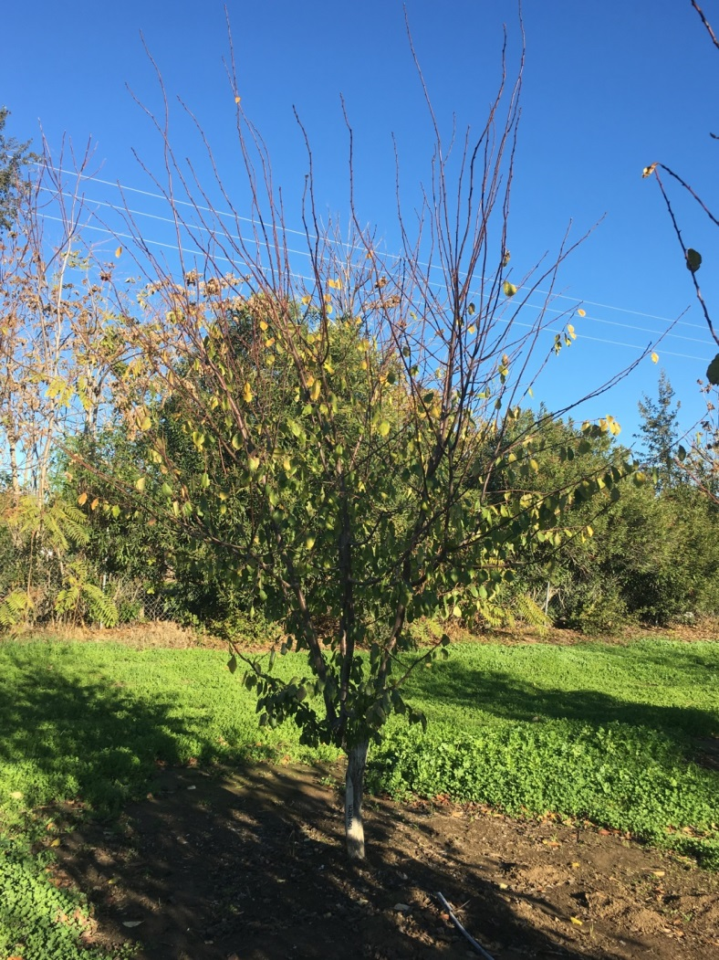
H21N- 101
Early harvest, 30 days before Improved French
Upright structure with long internodes
Dries on the tree, only dried for 18 hours @ 165F and got 2.3 dry away
Good tasting dried
Harvested last year at Kearney with good results
Bloomed 8 days before Improved French

Slide 31
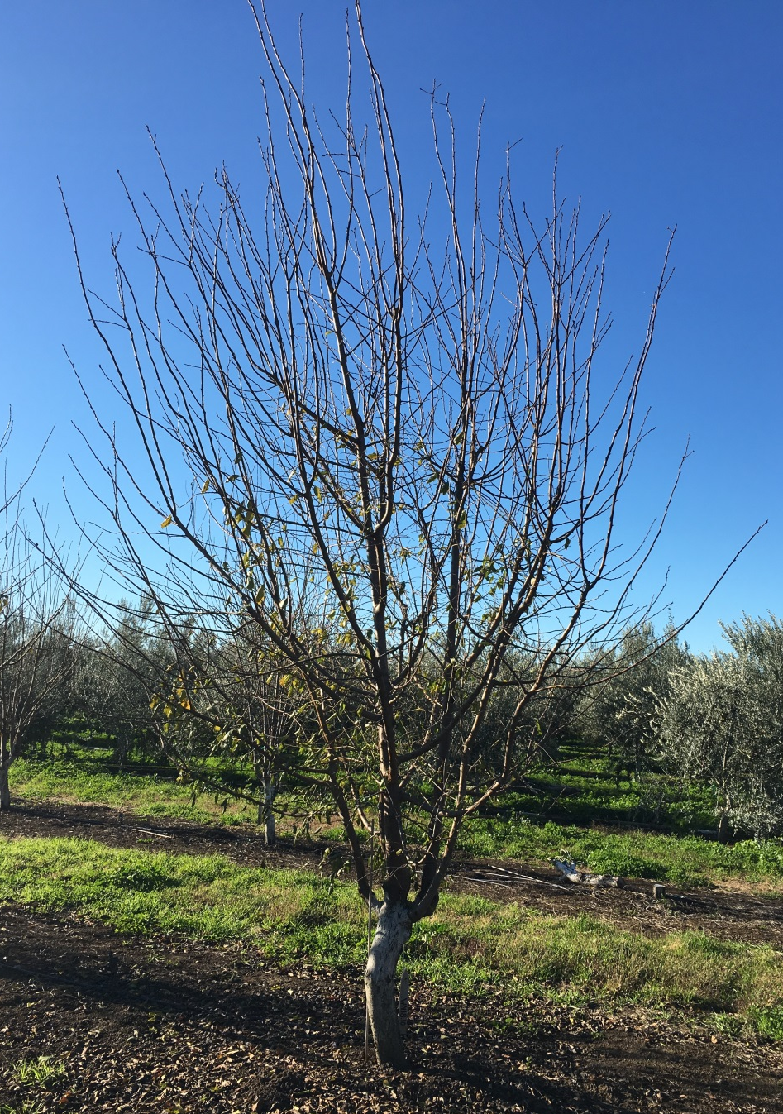
G37S- 38
Vigorous growth habit
Dry away ratio of 2.9 & 2.7
First dry evaluation from the seedling block
Fruit has heavy waxy bloom
Pit might be too big
Bloomed 8 days before Improved French

Slide 32
Tasting number | Test date | Name | days from French | weight (g/fruit) | Pressure | BRIX | count per lb | dry away ratio | Avg. taste evaluation (1=bad, 5=excellent)
1 | 7/7 | H21N-101 | -34 | 25.4 | 3.8 | 32.3 | 44.5 | 2.3 | 3.8
2 | 8/8 | G37S- 38 | -4 | 31.1 | 4.1 | 22.8 | 42.5 | 2.7 | 3.0
3 | 8/8 | H13S- 58 | -4 | 27.6 | 3.1 | 20.0 | 40.4 | 2.3 | 3.5
4 | 8/8 | H13S- 65 | -4 | 37.0 | 2.9 | 24.3 | 31.1 | 2.7 | 3.8
5 | 8/8 | H5N- 83 | -4 | 30.0 | 2.9 | 26.4 | 37.9 | 2.4 | 3.3
6 | 8/15 | H16N- 83 | 3 | 39.9 | 3.1 | 29.6 | 33.7 | 2.4 | 3.5
7 | 8/15 | H8S- 75 | 3 | 25.7 | 6.0 | 35.5 | 41.8 | 2.2 | 3.0
8 | 8/23 | G26N- 8 | 11 | 37.0 | 7.9 | 25.6 | 37.2 | 2.6 | 3.3
9 | 8/23 | G27N-31 | 11 | 26.9 | 5.5 | 23.7 | 47.4 | 2.9 | 4.0
10 | 8/23 | H15N- 92 | 11 | 31.5 | 6.7 | 27.9 | 36.0 | 2.6 | 3.3
 | 8/8 | Imp. French | +/-3 | 34.2 | 2.9 | 27.9 | 35.1 | 2.5 | 2.0

Slide 33
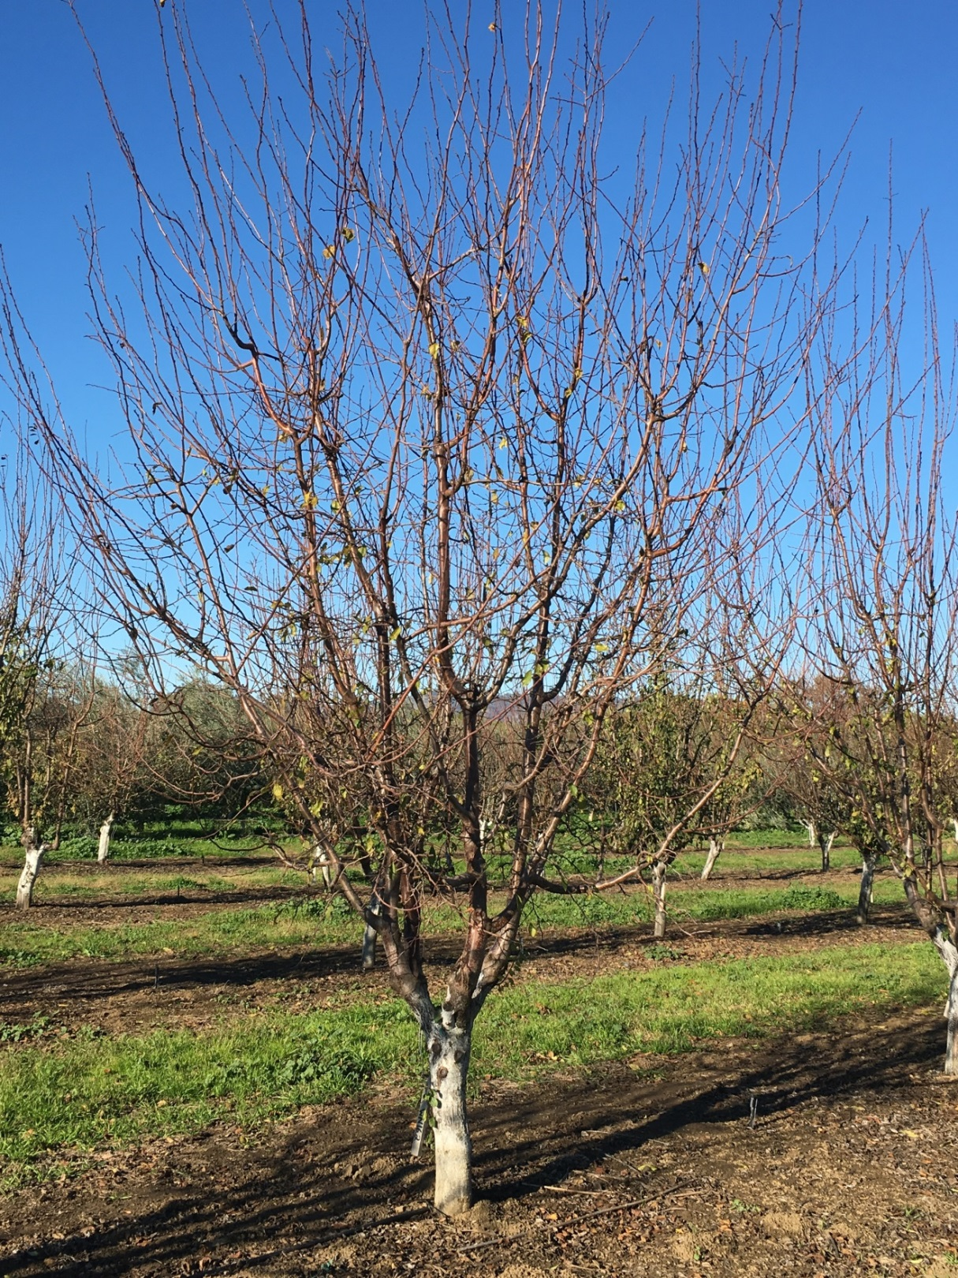
H13S- 58
Top item
Dry away ratio of 2.2 & 2.3 @ Winters
Dry away ratio of 2.8 or 2.9 when harvested early @ Kearney
Dries on the trees
Was planted in growers orchards in 2018.

Slide 34
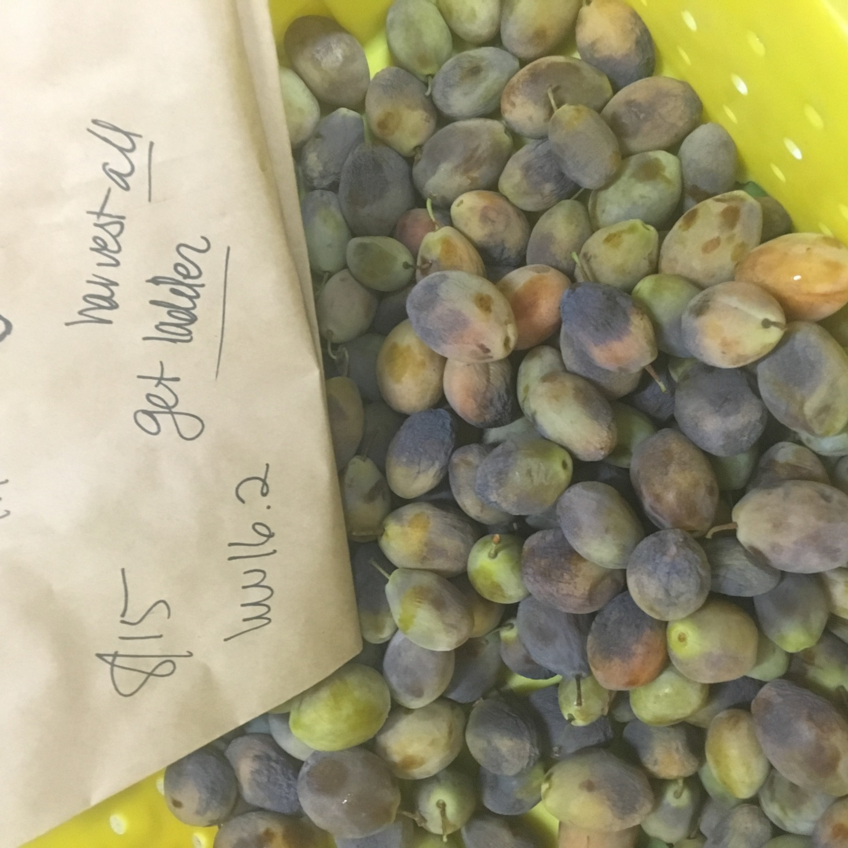
H13S- 58 (Changes color from yellow-green to grey-purple when it dries on tree and is mature.)

Slide 35
Tasting number | Test date | Name | days from French | weight (g/fruit) | Pressure | BRIX | count per lb | dry away ratio | Avg. taste evaluation (1=bad, 5=excellent)
1 | 7/7 | H21N-101 | -34 | 25.4 | 3.8 | 32.3 | 44.5 | 2.3 | 3.8
2 | 8/8 | G37S- 38 | -4 | 31.1 | 4.1 | 22.8 | 42.5 | 2.7 | 3.0
3 | 8/8 | H13S- 58 | -4 | 27.6 | 3.1 | 20.0 | 40.4 | 2.3 | 3.5
4 | 8/8 | H13S- 65 | -4 | 37.0 | 2.9 | 24.3 | 31.1 | 2.7 | 3.8
5 | 8/8 | H5N- 83 | -4 | 30.0 | 2.9 | 26.4 | 37.9 | 2.4 | 3.3
6 | 8/15 | H16N- 83 | 3 | 39.9 | 3.1 | 29.6 | 33.7 | 2.4 | 3.5
7 | 8/15 | H8S- 75 | 3 | 25.7 | 6.0 | 35.5 | 41.8 | 2.2 | 3.0
8 | 8/23 | G26N- 8 | 11 | 37.0 | 7.9 | 25.6 | 37.2 | 2.6 | 3.3
9 | 8/23 | G27N-31 | 11 | 26.9 | 5.5 | 23.7 | 47.4 | 2.9 | 4.0
10 | 8/23 | H15N- 92 | 11 | 31.5 | 6.7 | 27.9 | 36.0 | 2.6 | 3.3
 | 8/8 | Imp. French | +/-3 | 34.2 | 2.9 | 27.9 | 35.1 | 2.5 | 2.0

Slide 37
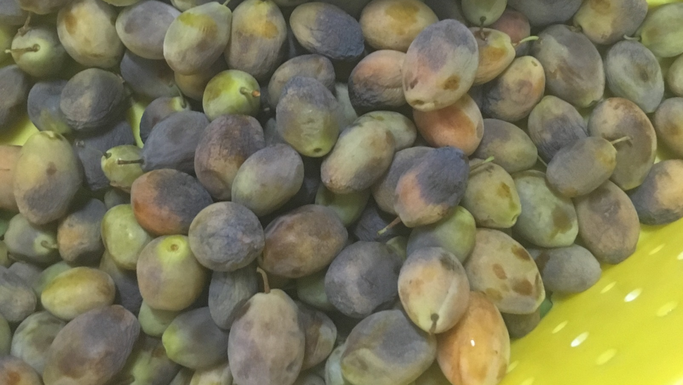

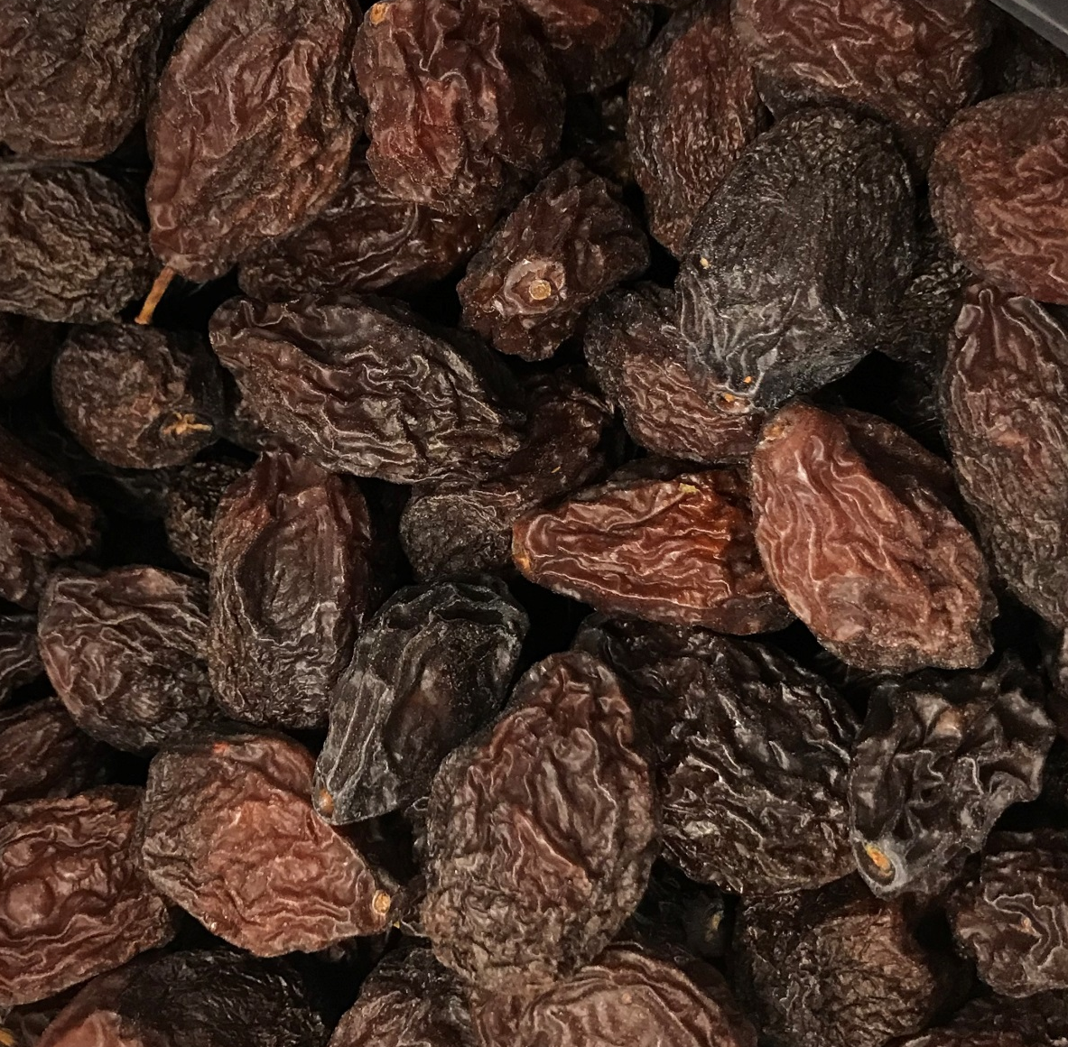

Slide 38
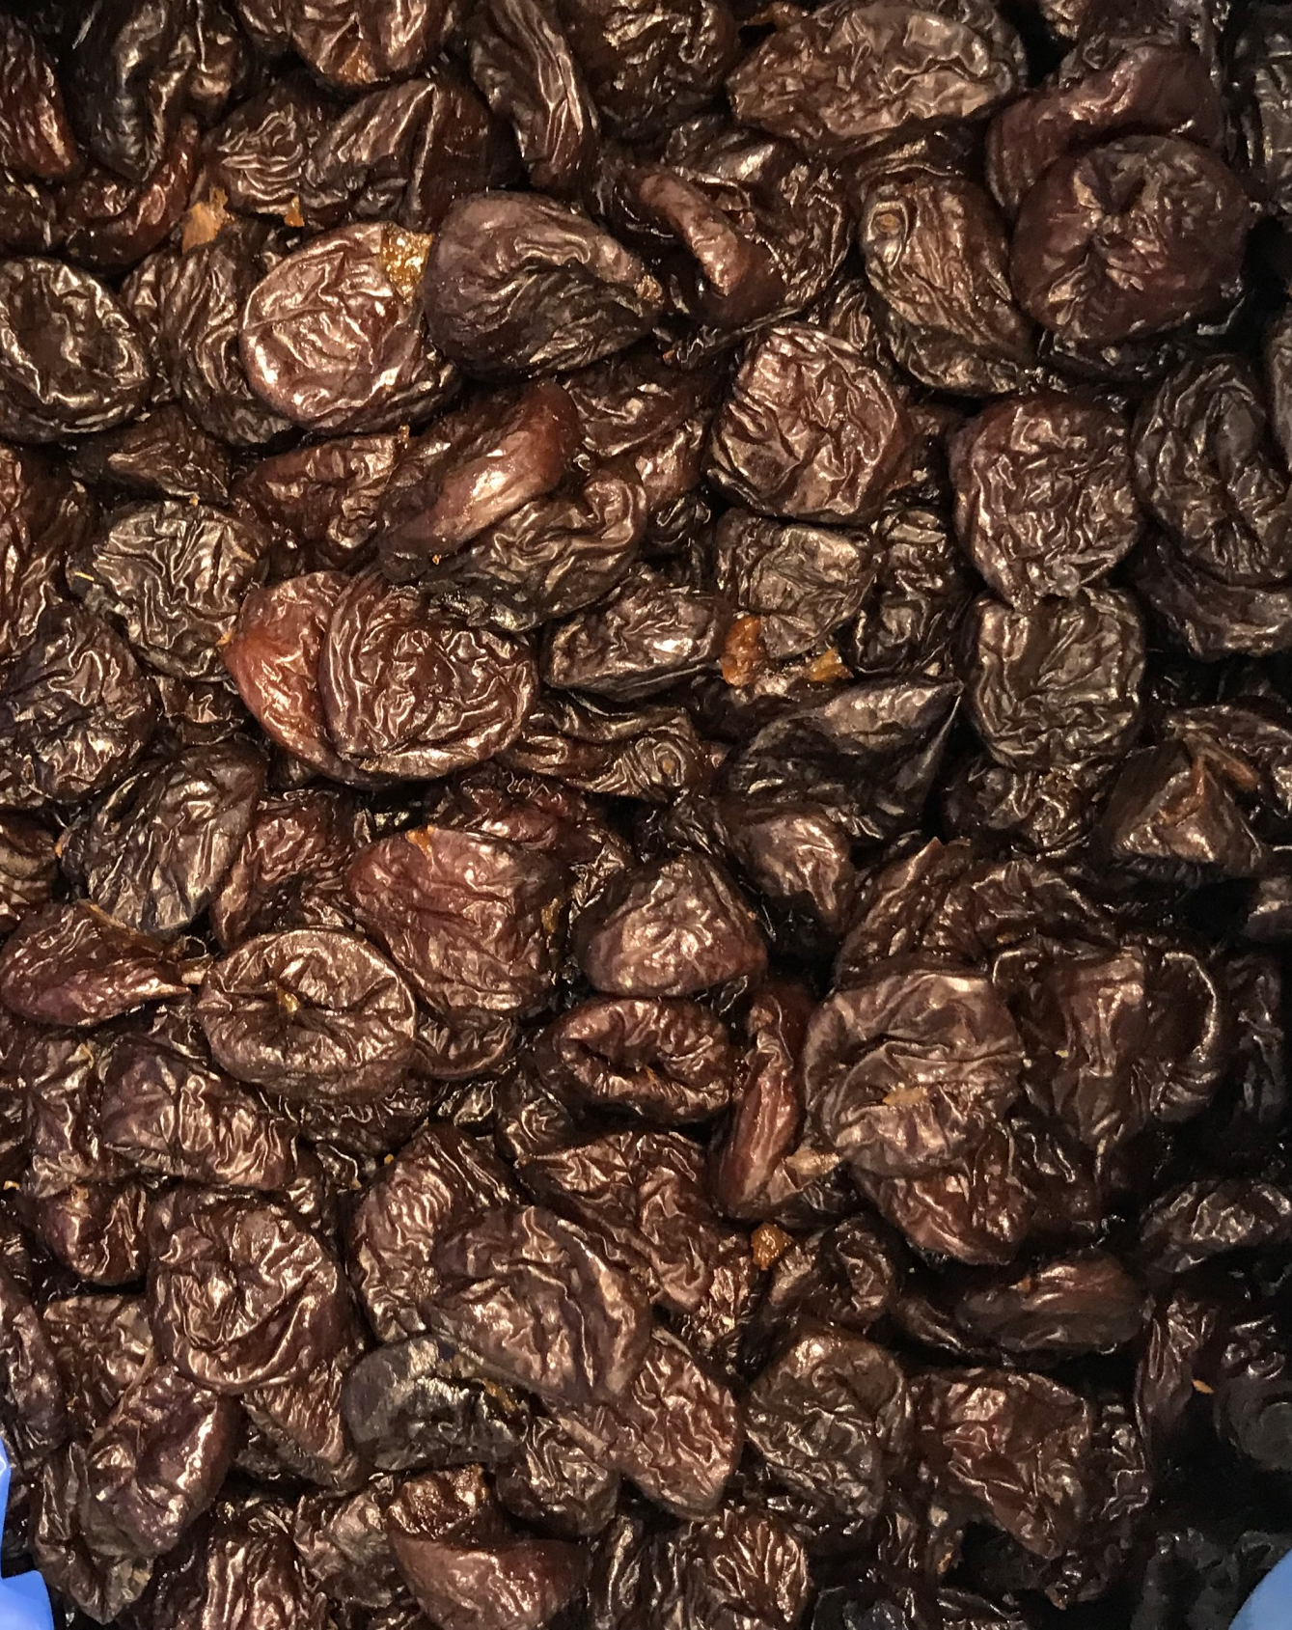



Slide 39

H13S- 65
Vigorous upright and spreading structure
Thick flesh
Dry away ratio of 2.7 at Winters
Bloomed 9 days before Improved French, good fruit set
Harvests with Improved French

Slide 40


H13S- 65

Slide 41


H16N- 83
Low Dry away 2.4 at Winters
Pit might be too big
Harvests with Improved French
Bloomed 11 days before Improved French

Slide 42

G26N- 8
Late harvesting, will have high pressure at harvest
Low dry away ratio: 2.6 & 2.8
Third year of production in Kearney orchard, first for Winters
Spreading and upright structure
Bloomed 11 days before Improved French

Slide 43

G27N- 31
Short internode, compact tree
Harvests after Improved French
Fairly free pit.
Flesh texture is soft/gooey
Bloomed the day before Improved French

Slide 44

H15N- 92
Compact tree structure
Dry away ratio of 2.6 at Winters
Might be too big
Tough skin

Slide 45
Items ready for grower trials
Harvest date | Item Name | Location grown | Days +/- French | Weight (g/frt) | Pressure | Sugar in Brix | Dry away ratio | Dry count per lb. | Comments
7/19 | G37S- 45 | Kearney | -28 | 28.3 | 4.3 | 20.0 | 2.8 | 47.4 | harvested too early at Kearney, wide branching tree
8/21 | G37S- 45 | Winters | +1 | 25.4 | 5.8 | 26.7 | 2.4 | 45.4
8/7 | F11S- 38 | Winters | -16 | 20.0 | 4.1 | 31.8 | 2.1 | 46.7 | usually harvests earlier in the season
8/31 | G43S- 15 | Kearney | +15 | 32.7 | 3.2 | 27.0 | 2.3 | 32.3 | fruit size might be too big for processing
8/28 | G43S- 15 | Winters | +8 | 32.4 | 5.1 | 26.3 | 2.7 | 37.8
8/31 | H13S- 65 | Kearney | +15 | 30.3 | 2.7 | 23.0 | 2.9 | 45.0 | Pollination compatibility tested at Winters, determined self compatible, but should be restested
8/28 | H13S- 65 | Winters | +8 | 28.8 | 3.5 | 24.4 | 2.6 | 37.8

Slide 46

F11S-38 Harvests ~2 weeks before Improved French. Partially dries on the tree. Dried in Sunsweet dryer ~18 hrs. Pitted on Oct 16, 2019.

Slide 47

Plum Pox Virus
Resistance
Previously bred with Jojo (hypersensitive resistance) & Stanley (non-symptomatic)
Cooperation with Scorza/Dardick at USDA facility in Kearneysville, WV
Rootstocks & Varieties from Dr. Neumuller’s breeding program in Germany
  Docera 6
  4 cultivars for evaluation & breeding

Slide 48
Related Studies
S.B. Castro, C.H. Crisosto and T.M. DeJong. 2016. Variation in Fruit Constituent Sugar Concentrations and their Stability during Processing of Selected Genotypes in Prunus domestica. Journal of the American Pomological Society 70(3): 138-148 2016
Zhebentyayeva T., V. Shankar, R. Scorza, A. Callahan, M. Ravelonandro, S. Castro, T. DeJong, C. A. Saski and C. Dardick. 2019. Genetic characterization of worldwide Prunus domestica (plum) germplasm using sequence-based genotyping. Horticulture Research 6:12
S.B. Castro and T. M. DeJong (In Press) Soluble solids assessment of California Prunus domestica germplasm. Acta Horticulturae

Slide 49

How are French prunes relate to other plums?

Slide 50

Genetic analysis of 405 different accessions.
Phylogeny of P. domestica and related species.
Zhebentyayeva T., V. Shankar, R. Scorza, A. Callahan, M. Ravelonandro, S. Castro, T. DeJong, C. A. Saski and C. Dardick. 2019. Genetic characterization of worldwide Prunus domestica (plum) germplasm using sequence-based genotyping. Horticulture Research 6:12

Slide 51




Large fruit diversity within the hexaploid Prunus domestica germplasm
Notes:
In simply walking my seedling blocks last week I found a plum that is about the size of my fist, as well as one that is just a little bigger than a fingernail. I suspect a lot of this diversity is due to the fact that prunes are hexapliod.

Slide 52
Soluble solids assessment of California Prunus domestica germplasm.
Name | Glucose g/100g | Fructose g/100g | Sucrose g/100g | Sorbitol g/100g | Sum of Sugars | Glu/ Fru Ratio | Titratible Acidity | pH | Fruit Weight g/frt
D6N-103 | 6.80 | 2.55 | 1.75 | 3.65 | 14.8 | 2.67 | 0.44 | 3.98 | 32.3
D'Ente GF 2733 | 5.90 | 1.95 | 3.65 | 6.95 | 18.5 | 3.08 | 0.54 | 3.92 | 26.2
D'Ente GF 303 | 3.45 | 1.65 | 4.25 | 2.30 | 11.7 | 2.13 | 0.64 | 3.90 | 23.4
D'Ente GF 652 | 4.90 | 2.00 | 6.50 | 2.50 | 15.9 | 2.45 | 0.77 | 3.80 | 27.0
Double Robe | 3.10 | 1.15 | 5.55 | 3.95 | 13.8 | 2.77 | 0.52 | 3.74 | 42.0
Emperor | 4.90 | 2.00 | 6.40 | 6.20 | 19.5 | 2.45 | 0.59 | 3.92 | 30.3
Empress | 4.20 | 1.05 | 5.80 | 1.80 | 12.9 | 4.36 | 0.90 | 3.58 | 76.6
Gerrans E. French | 4.25 | 1.65 | 6.95 | 2.15 | 15.0 | 2.62 | 0.60 | 3.83 | 16.3
Improved French | 6.15 | 2.25 | 1.65 | 5.00 | 15.1 | 2.74 | 0.50 | 3.86 | 26.2
Lorida | 4.15 | 1.40 | 4.05 | 2.30 | 11.9 | 3.32 | 0.52 | 4.10 | 41.4
Moyer | 4.30 | 0.70 | 6.45 | 4.80 | 16.3 | 6.38 | 0.43 | 4.32 | 46.9
Muir Beauty | 4.70 | 1.55 | 7.50 | 4.80 | 18.6 | 3.19 | 0.44 | 4.19 | 43.6
Petite 3x | 5.80 | 1.95 | 2.60 | 4.45 | 14.8 | 2.97 | 0.46 | 3.98 | 26.0
President | 3.70 | 1.50 | 4.65 | 3.15 | 13.0 | 2.50 | 1.00 | 3.53 | 39.6
Stanley | 4.40 | 1.55 | 5.25 | 4.05 | 15.3 | 2.87 | 0.60 | 3.96 | 38.6
Sutter | 3.90 | 1.20 | 7.50 | 4.80 | 17.4 | 3.38 | 0.44 | 3.95 | 26.8
Tragedy | 1.95 | 0.40 | 5.85 | 1.15 | 9.2 | 6.75 | 1.73 | 3.24 | 59.7
Tulare Giant | 4.10 | 2.20 | 6.30 | 4.45 | 17.1 | 1.87 | 0.46 | 4.03 | 65.4
D2N-76 | 6.30 | 2.00 | 5.20 | 7.30 | 20.8 | 3.15 | 0.43 | 4.24 | 33.4
Notes:
You can see we have Improved French on the list. This is the agen type that is the commerical standard in CA. We also have the three parents of the crosses we evaluated in this study. In looking at theTA tragedy, president and empress had by far the most acid out of all of these varieites. Most of the CA selections that we tested in this study did not have such high TA, so I suspect that is something we have been selecting out. Most of our evaluations in the breeding programs are based on taste, so typically a high acid fruit would likely be rouged out.

Slide 53


Google: FNRIC UC Davis

Slide 54


Slide 55




Thank you for your attention!
Questions? Comments?
Sarah Castro: (530) 754-5264 scastro@ucdavis.edu
Ted DeJong: (530) 752-1843 tmdejong@ucdavis.edu
Google: T M DeJong Plant Sciences UC Davis

