Slide 1

Supporting Demand for California Prunes Since 1997
Nutrition Research
International Prune Association Congress
Cape Town, South Africa
October 28-29, 2019

Slide 2
Creating Energy in the Nutrition Research World
    Over 2 decades of research
    Over 40 presentations, publications, abstracts
    Guided by a scientific panel
    Basis for marketing/communications
    Industry identified priorities
      Bone health: cell, animal & human studies
      Digestive & gut health
      Inflammation
      Carbohydrate quality: nutrients with no added sugar

Slide 3
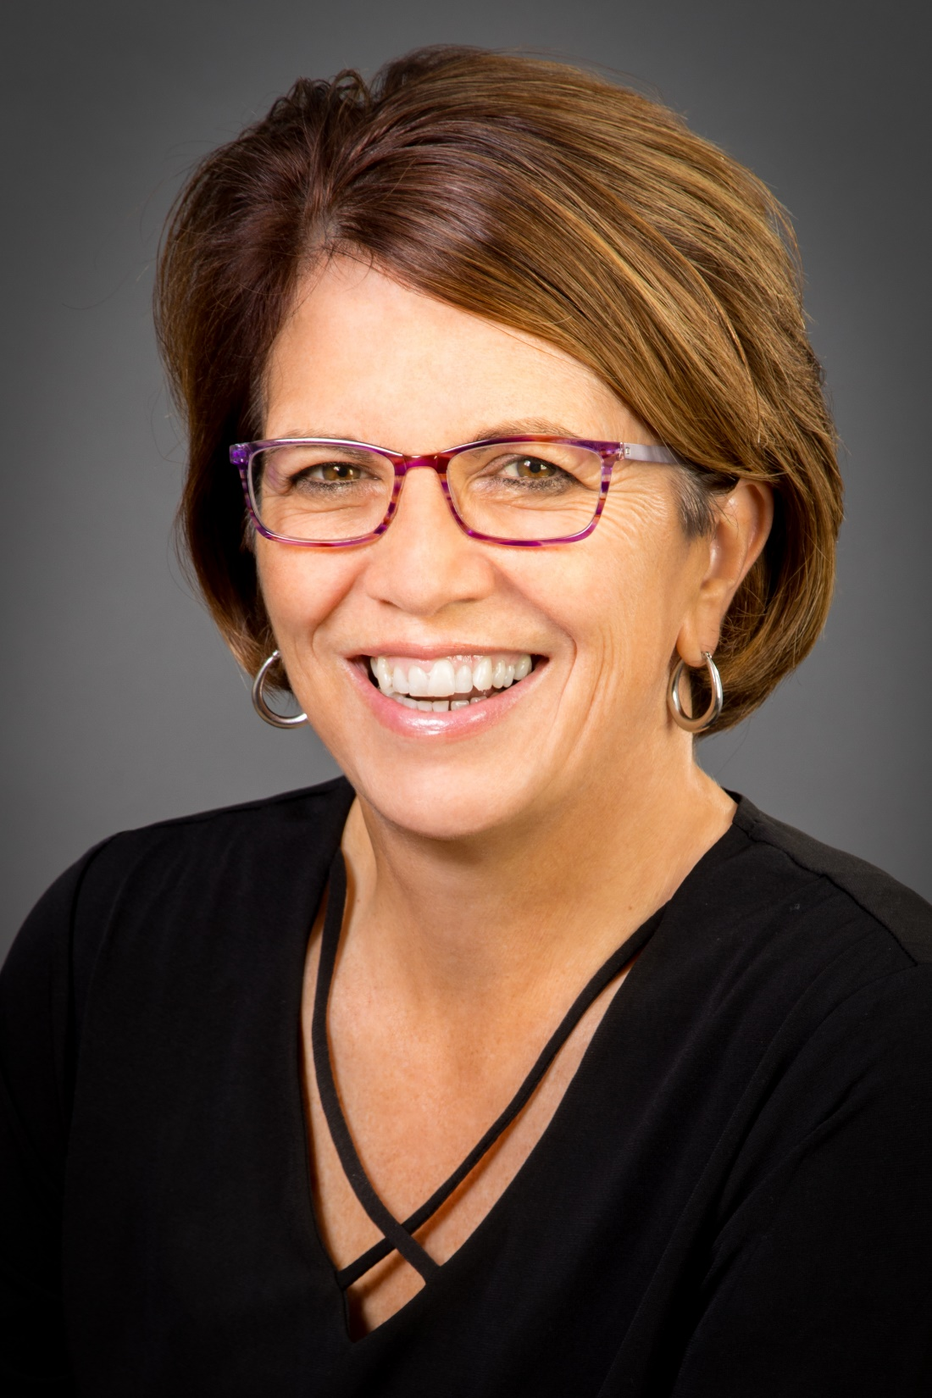
Clinical Trial on Prunes
& Bone Health
Randomized Control Trial of Dietary Supplementation with Prunes on Bone Density, Geometry & Estimated Bone Strength in Postmenopausal Women
Principal Investigator
Mary Jane De Souza PhD,
Professor, Kinesiology
& Physiology

Slide 4
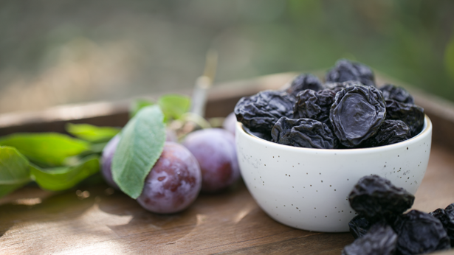
Snapshot of the Study
1 year randomized clinical trial
Postmenopausal women 55-75
Low bone mineral density
300+ in person screenings to have 63 completers per group
  Control Group: no prunes + Ca & VitD₃
  50 g Prune Group: (6/day) + Ca & VitD₃
  100 g Prune Group: (12/day) +Ca & VitD₃

Slide 5
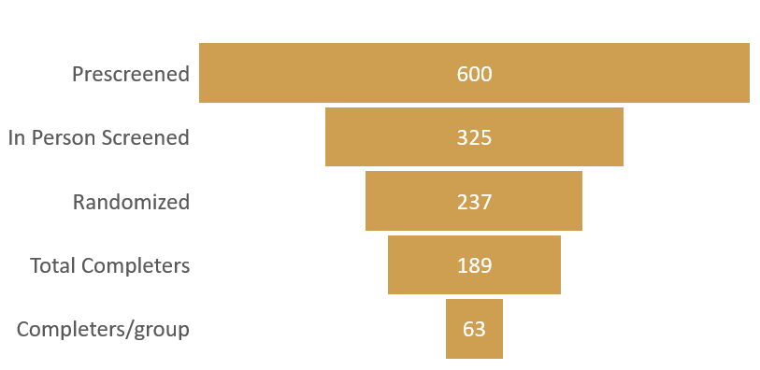
Participants Needed for the Study

Slide 6
Plan for the Best: Manage the Unknown
  Screen over 300 women and randomize 237 to the control, 6 or 12 prune group to detect BMD difference between the groups.
  Randomize 79 women to EACH group to allow for an overall drop out rate of 20% . This results in a total of 189 completers or 63 completers in EACH group.
  Women in the 12 prune group drop out at a higher rate: slightly under 40%. People dropout for a lot of reasons: lose interest; move; tired of eating prunes for 1 year.
  No Cost Extension to Dec. 31, 2019 granted to meet randomization goal of 79 in each group which results in 70 or more completers in the control and 6 prune group but 47 completers in the 12 prune group.
  To continue to enroll and randomize to reach 63 completers in the 12 prune group would extend the study and add additional costs.
  Statistician indicated all data will be useful.

Slide 7
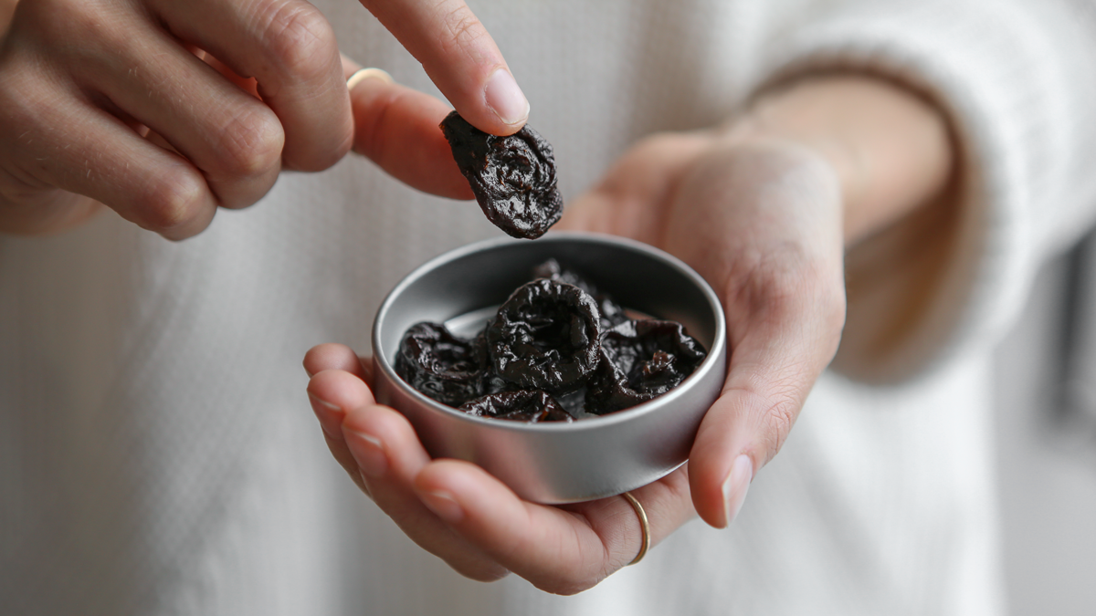
Completion Rate
October 2019
    67% completion for entire study (126/189)
    76% for the control group (48/63)
    68% for the 6 prune group (43/63)
    56% for the 12 prune group (35/63)

Slide 8
Osteopenia
T-Scores
According to the World Health Organization (WHO): A T-score of -1.0 or above is normal bone density. Examples are 0.9, 0 and -0.9. A T-score between -1.0 and -2.5 means you have low bone density or osteopenia.

Slide 9
Case Study
July 2016 a 55-year old, post menopausal woman with DXA
baseline spine L1-L4 T-score: - 1.6 randomized to Control Group
At completion October 2017, DXA spine L1-L4 T-score: -2.2 a decrease of 7.6%
Concerned with the decrease in her bone mineral density, she decided to consume 50 g prunes per day, on her own volition
A comparison of DXA data from October 2017 to February 2019, demonstrated positive results:
  Whole Body Bone Mineral Density (BMD) increased 0.5%
  Hip BMD increased 1%
  Spine BMD increased 7.9%
This brought her T-score back to the original July 2016 baseline value of -1.6

Slide 10
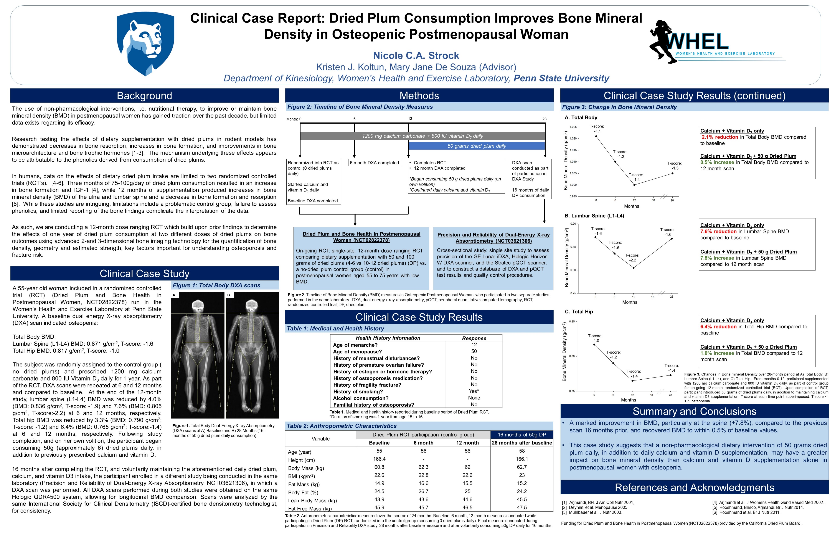
American Society for Bone & Mineral Research September

Slide 11
Next Steps
Anticipate all participants complete study end of December 2020 or January 2021
Data analysis continues through
June 2021
Bone outcome results estimated to be published December 2021
Presentations at professional meetings TBD
Message development and communication

Slide 12
Benefits to the Industry
  Further regulatory support for benefits to bone health in postmenopausal women with low bone mass – EFSA
  Non-pharma strategy for women to improve bone health
  Healthy lifestyle messaging to drive promotions and increase sales

Slide 13
Nutrition Activities
Abstracts and Presentations: Nutrition 2019 (Arjmandi/USDA; Hooshmand; Asian Congress of Nutrition (Hooshmand); American Society for Bone and Mineral Research (De Souza)
Bernard Halloran Spinal Cord Injury Animal Study/Manuscript
Bernard Halloran/Xuhui Liu/Jenny Karatli Spinal Cord Injury Clinical Trial

Slide 14
Palo Alto Veteran’s Administration Hospital Spinal Center
Bone response with dried plum supplementation in persons with SCI - Pilot findings
Authors: Bernard Halloran/Xuhui Liu/Jenny Karatli Spinal Cord Injury Clinical Trial
Objective: To explore bone response to dietary supplementation with dried plum (DP) in persons with spinal cord injury (SCI).
Pilot: 5 Subjects (3 currently enrolled)
Background: Bone loss following SCI is a serious secondary consequence for which there are no effective treatments – neither to prevent bone loss nor to restore bone. The reduction in bone mass leads to increased fracture risk which can lead to subsequent additional disability. Based on promising results from rodent studies at UCSF , dietary supplement of dried plum (DP) appears to be a potential treatment. DP is particularly attractive as it is natural food and has no known/expected negative effects. The primary mechanism seems to be reduction in bone resorption. This pilot work provides an initial evaluation of tolerability and safety of DP supplementation in persons with SCI as well as its effects on bone.

Slide 15
VA Pilot Study(continued)
Results: P1NP values showed a slight decline over the 6 month period in two of the participants, although both maintained normative values >32ug/L at all three time points. In P1NP increased to a normative 49 ug/L at 3 months from 29ug/L (below normal) at baseline. CTX values, on the other hand, appeared to increase at 3-months but dropped to values below baseline at 6 months. In one participant, CTX values normalized to <0.25 ug/L at 6 months from 0.29ug/L at baseline. Changes in BMD were minimal during the 6-month period. In general, participants tolerated daily DP, but adjustment in amount was needed in some cases related to bowel function. One participant discontinued consumption at 4 months. While there was elevation in HbA1c at 3 months for one participant, this was not sustained and all safety labs were reassuring.
Conclusions: DP supplementation appears to slow bone turnover SCI in this small sample, however a longer assessment period is needed for adequate therapeutic response.

Slide 16
New Studies
Two new studies will expand our understanding on the role of prunes and bone health in the rate of fracture healing and in lowering the risk of bone loss in young women using oral contraceptives.
Dr. Bahram Arjmandi and his team at Florida State University and the Tallahassee Orthopedic Clinic will investigate the Effect of Prunes on Fracture Healing in Men and Women with a Wrist Fracture. According to the investigators, wrist fractures are the most common type of upper extremity fracture in older adults. The study will compare the rate of healing and other bone related measures of ambulatory men and women ages 50-85 eating 100 g of prunes daily for 3 months along with the standard of care (calcium and vitamin D) to those receiving only the standard of care (calcium and vitamin D).
Drs. Shirin Hooshmand and Mark Kern (San Diego State University) will investigate the Impact of Consuming California Dried Plums/ Prunes on Bone Health of Young Women Using Hormonal Contraceptives. According to the investigators, estrogens are major determinants of bone mass, affecting the acquisition of peak bone mass during adolescence and young adult age, modulating bone mineral density (BMD) and the risk of osteoporosis and bone fracture later in life. This study will investigate whether 12 months of consuming 50 grams of prunes/dried plums daily will lower the risk of bone loss or augment bone accrual of women 18-25 using oral contraceptives. The study also will assess biomarkers of bone formation and resorption.
Drs. Peter Clifton, Yoona Kim, Jennifer Keogh: Effects of Prunes on Bone Health in Korea
Colon Cancer RFP

Slide 17
Intestinal Health
Bone Health
Research Opportunities
Intestinal Microbiota
Inflammation
?
Flavonoids
Intestinal Barrier
Function
?
?
Nutrient absorption (Ca²⁺)?
Gastrointestinal motility
Laxation

Slide 18
Thank You

