Slide 1
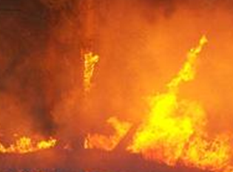
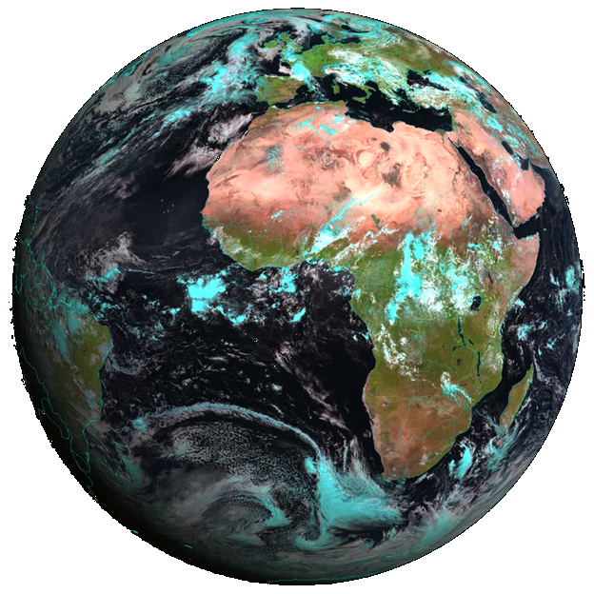
Climate change in SA and the impact on Agriculture and Water - a focus on Stone Fruit
Peter Johnston, Climate System Analysis Group, UCT

Slide 2
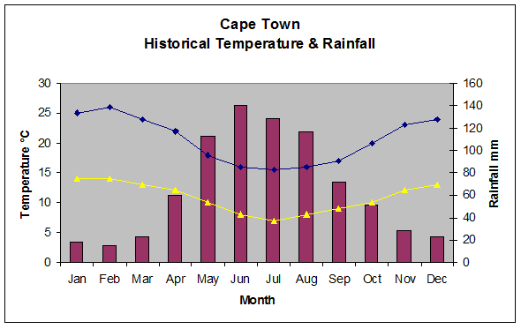
Annual Rainfall – CT centre +/- 820mm

Slide 3
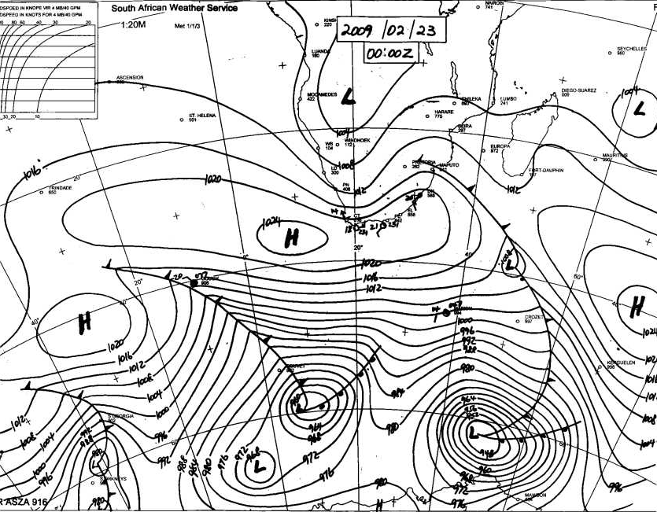
Cape Doctor….

Slide 4
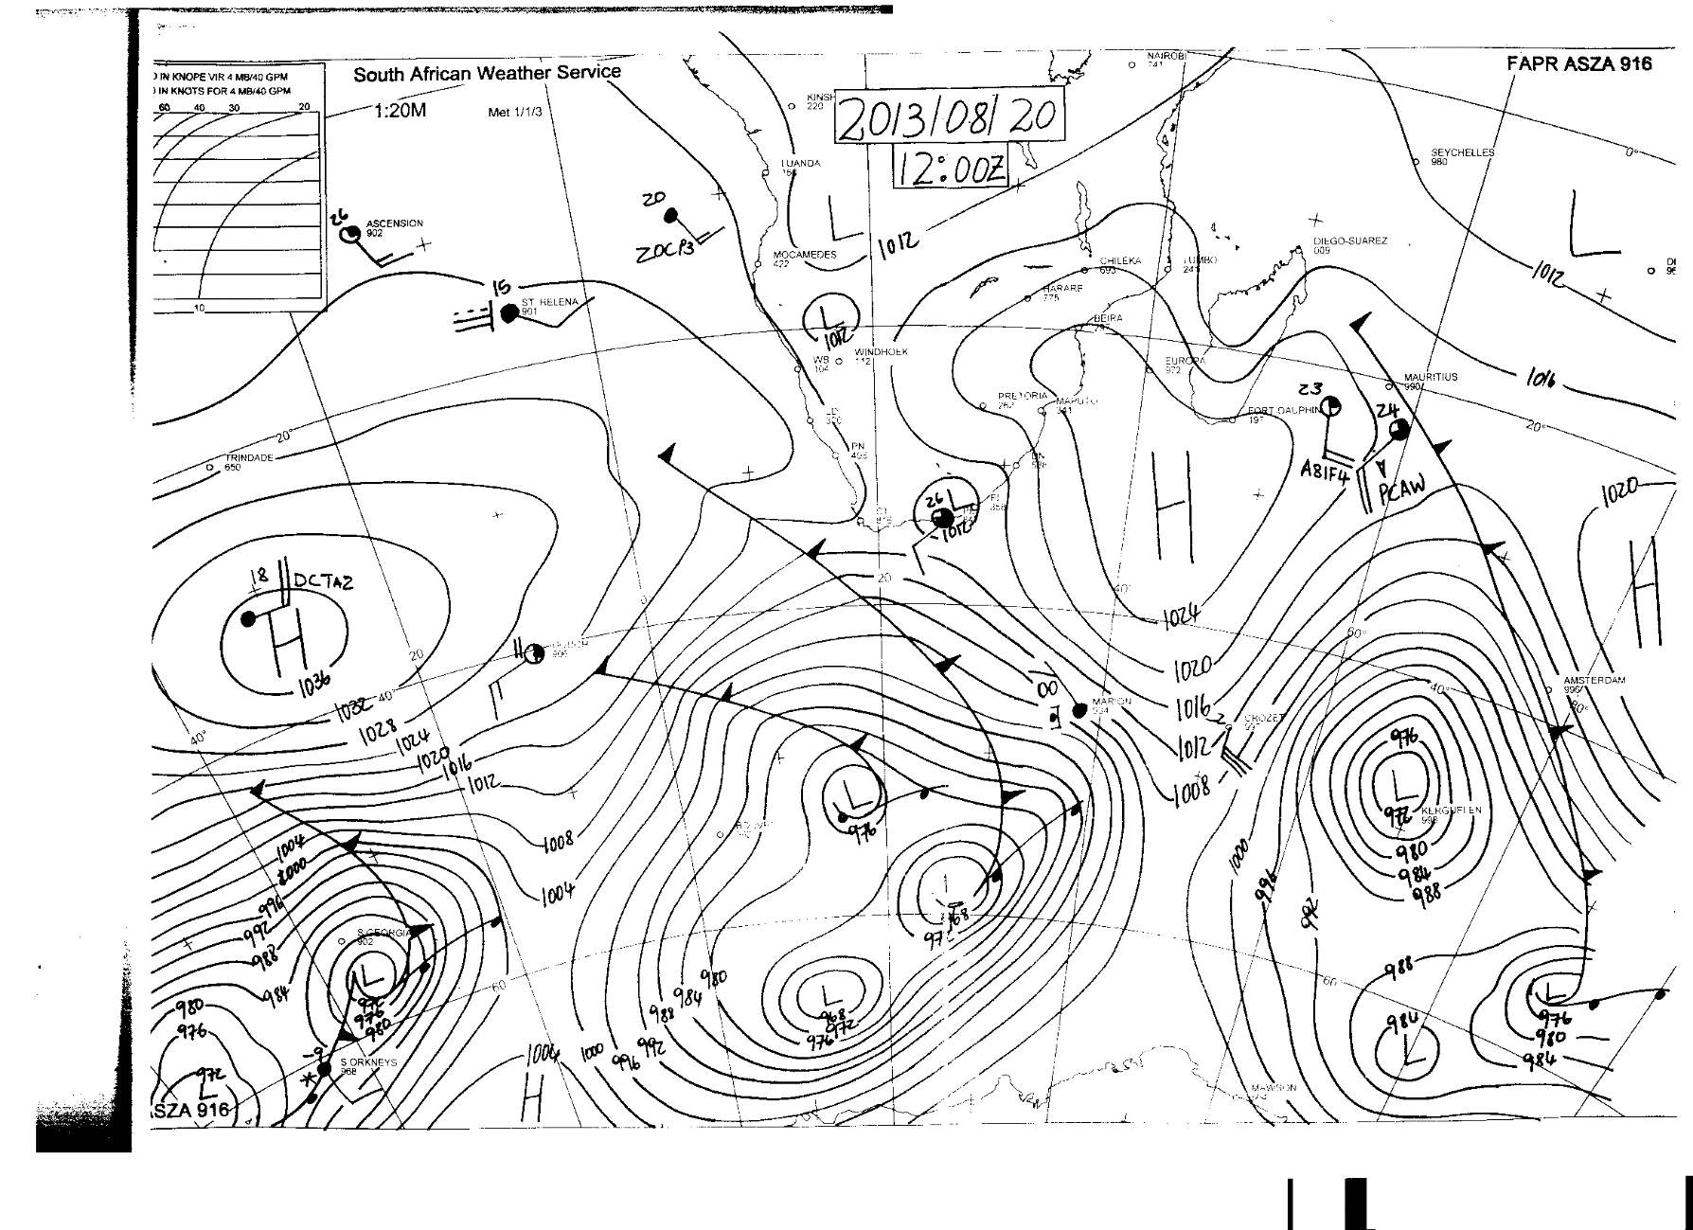
Cape Town Winters….

Slide 5
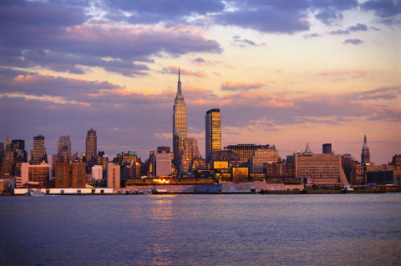
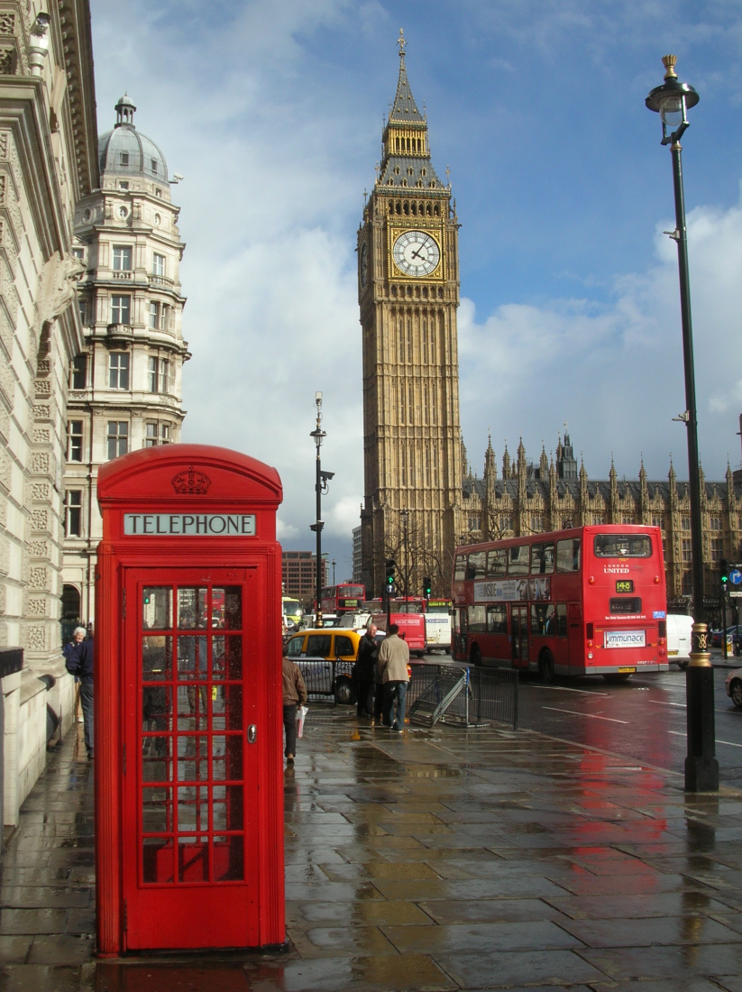
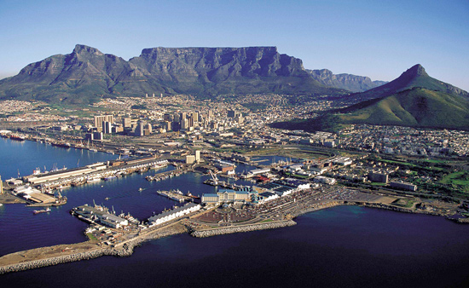
Wet winters
1260 mm
583 mm
820 mm

Slide 6
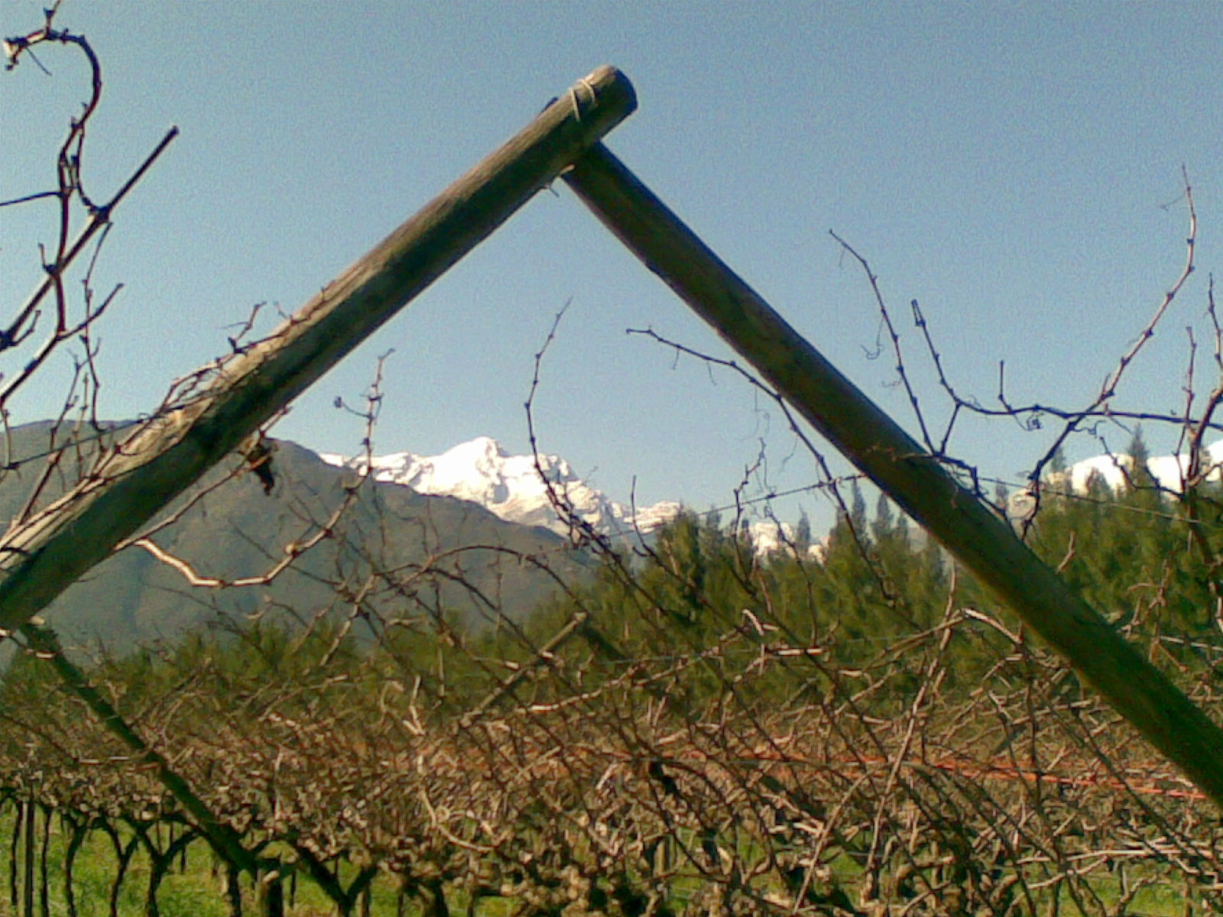
Our weather: June/July/August

Slide 7
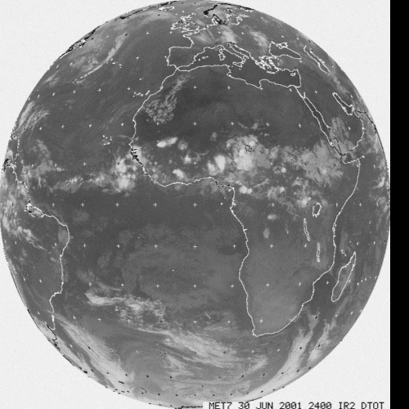
You are here !

Slide 8
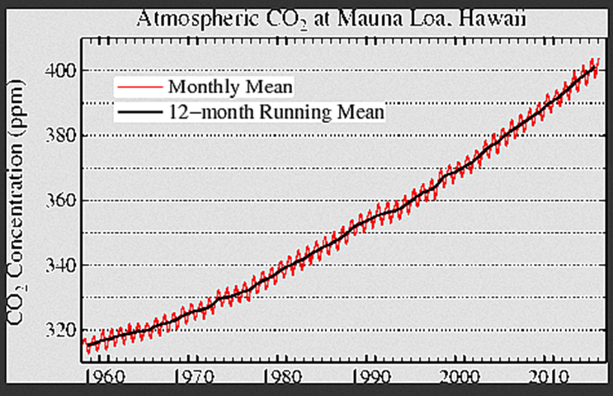
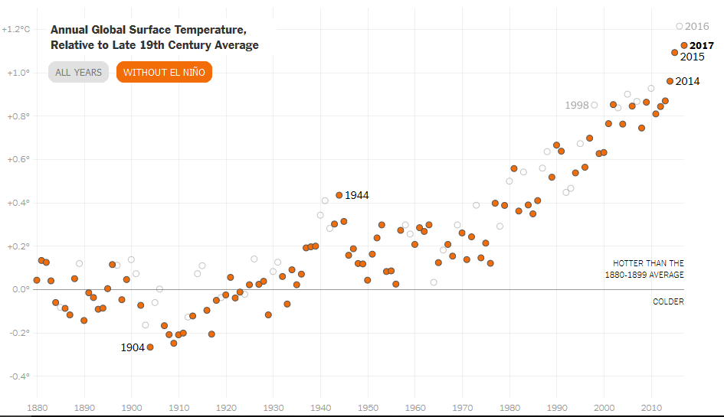

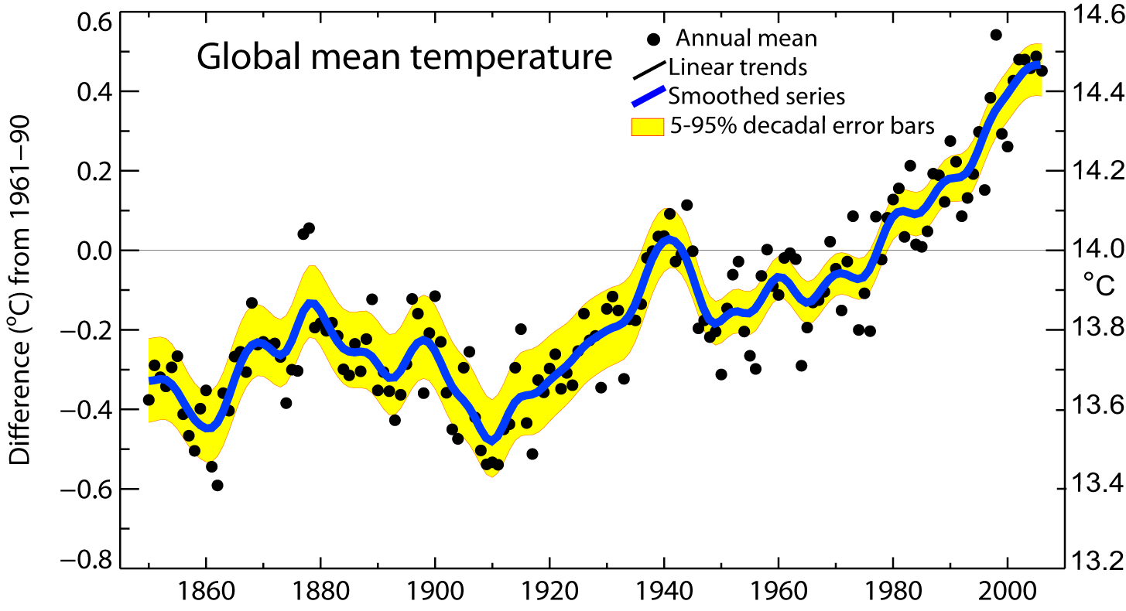
Global mean temperatures are rising faster with time
Warmest 12 years:
2016, 2017, 2015, 2014, 2010, 2005
2013, 2003, 2002, 2006, 1998, 2009
Period Rate
Years °/decade
50 0.128±0.026
100 0.074±0.018
Notes:
Average global temperatures are not increasing stedily.
Average global temperatures are rising at an ever increasing rate.

Slide 9
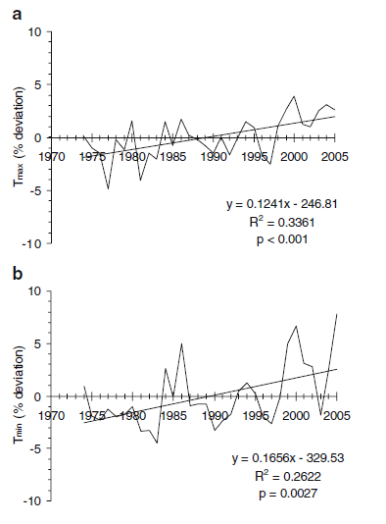
Temperature Trends
1974-2005
Western Cape

Slide 10
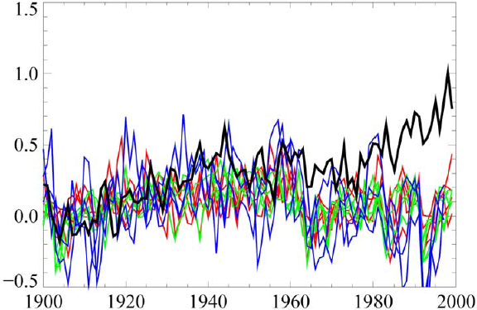
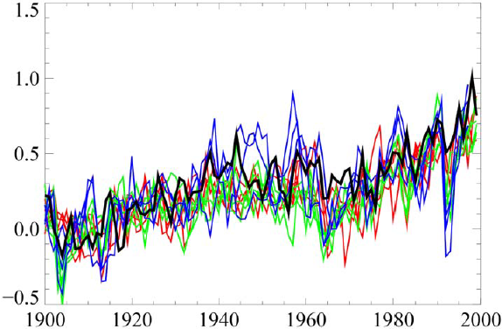

So can we attribute the change to:
Human-induced
or
Natural cycles?
Without human-induced
With human-induced

Slide 11
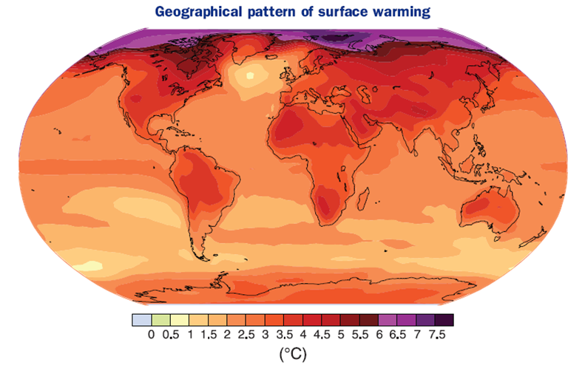
Future temperature – 2090-2099

Slide 12
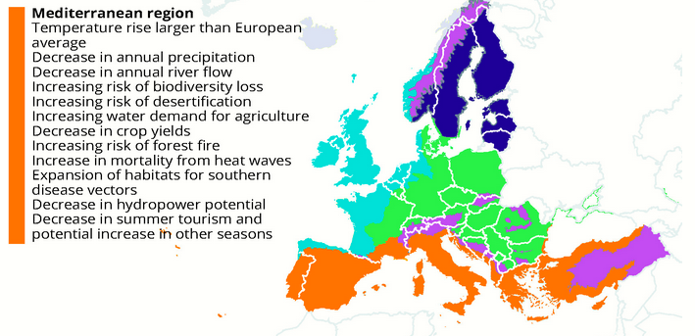

Slide 13
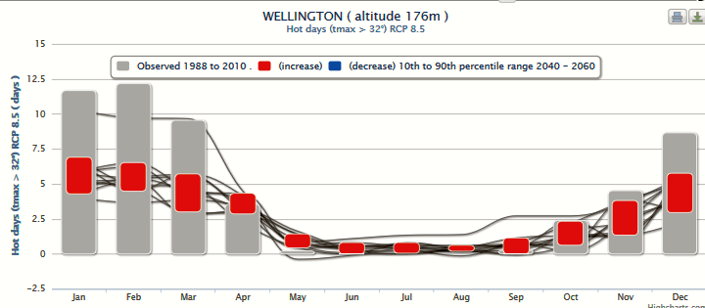
Wellington – very hot days

Slide 14
Hotter Temps’ impact on Water
Higher irrigation demand
Decreases in soil moisture
Drying out occurs more often
Crop damage
Picking conditions
Cold storage/chain requirements

Slide 15
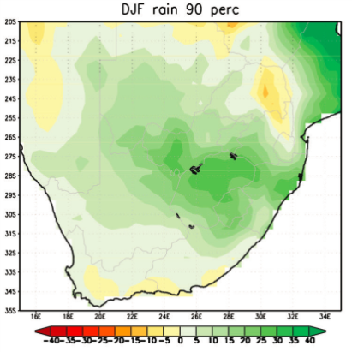
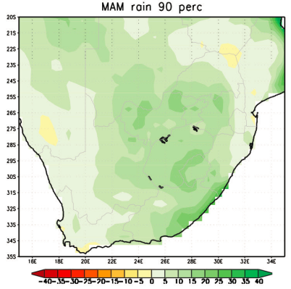
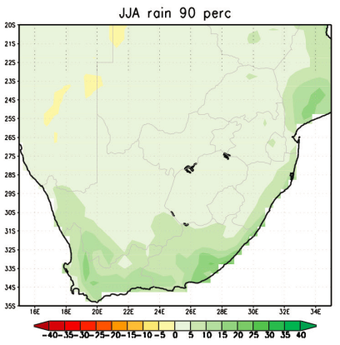
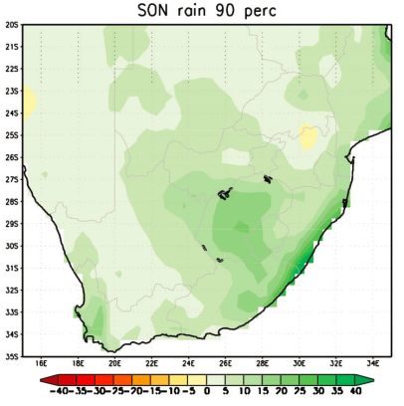
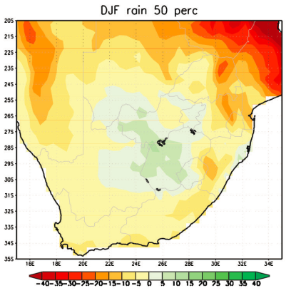
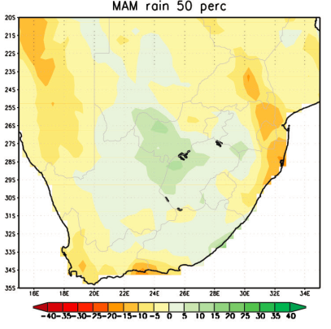
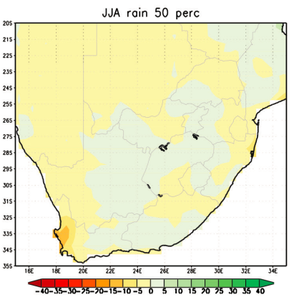
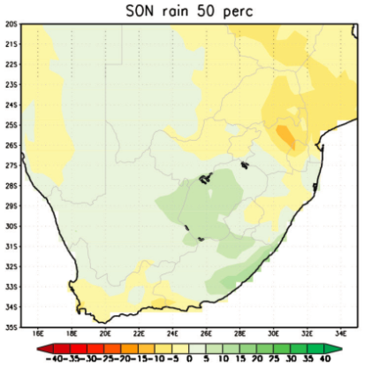
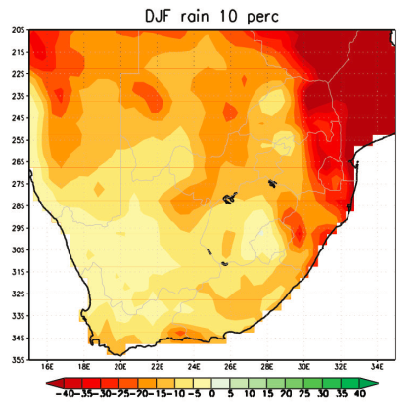
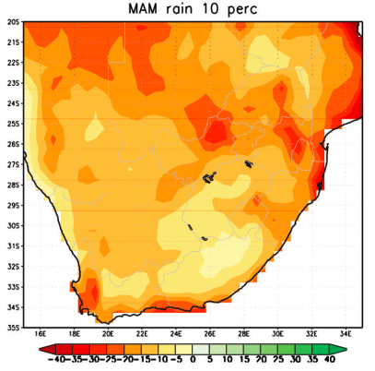
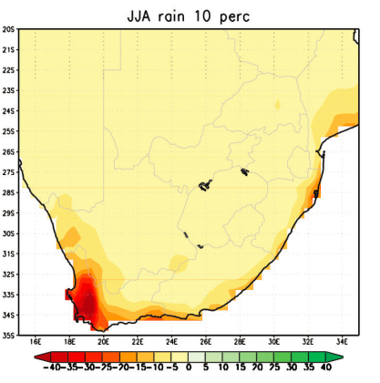
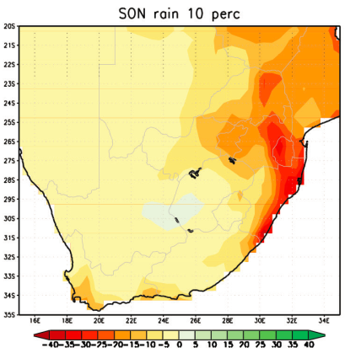
Rainfall (2015–2035, relative to 1971–2005) under RCP4.5
---15mm -> +5mm -30mm -> +15mm -10mm -> +10mm -10mm -> +15mm
Notes:
This slide shows the variation amongst models. The columns are the seasons, Summer/autumn/winter/spring
The rows are the variation among all the model outputs: Top- wetter results, Middle-average, bottom drier results. You can see that most seasons show a drying rather than a wetting future

Slide 16
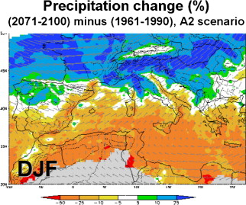
Mediterranean regions

Slide 17
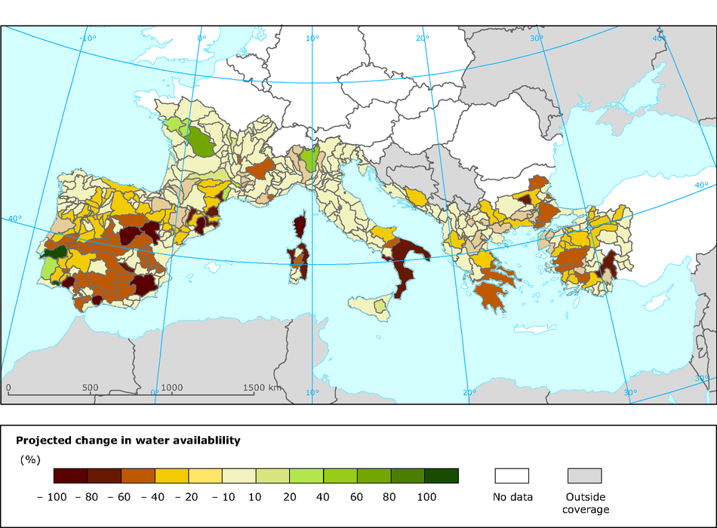

Slide 18
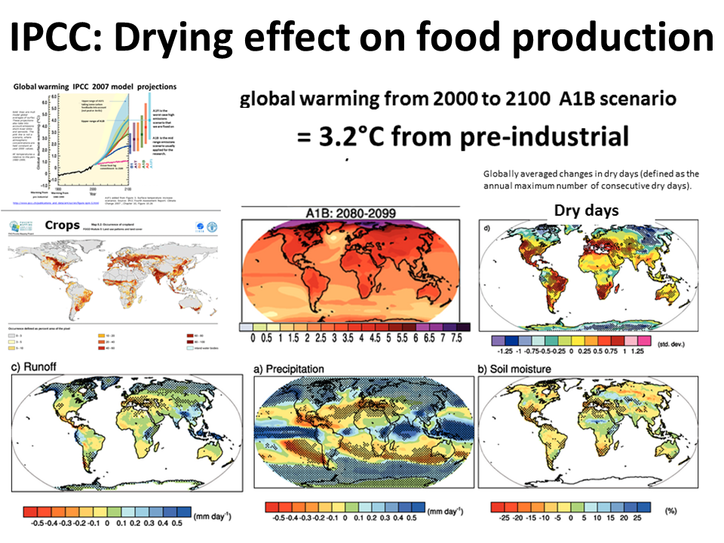
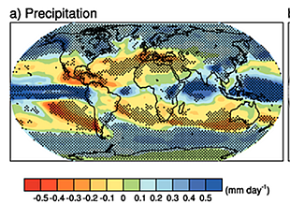

Slide 19
CC Threats
Very high temperatures and prolonged heat waves
Increased evaporation, and soil/leaf transpiration
Sunburn
Reduced seasonal rainfall and longer dry spells
Higher frequency of heavy rainfall and flooding
More frequent and heavier late spring and early summer rainfall
Rising CO_{²} levels – may have an impact on yield

Slide 20
Income earned from agriculture

Slide 21
Prune responses
What are risks of Higher Temperature?
What are the risks of reduced temp range?
Will increased irrigation requirements be sustainable?
Fruit size/quality?

Slide 22
Water
Prunes require sufficient water during the growth season, provided by a combination of rainfall and irrigation.
High temperatures increase orchard evapotranspiration leading to an increased demand for irrigation water.
It has been estimated that warming associated with climate change will increase the irrigation requirement of crops by around 8 % by mid-century.

Slide 23
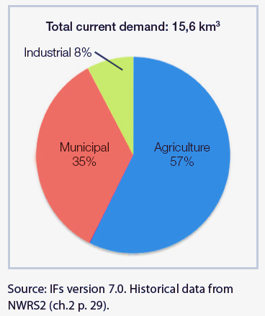
Which sector uses the most water in S Africa?
Sectors:
Agriculture
Industrial
Municipal

Slide 24
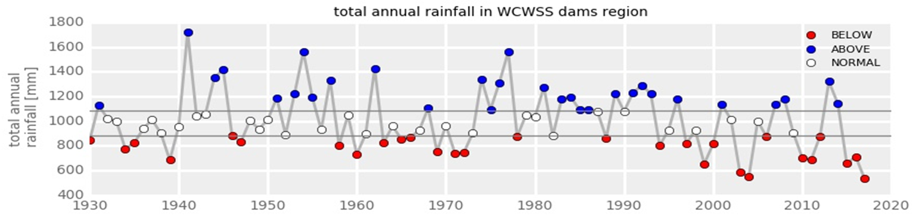
Rainfall trend?
In the last 30 years, 10 above normal, 14 below normal

Slide 25
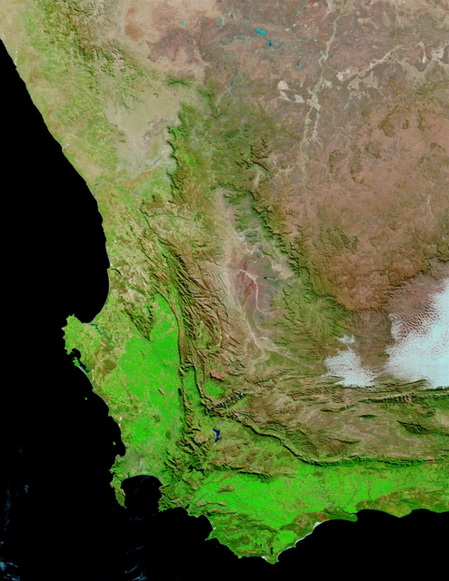
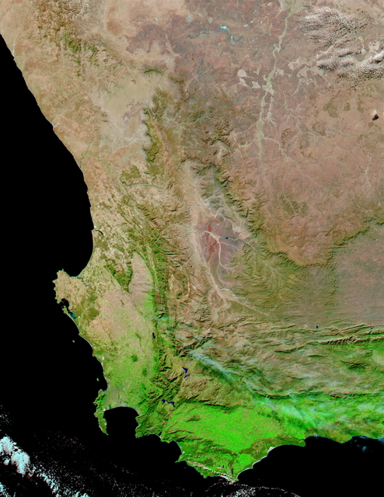
Water is an already scarce resource in the Western Cape
21 July 2002 – Normal Year
21 July 2003 – Drought Year
25
Notes:
25

Slide 26
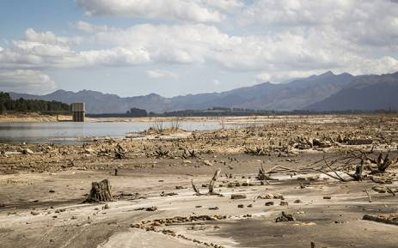
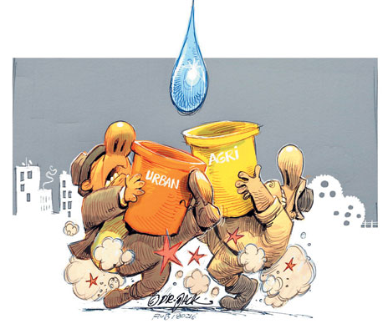
Is W Cape facing a long-term water crisis?

Slide 27
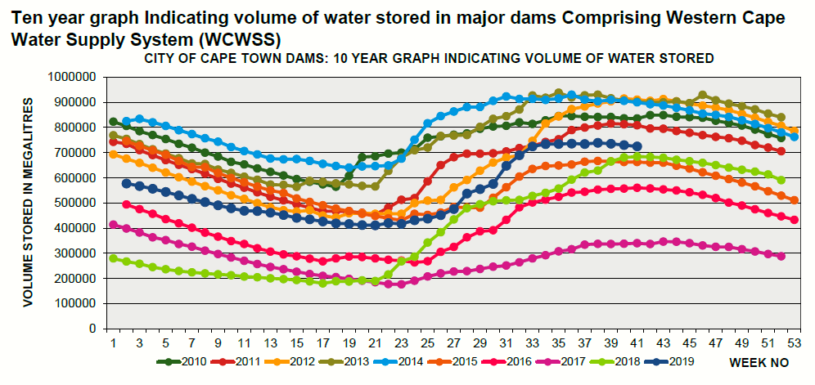
Historical water storage in dams supplying Cape Town

Slide 28
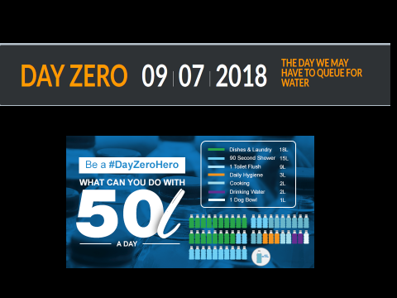
POSTPONED TO 2019

Slide 29
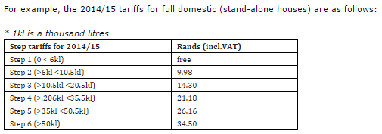
Price management: Level 6 prices
R29.93
R52.44
R114
R342
R912
R912
Average Household using 500l/day = 15kl/month
2014/15 4.5x9.98 + 4.5x14.30 = R109.26
2016/17 4.5x16.54 + 4.5x23.54 = R180.36
6x29.93 +4.5x52.44 +4.5x114 = R928.56
So 200l per day = 6x29,93 = R179.52

Slide 30
Conclusion
Why is there a looming crisis?
Agriculture needs water
Still a need for water and sanitation
Low and unpredictable supply
High demand for water
Poor use of existing resources→ poor water quality: rivers, dams, groundwater

Slide 31
And now..
The agricultural industry needs to respond, by:
    Scaling up research into heat resistant crops
    Better soil water management
    Better precision agricultural management
Climate scientists need to provide a realistic spread of scale-appropriate scenarios with relevant parameters that agricultural users can apply to their needs ….
We all need to realise that short term information is more important for agricultural application than long term, but that the provision and effective communication of “seamless climate information” is still (one of) the holy grail(s) for agriculture……

Slide 32
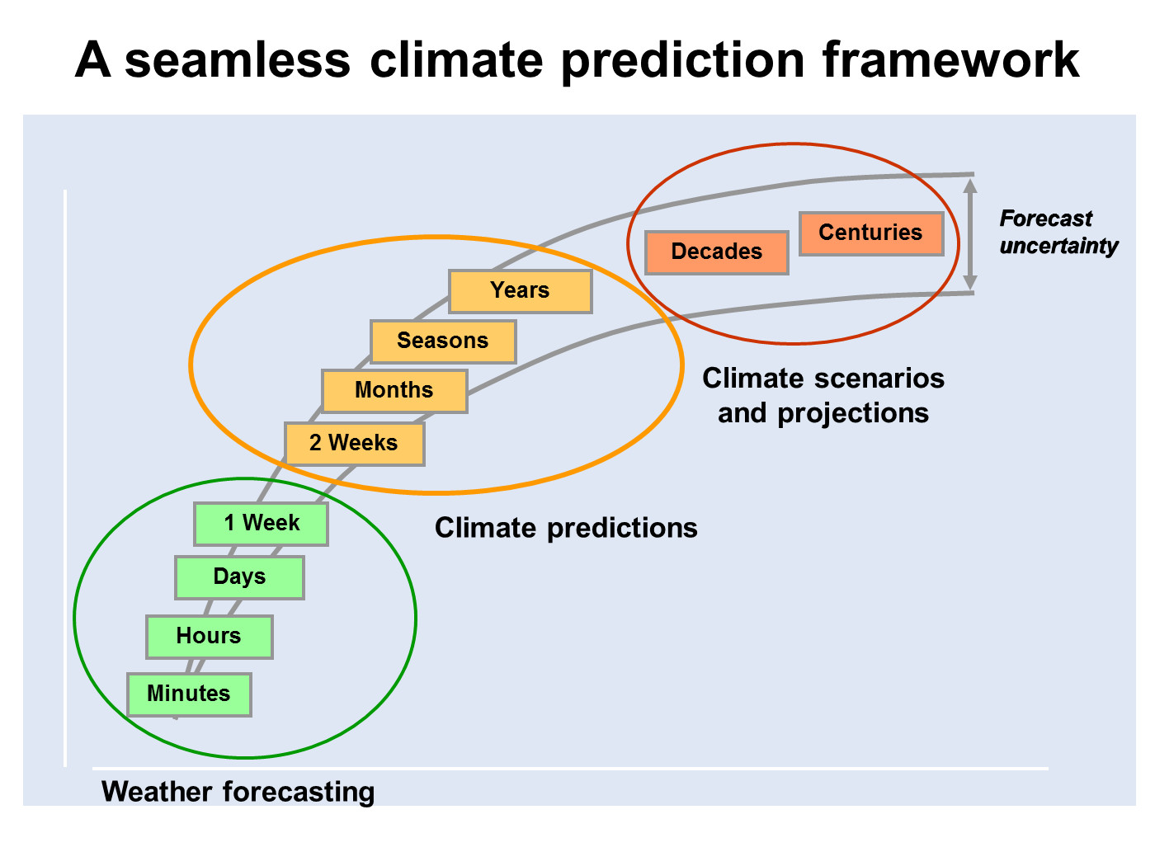

Slide 33

The SmartAgri Project
Western Cape Agricultural Sector Climate Change Framework and Implementation Plan
The SmartAgri Plan builds on the Western Cape Climate Change Response Strategy (WCCCRS 2014) – It is a multi-sectoral response framework and plan for the province, a “road map”

Slide 34
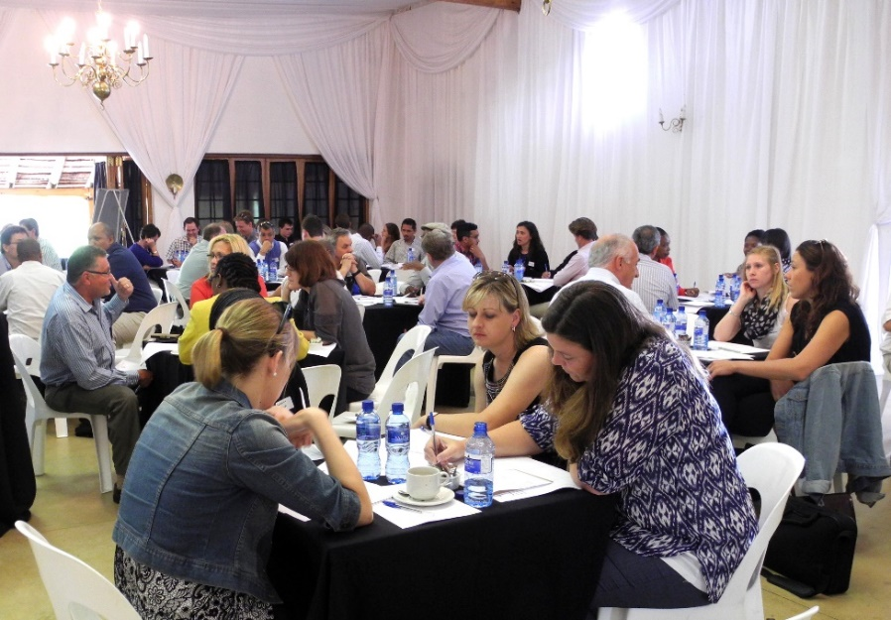
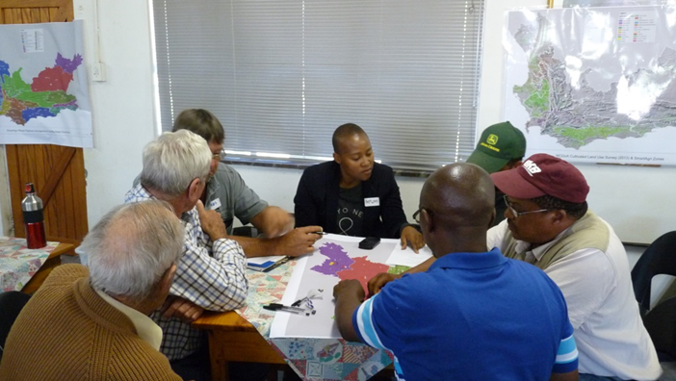
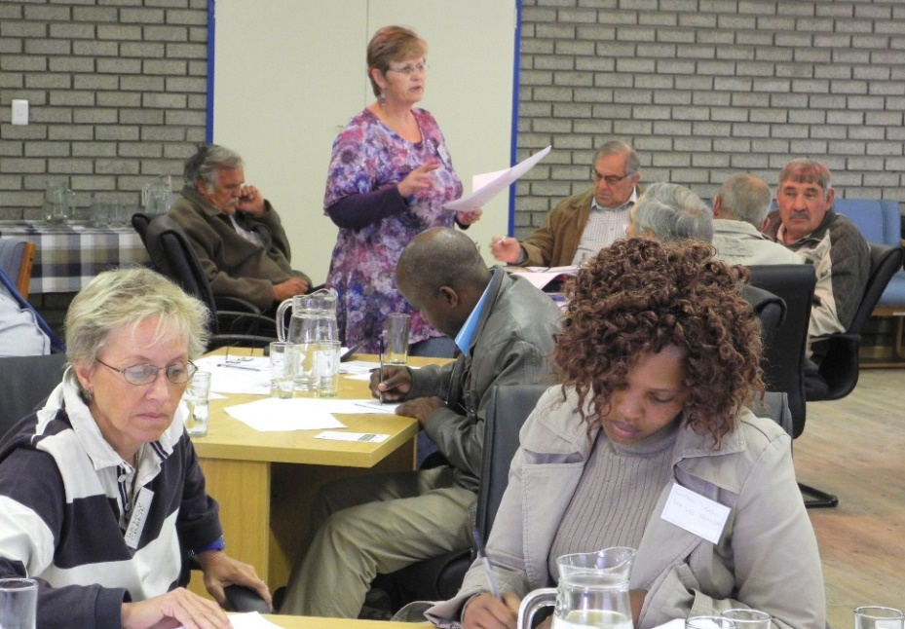
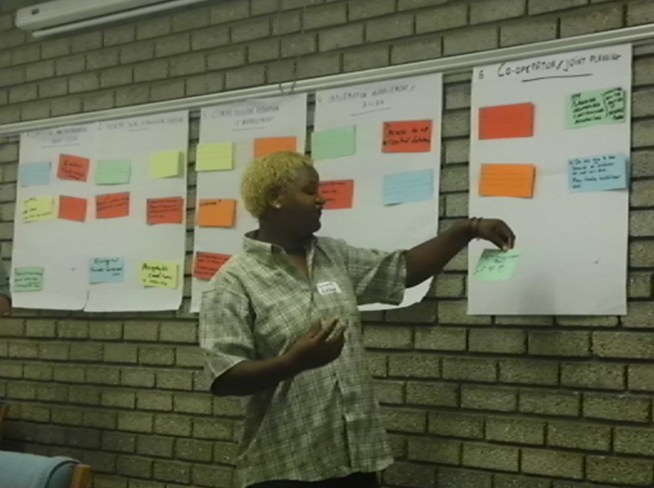
Stakeholder engagement
Notes:
Expert interviews with researchers, industry experts and champions
How to engage with a specific sup-sector, what communication channel to use
More understanding on a specific topic
Better understanding of the value chain and expand awareness aroud SmartAgri and how to align with existing initiatives efforts
Other presentations:
DPAC
FSD Extension Block
AgriMega

Slide 35

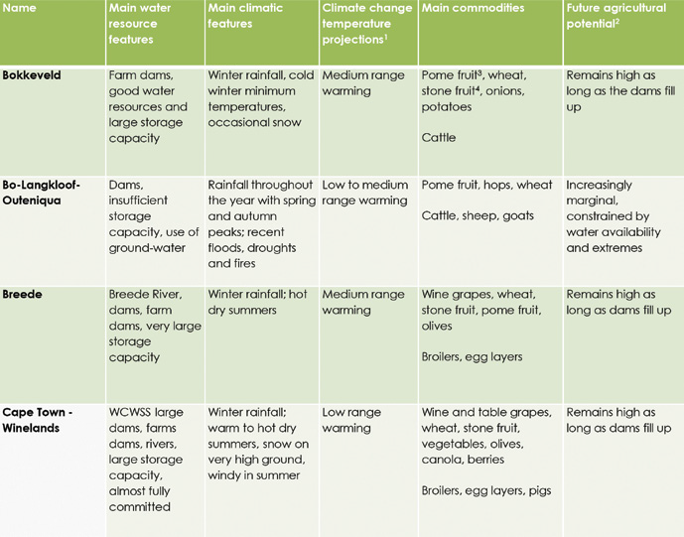

Slide 36

Protect and build the soil

Slide 37
Water productivity
(crop per drop)
Through precision measurements we are beginning to understand the water use of crops of different types and in different regions. Adaptation will require the optimisation of water productivity (volume of water used per unit of yield) and fruit quality.

Slide 38

Water management
Maintain water infrastructure and reduce losses
Attention to drainage and runoff management
Correct management of on-farm wetlands and river banks
Have a farm “drought plan”

Slide 39

Precision irrigation
Know precisely how much water is needed and how much is given – measure!
Use FruitLook
Use precision irrigation technology
Eliminate wastage (over-irrigation)

Slide 40

Shade netting?
There is a huge amount we still don’t understand about shade netting. The benefits could be enormous, but there are also risks.

Slide 41

Better ways
Better prunes
Better profits!

Slide 42

THANK YOU
Peter Johnston
University of Cape Town
www.csag.uct.ac.za
peter@csag.uct.ac.za

