Slide 1


How is the fruit industries organised?
October 2019
Anton Rabe
Executive Director: Hortgro

Slide 2


Agri Business environment
Pest & disease complex
Social & Environmental Compliance
Social & Environmental Compliance
Unemployment/Youth
Capital intensive
Environmental conservation
Water
Increased costs
Yield & Packouts & Price
Consolidation & integration
Profit
Foreign Direct Investment
Food security
Intellectual property/ Brands
Land Reform
Value chain
Traceability
National Interest
Efficiency
Logistics & Infra
Instabality/Policy uncertainty
Mechanization
Innovation
Labour Issues
Drought
Skills
Research & Development
Climate Change/Risks
Capacity & Expertise
Quality
Transformation
Co-optition
Energy
Resources – land, water, capital
Orchard of Future
Innovation
Soil
Food safety
Productivity
Inflation
Competitiveness
Energy Cost
BEE
Technology (bio- & info)
Integration – Backwards/Forwards
Value Chains Compete
Zero subsidies
Urbanization
Toll roads
Compliance & Cost
Free Trade

Slide 3
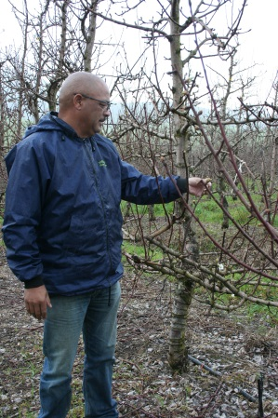
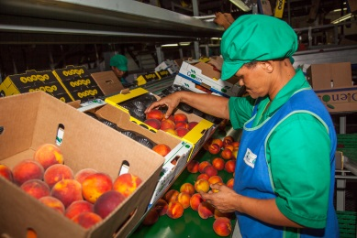
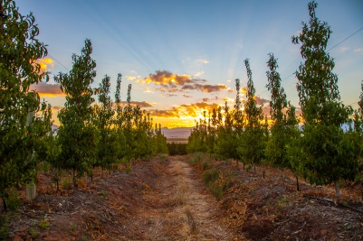


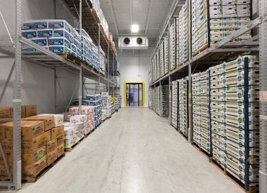
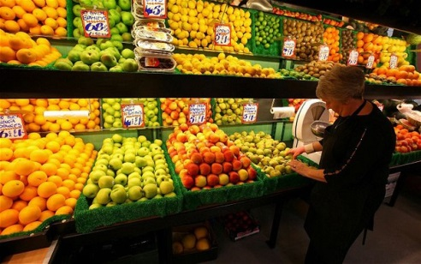
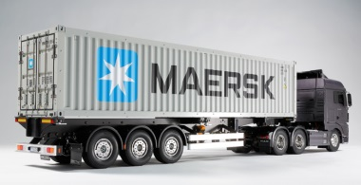
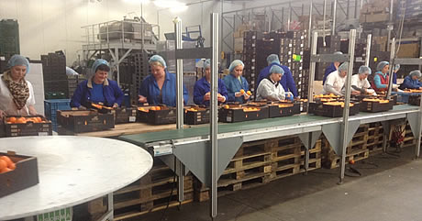
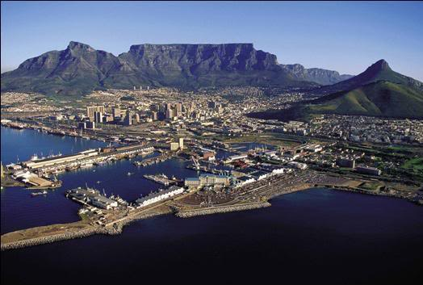
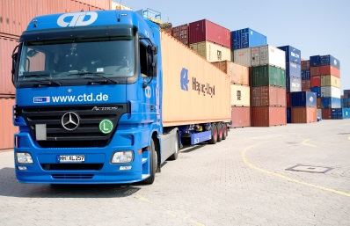
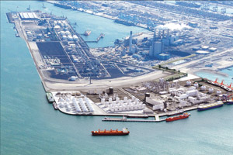
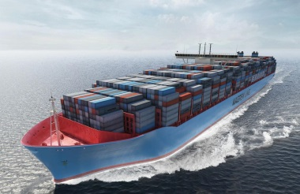
2
PACKHOUSE
FARMER
ORCHARDS
CONSUMER
3
12
1
4
COLDSTORAGE
SA Fruit
industry
supply chain
HAULER
11
5
RETAILER
6
SA PORT
10
9
7
IMPORTER
FOREIGN PORT
VESSEL
8
HAULER

Slide 4
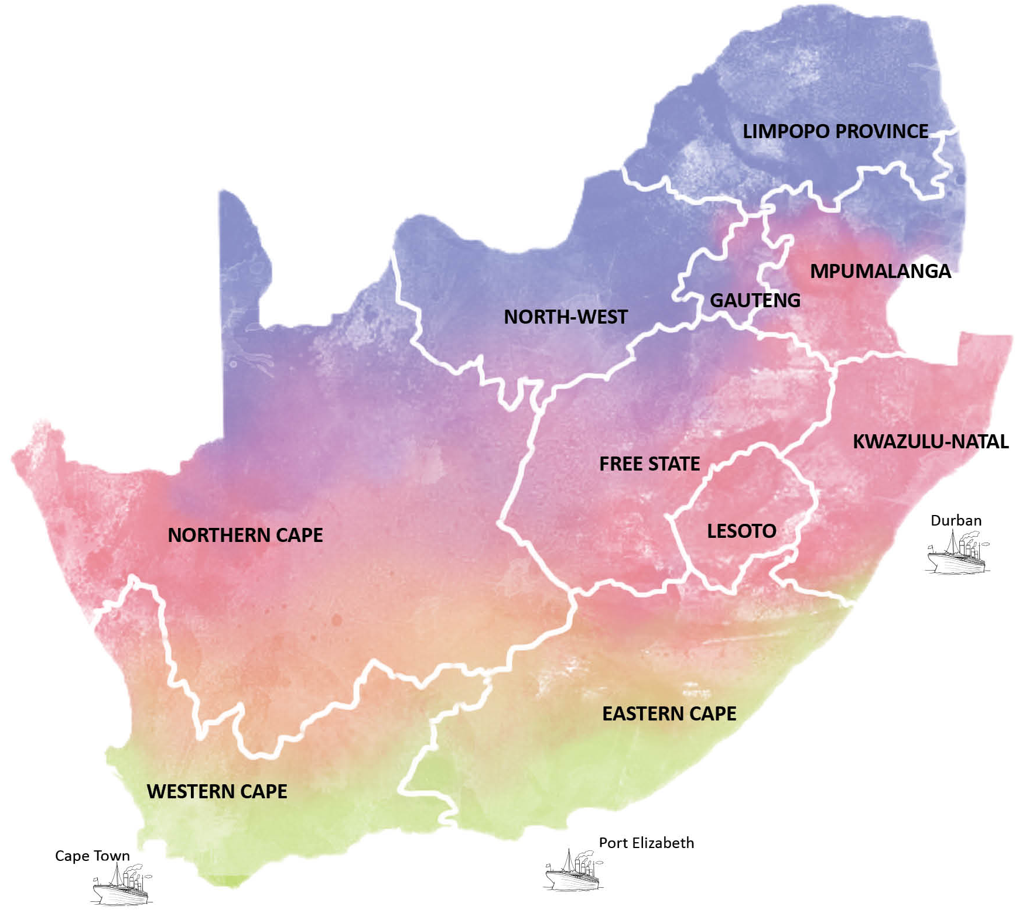






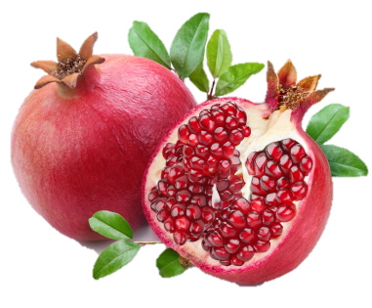













































DECIDUOUS FRUIT:
54 052 ha
(Pome 68%;Stone 32%)
ALTERNATIVE CROPS: 35 275 ha
Berries: 2 040 ha
Figs: 234 ha
Fynbos: 1 114 ha
Olives: 3 185 ha
Pomegranates: 932 ha
Pecan Nuts: 27 770 ha
2%
3%
2%
2%
2%
2%
22%
58%
7%

Slide 5



Key stats FRUIT and related Industries
164 186 Direct Employment
656 744 Dependents
Exports 45% of total production
Domestic market 20% of total production
Fresh Industry Generates 85% of annual turnover
Processing Sectors contribute 35%
(Processing: Dried, Pulp, canning & Juice)
TOTAL TURNOVER: R12,8 BN
Total production 2,14 mil tons
Industry Investment +14%
Over last 5 Years
Deciduous and Alternative Fruit HECTARES: 89,327 Ha

Slide 6
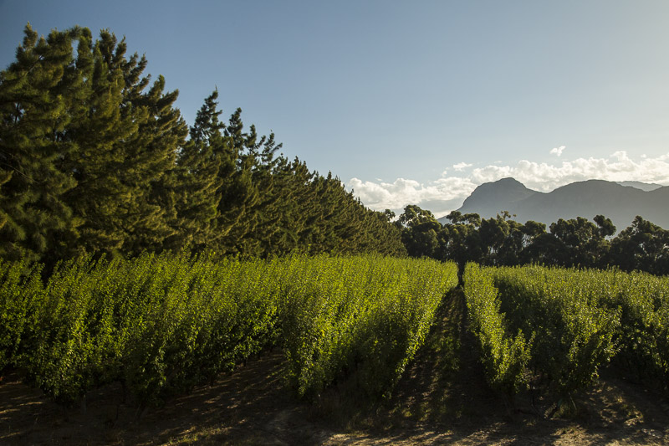


Production structure
Consolidation of units (70:25) principle
2018 Grower Groupings:
10% > 100 ha
14% 50 – 100 ha
34% 15 – 50 ha
42% < 15 ha
2002: 1 646
Avg fruit enterprise = 34 ha
-42%
2018: 1 161
Avg fruit enterprise =
47 ha

Slide 7
Strategic Framework 2019 – 2023 (levy funded & user pay)
Scientific R&D plus Associated Tech Transfer
Trade/MA, Market Intelligence & Trade Awareness
Technical Market Access, Protocols & Product Standards
Plant Material: Breeding/Acquisition – Scion & Rootstock
Independent Evaluation (Cultivars & Rootstocks)
Plant Improvement & Certification
Economic Development & Land Reform
Skills & Human Resource Development, Incl. Socio-Economic Development
Industry Information & statistics
Communication & Industry Representation
Good Governance, Administration & Financial Management

Slide 8

Industry Functions
Production (Supply side)
  Research & Development
  Technology Transfer
  Technical Services
  Plant Improvement (incl Breeding,
  Procurement & Evaluation
  Certification
Market (Demand side)
  Info & Stats
  Logistics & Infrastructure
  Trade & Market Access
  Trade Development & Consumer Awareness
  Market & Consumer Research
  Standards & Protocols
Other “cross cutting”:
  Transformation (Land Reform/Economic Development/BEE &
  Training & Skills development)
  Communication, Image, Representation
  Admin & Financial services
  Commercial/User Pay Industry Services

Slide 9












PRODUCERS
Service Structures

Slide 10

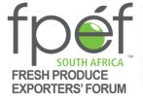




Government relations, Market Access, Policy & Legislation, Logistics & Infrastructure, Ethical trade/ (Environmental modules), Social Compact/FIVCRT
AgBiz/Fruit Desk

Slide 11
Alternative
crops
Producer Assns - “Own” affairs = “State/Province”
Hortgro - “shared” or joint affairs = “Federation”
Industry sub-structures responsible for operations/execution – operate along functional lines – “departments” providing user pay services
“Confederation” – FruitSA
United Nations” – WAPA, SHAFFE, other intnl forums
HORTGRO
Capacity/
Personnel
Pome
Pome Fruit
8 regions
PRODUCERS
Stone
Stone Fruit
13 regions
Appoint
Representatives
on
Functional entities & Advisory boards

Slide 12
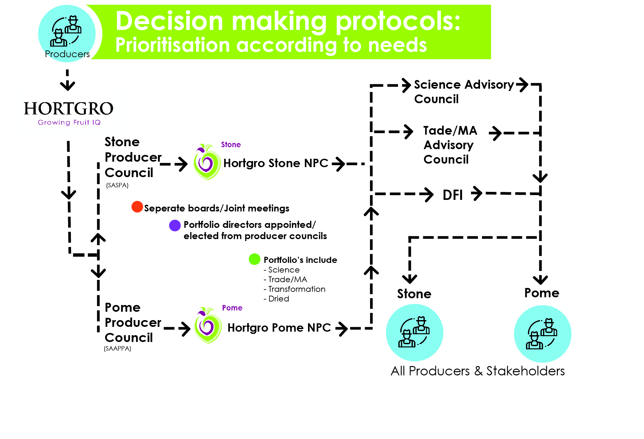
All growers are represented at highest level of decision making. Growers provide mandate and make decisions on the allocation of resources

Slide 13


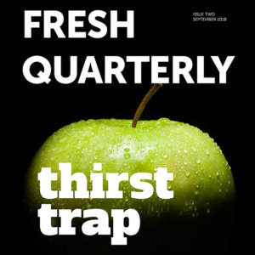
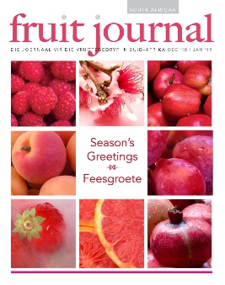


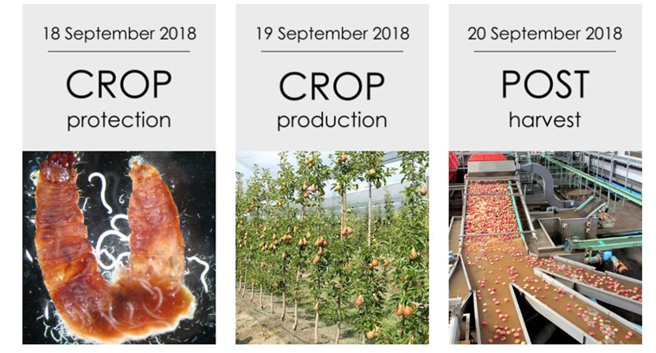
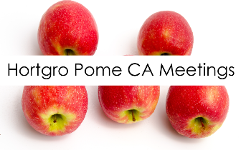
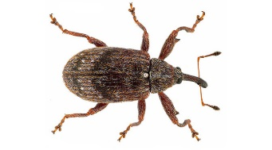


Communication Vehicles
Website
YouTube Channel
GROWER
Orchard of the future
Research Showcase
IPM
Pamphlets

Slide 14

Budget / Use of funds
Industry Representation (representing industry on national & international platforms; promotion of industry image, liaison & lobbying role-players, etc)
Statutory Levies HORTGRO POME & STONE = Est. R87 million

Slide 15


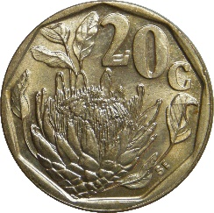

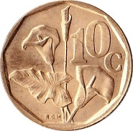
Gearing (cost benefit)
Statutory Levies Income = R87 mill
Total Gearing = R210 mill
Gearing Ratio R1:R2.40

Slide 16
Unique selling points
Industry expertise and focussed programmes based on industry needs – Grower controlled
An umbrella organisation for all growers and value chain players – unified voice
Well structured and networked industry to execute the mandate of the growers to ensure profitability, sustainability and competitiveness
Greater collaboration from fruit and horticultural industries regarding issues that is not sector/commodity specific, e.g. trade, market access, government relations, etc
Shared resources and capacity to provide cost-effective services to stakeholders
Maintaining the integrity and credibility of SA as a responsible supplier – self regulated, maintaining food safety standards, ethical trade & environmental compliance
Provide sector specific responses in terms of impact of legislation and policy matters
Independent, Trustworthy and Reliable Industry Information & Statistics for better decision making (Norms & Benchmarks)
Various Communication platforms to ensure all stakeholders remains informed
Levy provide a stable income base and opportunities for gearing other resources

Slide 17
Summary
Need to do more and more ourselves!!
Country with unique challenges;
Must manage change continuously to ensure competitiveness, sustainability and profitability;
Effective partnerships between industry & government agencies;
World class technology, R&D and technical knowledge and skills;
Systems to support fruit movement and logistics/infrastructure;
A wide spectrum of products, produced over a long period, with the best eating quality found anywhere in the world!; and
Focussed/Effective industry structures tackling key strategic imperatives – and more, all of which:
gives RSA fruit producers the ability to comply with strict market requirements and ability to sell product in any market of choice

