Slide 1


IPA
South Africa
28 October 2019
Mariëtte Kotzé

Slide 2
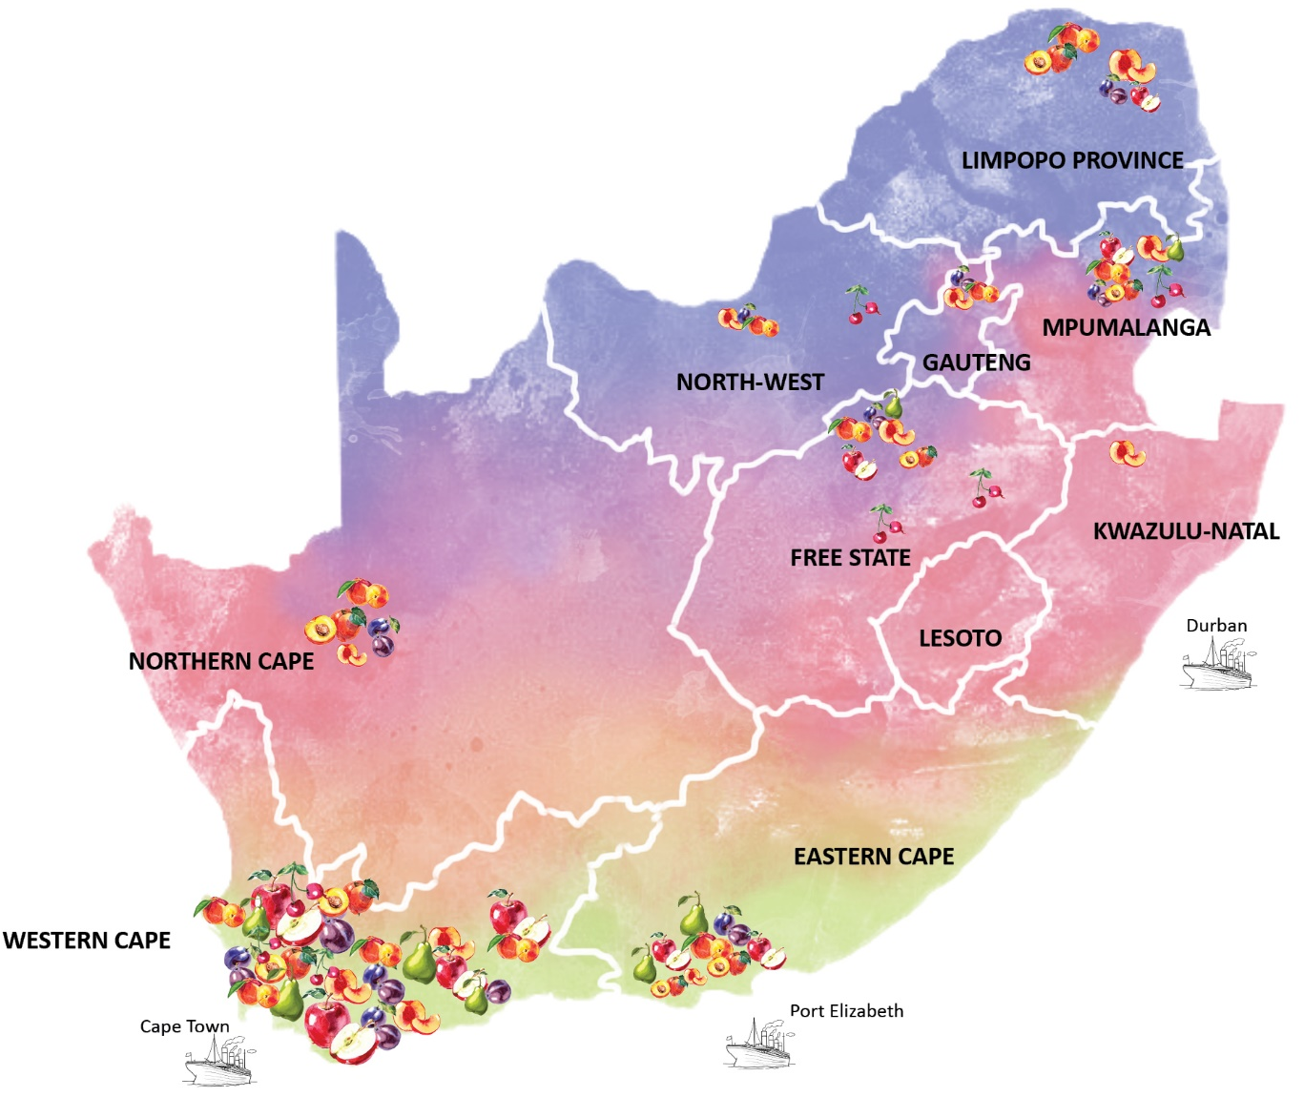
SA Deciduous Fruit Regions
Total Area Planted = 54 052 ha
Pome fruit = 68%
Stone fruit = 32%
51 Growers
Avg 5ha of Prunes
11 growers = 60% of industry
R31mill Value of Production
12% of dried fruit industry

Slide 3

Total area planted ( 54 052 ha)

Slide 4
Dried tree fruit production
Average dried fruit volumes = 6300 tons per annum
FRUIT KIND | 2010 | 2011 | 2012 | 2013 | 2014 | 2015 | 2016 | 2017 | 2018
APPLES | 99 | 159 | 111 | 296 | 316 | 275 | 20 | 217 | 208
PEARS | 1 009 | 1 013 | 1 234 | 1 506 | 1 485 | 1 695 | 1 660 | 3 801 | 1 059
APRICOTS | 1 912 | 1 265 | 1 745 | 1 659 | 1 449 | 1 782 | 1 325 | 1 430 | 1 780
PEACHES | 2 063 | 1 823 | 1 493 | 1 780 | 1 384 | 2 366 | 2 560 | 2 251 | 1 773
NECTARINES | 75 | 112 | 126 | 133 | 106 | 129 | 133 | 149 | 93
PRUNES | 990 | 878 | 893 | 811 | 455 | 602 | 1 050 | 1 100 | 1 005
TOTAL TONS | 6 148 | 5 250 | 5 602 | 6 185 | 5 195 | 6 849 | 6 748 | 8 948 | 5 918
Prunes = Avg 14% to SA dried fruit volume

Slide 5
Prunes: area planted (260 ha)

Slide 6
Cultivar distribution

Slide 7
Cultivar hectare trends
CULTIVAR | % CONTR.
VAN DER MERWE | 80%
ERFDEEL | 8%
PRUNE D' AGEN | 5%
JANAND | 4%

Slide 8
orchard age distribution
 | 0 - 3 YRS | 4 - 10 YRS | 11 - 15 YRS | 16 - 25 YRS | 25+ YEARS
TOTAL HECTARES | 19 | 47 | 32 | 43 | 119
% of Total area | 7% | 18% | 12% | 17% | 46%
<50%

Slide 9
Total production of tree fruit – dry weight
Prunes: -86% YOY
5 955 t
-34%
4 594 t
-23%

Slide 10
Sa Prune exports (tons)
Source: Trademaps

Slide 11
Sa prune imports (tons)
Source: Trademaps

Slide 12
Sa dried prune imports (tons)
Source: Trademaps

Slide 13

World Dried Prune Exporters (tons)
WORLD PRUNE EXPORTERS (TONS)
RANK | COUNTRY | 2011 | 2018
1 | Chile | 57 966 | 72 062
2 | United States of America | 67 913 | 35 390
3 | Argentina | 34 427 | 29 397
4 | Uzbekistan | 0 | 24 644
5 | France | 11 521 | 12 664
6 | Myanmar | 0 | 7 616
7 | Islamic Republic of Iran | 3 158 | 7 327
8 | Republic of Moldova | 1 773 | 5 220
9 | Serbia | 3 927 | 3 034
10 | Netherlands | 4 268 | 2 684
34 | South Africa | 233 | 192
 | Rest of the World | 28 550 | 21 008
 | Tons Exported | 213 736 | 221 238
<1%
Source: Trademaps

Slide 14

World Dried Prune importers (tons)
WORLD PRUNE IMPORTERS (TONS)
RANK | COUNTRY | 2011 | 2018
1 | Russian Federation | 27 405 | 19 571
2 | Kazakhstan | 6 800 | 19 122
3 | Brazil | 15 282 | 12 852
4 | United States of America | 316 | 10 996
5 | Germany | 14 709 | 10 798
6 | Mexico | 10 175 | 10 359
7 | Poland | 8 672 | 9 660
8 | Italy | 10 319 | 8 021
9 | United Kingdom | 7 799 | 7 896
10 | Spain | 5 808 | 7 218
54 | South Africa | 219 | 511
 | Rest of the World | 103 433 | 84 530
 | Tons Imported | 210 937 | 201 534
<1%
Source: Trademaps

Slide 15

Introduce new areas of production
Increase production but retain quality = productivity
Manage competition – fresh & other fruits
Increase local consumption
Seek low chilling cultivars
Change in consumer preferences (pitted) / pitting capacity
Change the perceptions associated with “Prunes” and create demand

Slide 16
THANK YOU

