Slide 1

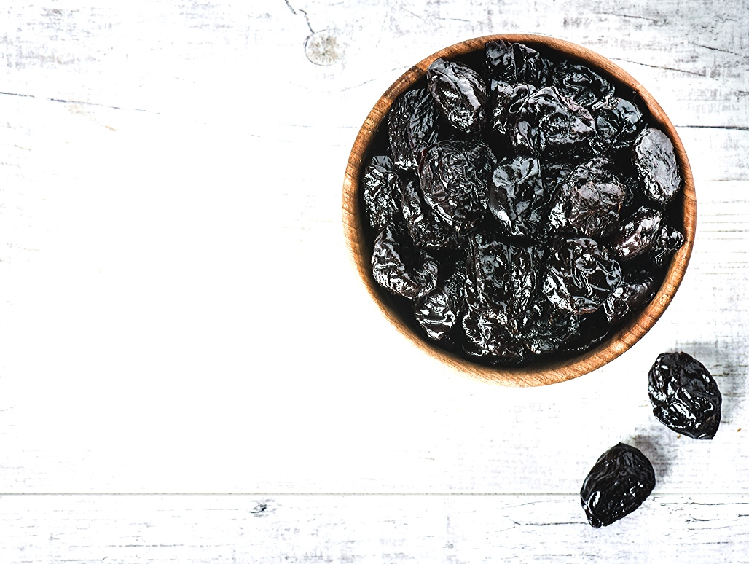




COUNTRY REPORT.
CHILE
Pedro Pablo Díaz
Chairman of the board
IPA CONGRESS – SOUTH AFRICA 2019

Slide 2
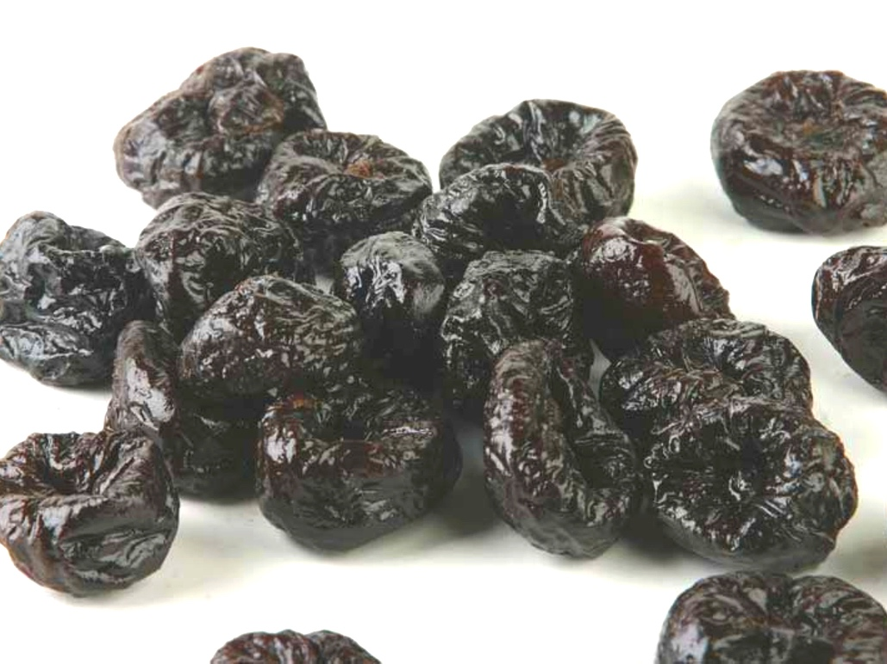
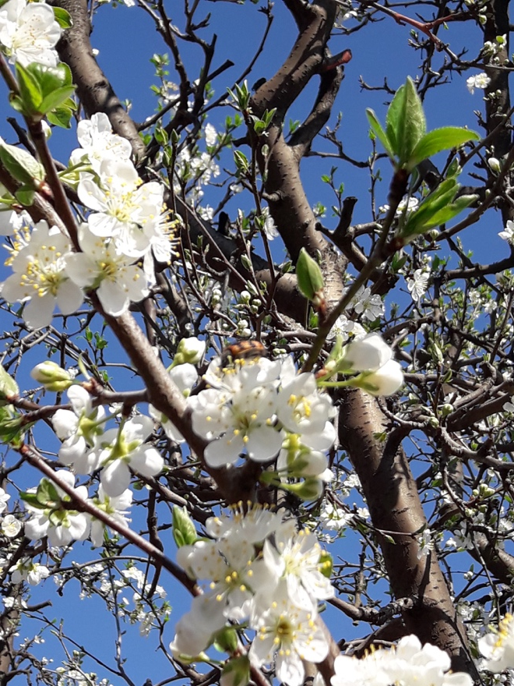
CHILE PRUNES A.G.
Overview
  Prune production in Chile
    Orchards
    Volume and Sizes
    Evolution
  Exports
    Volume / Value
    Destinations
  Promotion

Slide 3
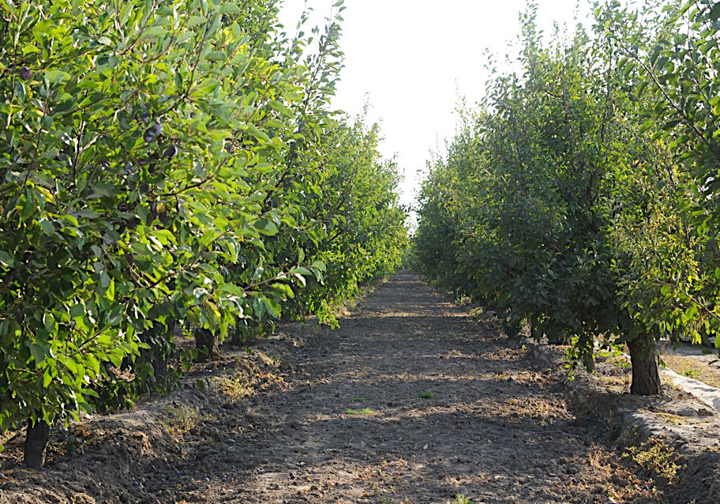
CHILE PRUNES A.G.
Chile, Orchards 2019
13.030,5 Hct.
  Coquimbo: 0,2%
  Valparaiso: 1,09%
  Metropolitana: 24,26%
  O’Higgins: 67%
  Maule: 7,31%
  BioBio: 0,14%
Source: ODEPA

Slide 4
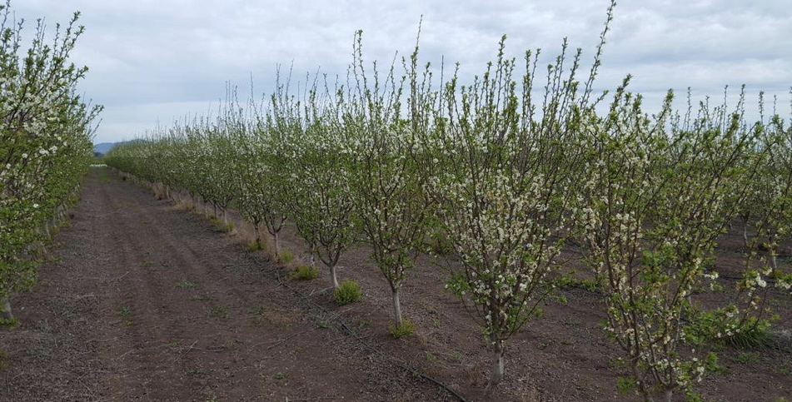
CHILE PRUNES A.G.
Prune Orchards, Evolution.
Source: ODEPA

Slide 5
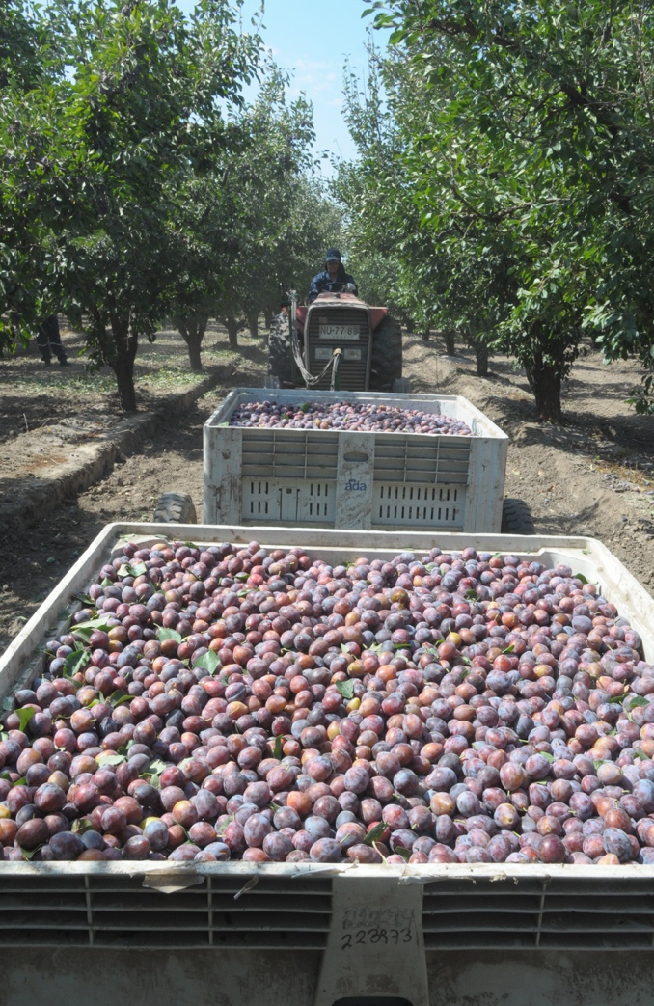
CHILE PRUNES A.G.
Prune Production, Chile 2019
74.378 tons. of dehydrated prunes.
Marketeable crop: 85,13% *
Average Size: 70,383 *
* August
Source: ChilePrunes

Slide 6
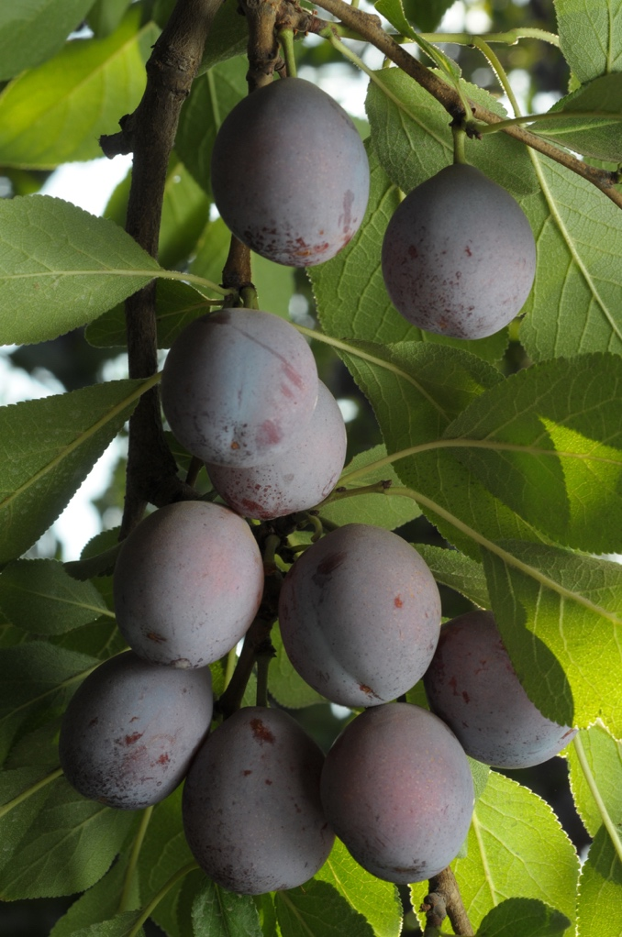
CHILE PRUNES A.G.
Prune Production evolution
*
Year | Average Size | Marketeable
2019 * | 70,38 | 85,13%
2018 | 73,45 | 78,73%
2017 | 78,35 | 74,08%
2016 | 89,64 | 66,94%
* August
Source: ChilePrunes

Slide 7
CHILE PRUNES A.G.
15%
Prune Exports Chile
76%
85%
37%
Growth in exports in terms if volume comparing 2007 and 2018.
Growth in markets reached by Chile comparing 2007 and 2018.

Slide 8
CHILE PRUNES A.G.
In 2018 the share of Chile in the global market in terms of volume
32,6%
Chilean exports were 72.062 tons in a World global of 221.239 Tons.
Source: TradeMap

Slide 9
CHILE PRUNES A.G.
15%
Prune Exports Chile Evolution
85%
Source: Aduanas

Slide 10
CHILE PRUNES A.G.
Exports
2012 | 2015 | 2016 | 2017 | 2018
RUSSIAN FED. | MEXICO | U.S.A | U.S.A | MEXICO
MEXICO | U.S.A | MEXICO | MEXICO | POLAND
POLAND | POLAND | U.K | POLAND | RUSSIAN FED.
GERMANY | U.K | POLAND | U.K | U.K
BRAZIL | GERMANY | ITALY | RUSSIAN FED. | U.S.A
ITALY | RUSSIAN FED. | RUSSIAN FED. | ITALY | GERMANY
U.K | SPAIN | GERMANY | GERMANY | ITALY
SPAIN | ITALY | SPAIN | BRAZIL | BRAZIL
ARGENTINA | AUSTRALIA | NETHERLANDS | SPAIN | CHINA
LITHUANIA | VENEZUELA | AUSTRALIA | CHINA | SPAIN
  Main destinations markets have changed trough the years.
  Chile access to markets have been growing yearly.
YEAR | MARKETS
2006 | 59
2007 | 59
2008 | 61
2009 | 66
2010 | 72
2011 | 74
2012 | 75
2013 | 69
2014 | 73
2015 | 77
2016 | 77
2017 | 80
2018 | 81
Source: Aduanas

Slide 11
CHILE PRUNES A.G.
Promotion
Planning ahead means action. We need to be spending time in promotion
considering the best outcome for our next years.

Slide 12

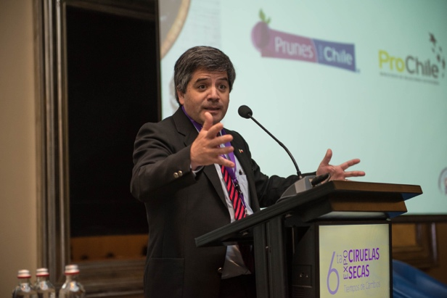
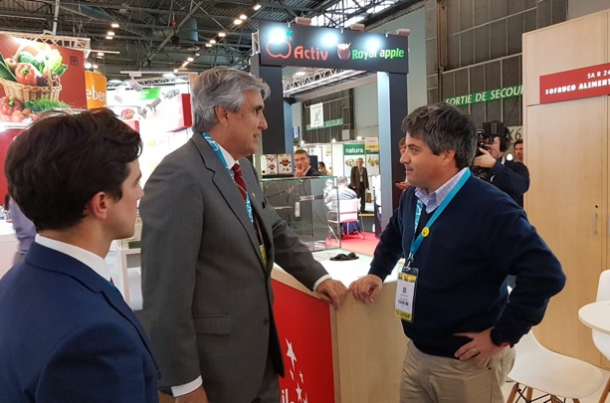
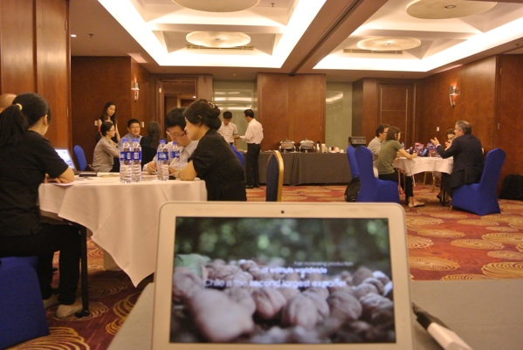
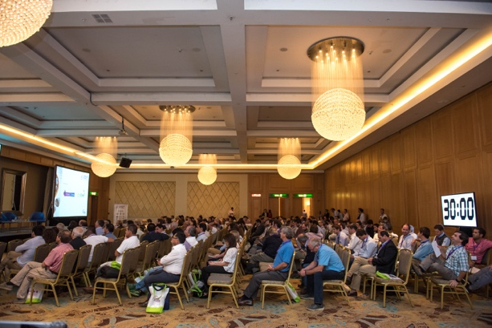
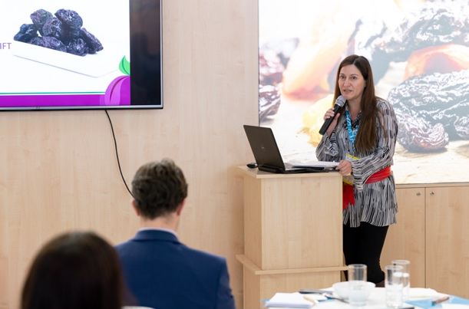
CHILE PRUNES A.G.
Trade Missions
ExpoCiruelas Secas
International Trade Shows

Slide 13
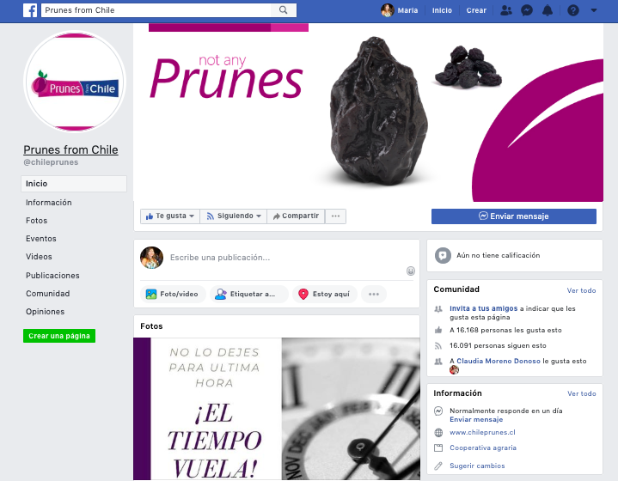
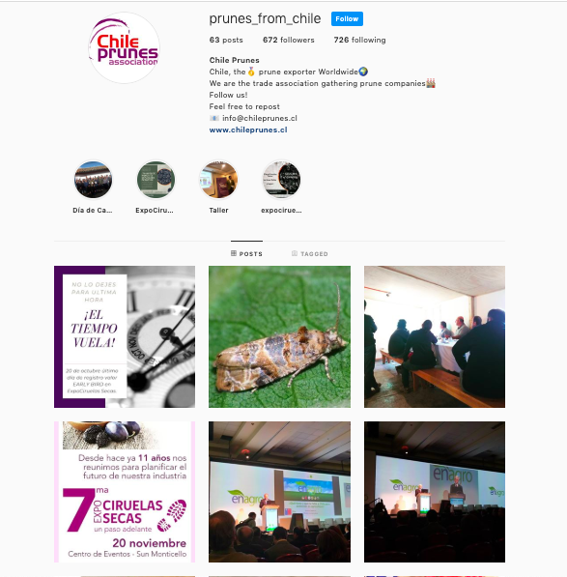
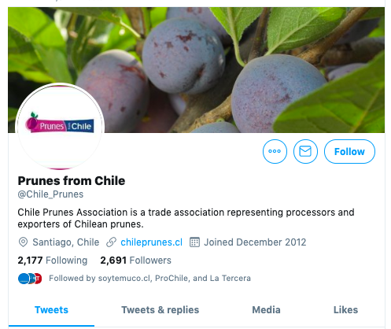

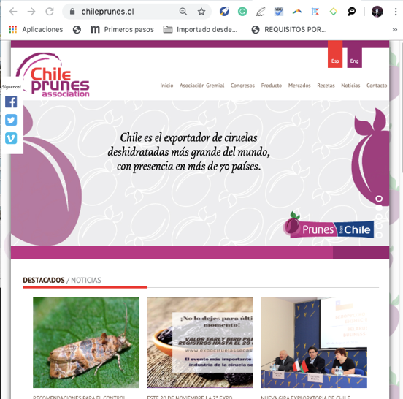
CHILE PRUNES A.G.
Social media / web

Slide 14
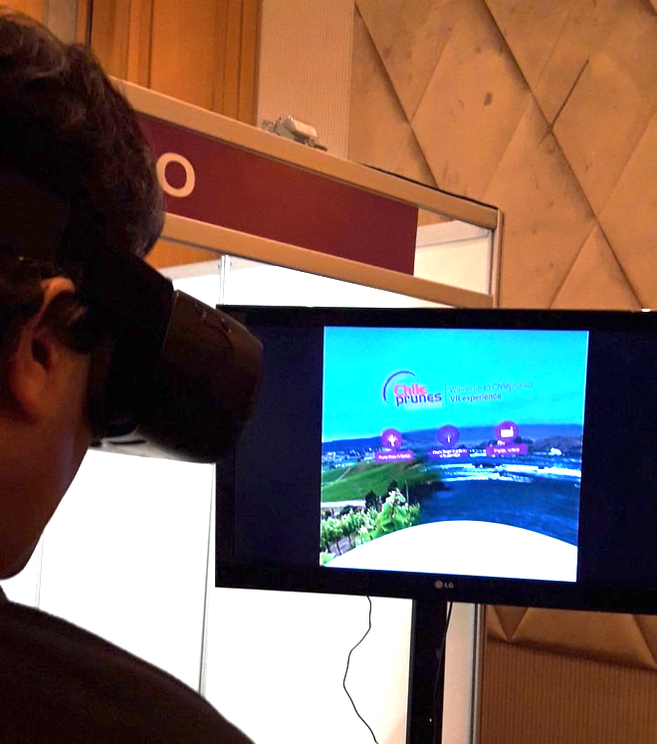
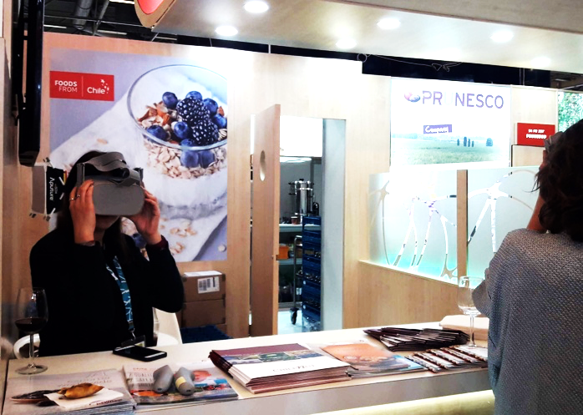
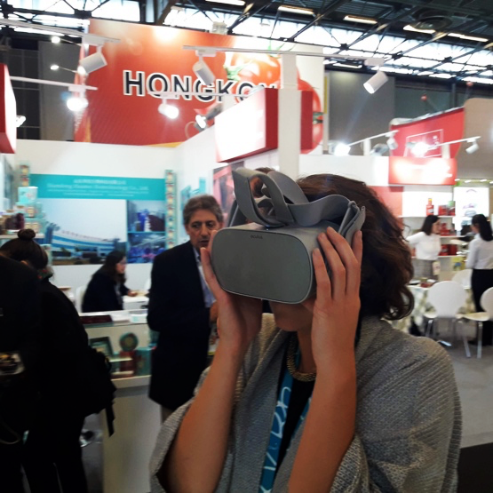
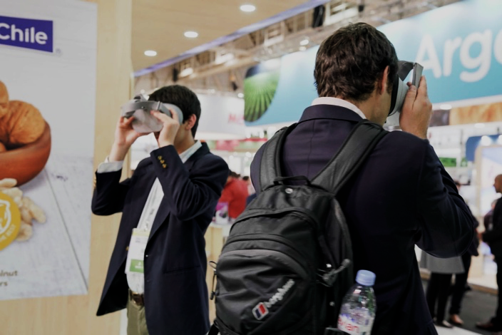
CHILE PRUNES A.G.
Virtual reality

Slide 15
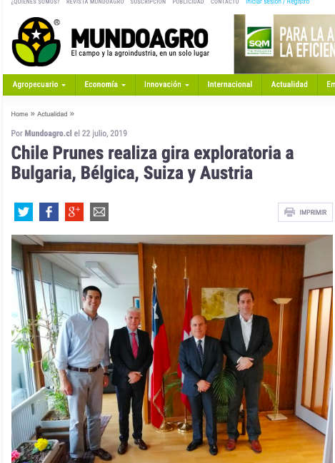
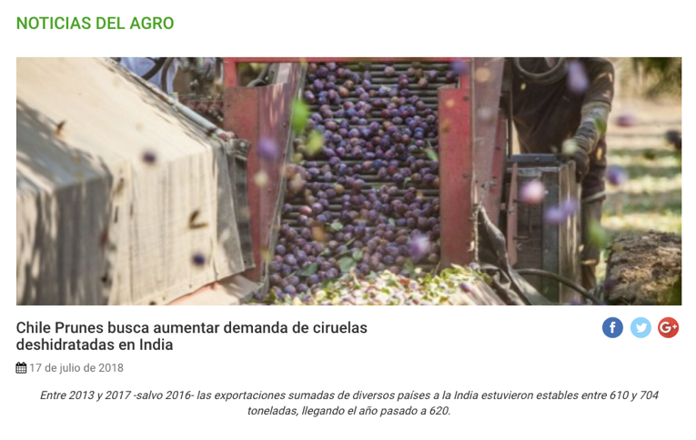
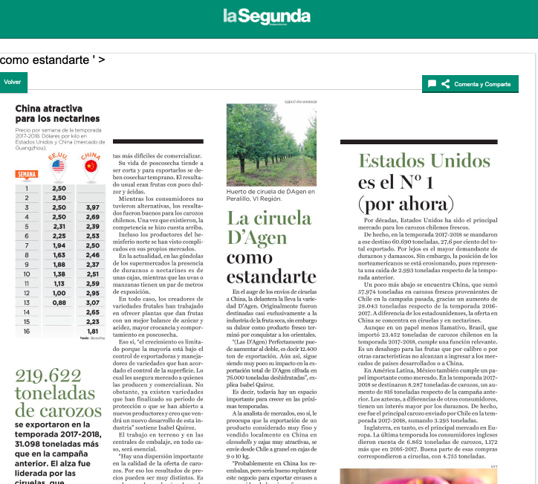
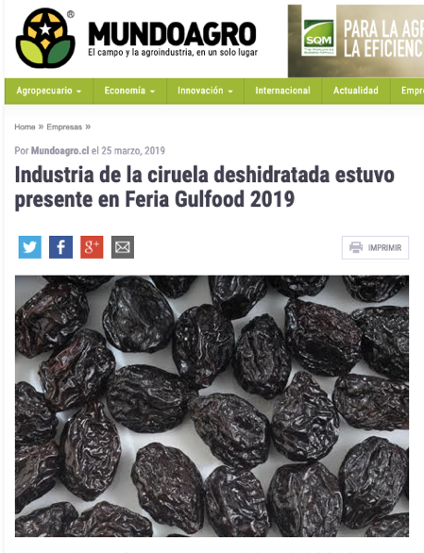
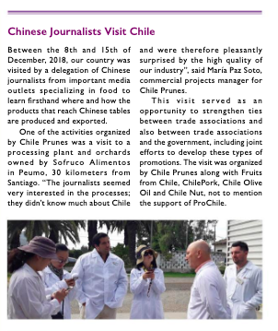


CHILE PRUNES A.G.
Press
Total Value: $29.905.193
(aprox. US$ 42.700)

Slide 16
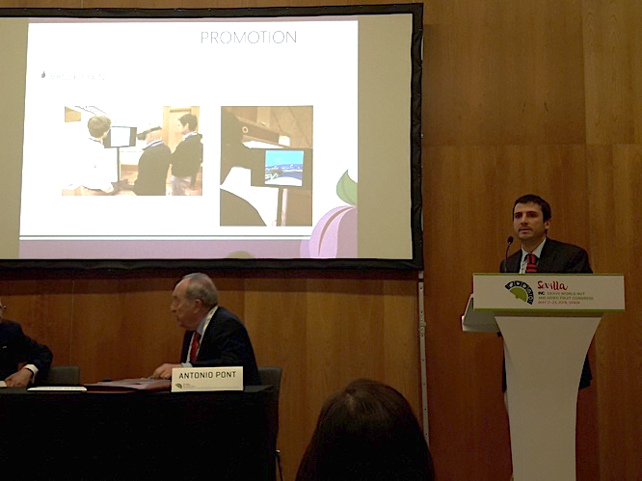
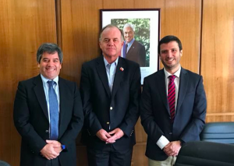
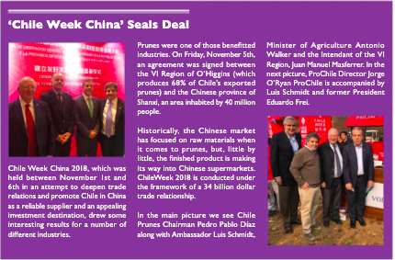
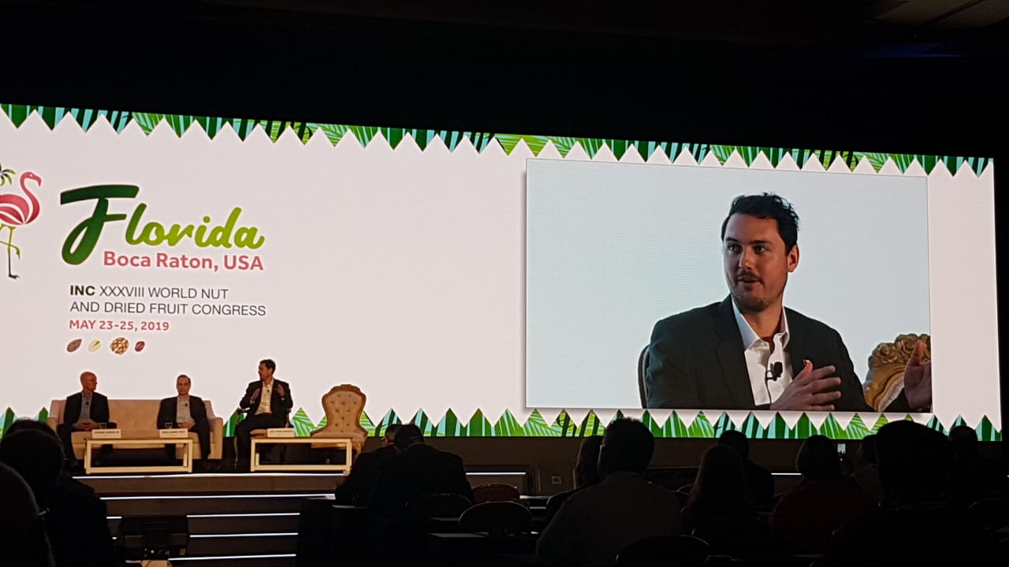
CHILE PRUNES A.G.
Conferences
Public – Private work

Slide 17

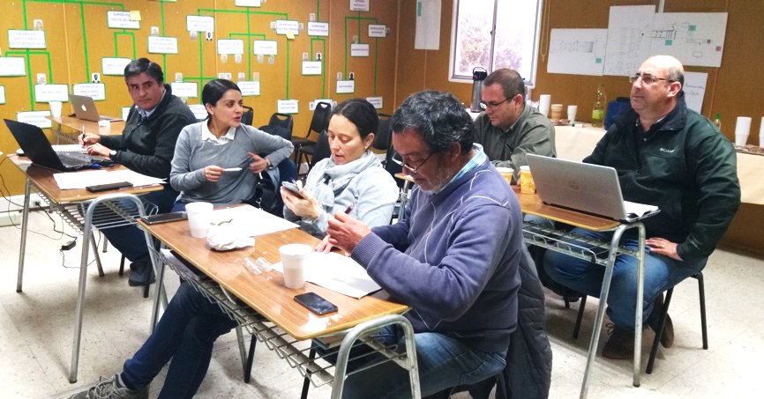
CHILE PRUNES A.G.
Technical Committee

Slide 18
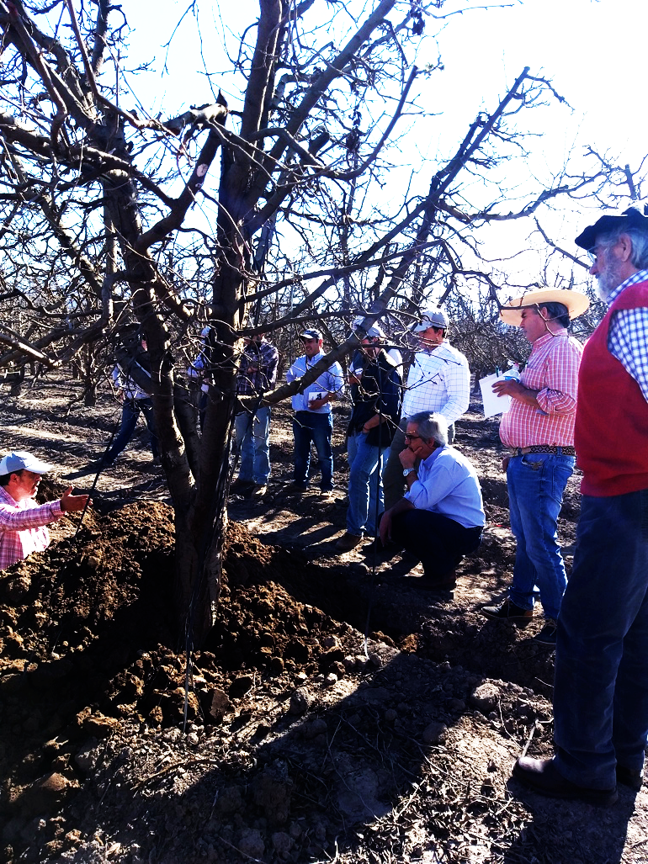
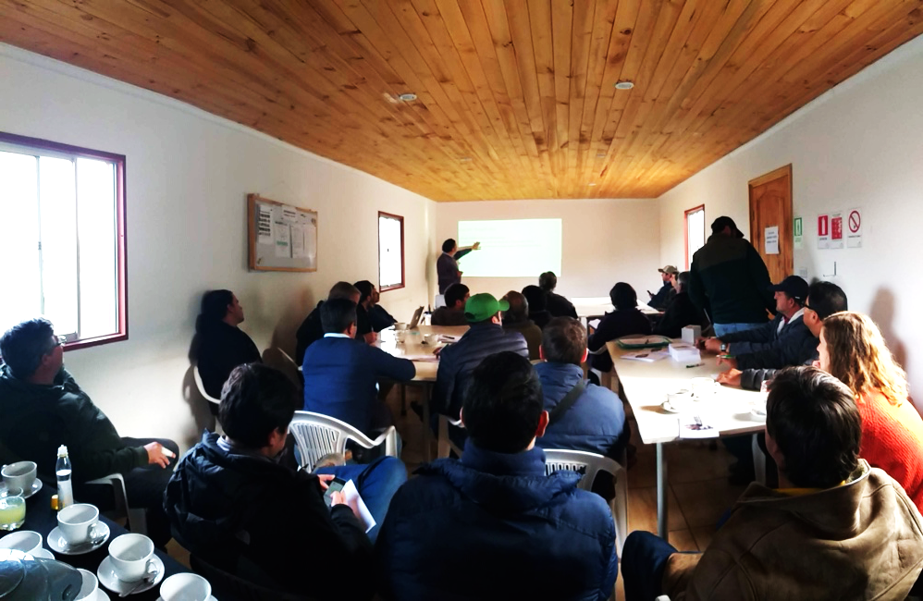
CHILE PRUNES A.G.
Workshops and field activities

Slide 19
CHILE PRUNES A.G.
What's next
for us?
Let’s talk……

Slide 20

THANK YOU

